Slide 1
CONNECTA
15th Technical Committee on Railway
Topic: ITS Strategy in the Western Balkans
22/02/2023, Pristina
Author: CONNECTA
www.connecta-info.eu

Slide 2
Context
General
Project Process
Vision
Strategic Objectives General
Strategic Objectives per RP

Slide 3
General
ITS stands for Intelligent Transport Systems.
Technical assistance for preparation of national ITS strategy for Bosnia and Herzegovina, Kosovo* (all modes), Albania (railway and maritime) and Montenegro (railway) and deployment of road traffic management centers in Bosnia and Herzegovina and Kosovo*
*This designation is without prejudice to positions on status, and is in line with UNSCR 1244/1999 and the ICJ Opinion on the Kosovo declaration of independence.
Transport Systems – Modes of Transport
Roads
Railways
Maritime / Ports
Inland Waterways

Slide 4
ITS 08 – Sub Project Process
The Process followed
Current Situation
As per Annex I of Transport Community Treaty framework
Gaps identified
Vision
Short, Medium and Long Term Measures to be applied
and
Implementation Roadmap
Strategic Objectives
Report 2 of the Project
Report 3 of the Project
Report 4 of the Project
https://eur-lex.europa.eu/legal-content/EN/TXT/PDF/?uri=CELEX:22017A1027(01)&from=EN

Slide 5
Vision
Review of the Vision accepted under the previous project
Asses the necessity for modifications regarding this Vision
Prepare the updated version of the Vison to be accepted by the RPs

Slide 6
Vision
Intelligent Transport Systems development in the entire WB6 area will contribute significantly to the creation of an integrated, resilient, safe and efficient transport network and will be a policy axis for ensuring sustainable mobility of people and transport of goods, as well as development, employability and social cohesion in the Western Balkans region.
The Vision for the future of ITS in each RP’s transportation system is to deploy resilient and integrated ITS infrastructure and services for:
the travelling public to make and adjust their travelling plans, regardless the transport mode they use
transport Infrastructure entities (and their contracting parties) to better develop, manage, operate and maintain the infrastructure and improve the services to and the safety of the travelling public; and
commercial vehicle operators to improve their productivity, efficiency and competitiveness

Slide 7
Objectives – Per RP
Gaps analysed per Mode of Transport for: Operation, Maintenance and Necessity for New Equipment
While the level of implementation of ITS per RP significantly varies, Strategic Objectives were grouped in order to easily track progress and apply lessons learned
The General Objectives, common for all RP, were also included

Slide 8
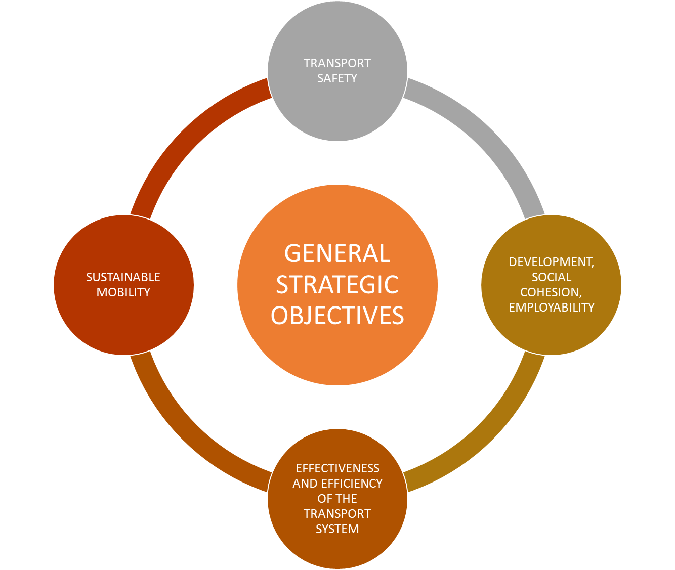
Objectives - General
General
General Objective 2
ITS applications are seamlessly integrated, compatible with systems in neighbouring RPs and meet with EU ITS architecture standards
General Objective 4
ITS are well integrated in the planning, design, construction and maintenance of the transportation infrastructure
ITS development and deployment are sustainable
General Objective 3
ITS are developed and deployed in a coordinated, systematic and cost effective manner.
General Objective 1

Slide 9
Objectives – Per RP
Regional Partner | Mode of Transport | General Objectives (GO) and Strategic Objective (SO)
ALL | ALL | GO 1- Establish a permanent ITS Steering committee, to coordinate all ITS initiatives, regardless the mode and ministerial jurisdiction
 |  | GO 2 - Cooperate and participate with the EU ITS agencies and neighbouring RPs to ensure interoperability and integration of ITS technologies
 |  | GO 3 - Integrate ITS early in the planning and design process for all modes of transport
 |  | GO 4 - Incentives should be provided (e.g. subsidies, grants) to the private sector transport providers for ITS deployments

Slide 10
Abbreviations
AIS | Automatic Identification System
CONNECTA | Technical Assistance to Connectivity in the Western Balkans
ERTMS | European Rail Traffic Management System
ETCS | European Train Control System
GSM-R | Global System for Mobile Communications - Rail
ITS | Intelligent Transport Systems
LRIT | Long Range Identification & Tracking
RRA | Rail Regulatory Authority
SC | Steering Committee
TAF - TAP | Telematic Applications for Freight/Passenger services (railways)
TCPS | The Permanent Secretariat of the Transport Community
TEN-T | Trans-European Network – Transport
TSI | Technical Specifications for Interoperability
UIC | Union Internationale des Chemins de Fer
WB6 | Western Balkans 6 Regional Partners

Slide 11
Objectives – Per RP
Regional Partner | Mode of Transport | Strategic Objective (SO)
Albania | Rail | SO 1- Remove institutional barriers (legal, technical and organizational)
 |  | SO 2 - State institutions and railway management to be well informed of the benefits, potentials and limitations of ERTMS, TAP-TSI and TAF-TSI and get prepared for their deployment
 |  | SO 3 - Deploy ERTMS in TEN-T core rail network
 |  | SO 4 - Deploy Secondary ITS (TAF and TAP)
Bosnia and Herzegovina | Rail | SO 1- Remove institutional barriers (legal, technical and organizational)
 |  | SO 2 - State institutions and railway management to be well informed of the benefits, potentials and limitations of ERTMS, TAP-TSI and TAF-TSI and get prepared for their deployment
 |  | SO 3 - Deploy ERTMS in TEN-T core rail network
 |  | SO 4 - Deploy Secondary ITS (TAF and TAP)
Kosovo | Rail | SO 1- Remove institutional barriers (legal, technical and organizational)
 |  | SO 2 - State institutions and railway management to be well informed of the benefits, potentials and limitations of ERTMS, TAP-TSI and TAF-TSI and get prepared for their deployment
 |  | SO 3 - Deploy ERTMS in TEN-T core rail network
 |  | SO 4 - Deploy Secondary ITS (TAF and TAP)
Montenegro | Rail | SO 1- Remove institutional barriers (legal, technical and organizational)
 |  | SO 2 - State institutions and railway management to be well informed of the benefits, potentials and limitations of ERTMS, TAP-TSI and TAF-TSI and get prepared for their deployment
 |  | SO 3 - Deploy ERTMS in TEN-T core rail network
 |  | SO 4 - Deploy Secondary ITS (TAF and TAP)

Slide 12
Objectives – Per RP
SO 1- Remove institutional barriers (legal, technical and organizational) | Albania: Establishment of functional and operational bodies, publishing of TSI’s and harmonization with the 4th railway package
 | Bosnia and Herzegovina: Further harmonization with the 4th railway package, strategic planning of rail ITS systems
 | Kosovo: Adoption of EN standards, further harmonization with the 4th railway package, further adoption of TSI’s,
 | Montenegro: Publishing of the laws harmonized with the 4th railway package, completion of TSI’s publishing, ERTMS implementation plans
https://transport.ec.europa.eu/transport-modes/rail/railway-packages/fourth-railway-package-2016_en

Slide 13
Objectives – Per RP
SO 2 - State institutions and railway management to be well informed of the benefits, potentials and limitations of ERTMS, TAP-TSI and TAF-TSI and get prepared for their deployment | Albania: Cooperation in the field of interoperability, improvement of knowledge and professional skills necessary for the implementation of ERTMS and other ITS
 | Bosnia and Herzegovina: Establishment of procedures for traffic operation and maintenance of new ITS systems, improving technical knowledge, professional skills and experience regarding the new ITS systems and experience in the transposition of EU acquis, experience on employee and management level regarding the maintenance, developing manuals and better planning of funds
 | Kosovo: Implementation of TSI’s, cooperation in the field of safety and interoperability, improvement of the knowledge and professional skills necessary for the implementation of ERTMS and other ITS in railways
 | Montenegro: Exchange of data and cooperation related to interoperability, fund planning, further improvement of the knowledge and professional skills necessary for the implementation of ERTMS and other ITS in railways

Slide 14
Objectives – Per RP
SO 3 - Deploy ERTMS in TEN-T core rail network | Albania: Poor condition of the railway infrastructure and railway fleet, ETCS deployment
 | Bosnia and Herzegovina: Full application of TSI’s for new infrastructure projects, ERTMS manuals, improvement of the condition of rail infrastructure
 | Kosovo: Poor condition of rail infrastructure, traffic organization and safety
 | Montenegro: Improvement of the condition of rail infrastructure and the need for modernizing of signaling systems on the main railway line, examination of GSM-R coverage and its functionality

Slide 15
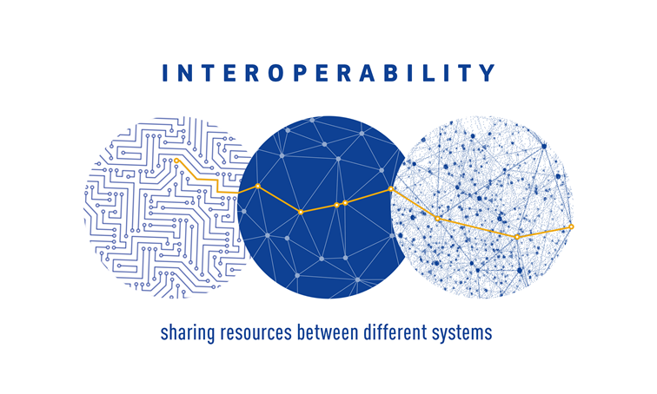
Objectives – Per RP
SO 4 - Deploy Secondary ITS (TAF and TAP) | Albania: New Infrastructure
 | Bosnia and Herzegovina: New Infrastructure
 | Kosovo: New Infrastructure
 | Montenegro: New Infrastructure
The ability of ITS-based systems to provide services (data, information, and control commands) to other systems and to accept services from those other systems so that the inter-connected systems operate effectively together. Systems are interoperable when the ITS services are seamlessly provided in real-time including between different organisations and/or at different locations.

Slide 16
Contact information
Emmanouil (Manolis) Zafeiris
Project Manager
E. emmanouil.zafeiris@connecta-ta.eu
Uros Marjanovic
ITS Expert
E. urosm11@yahoo.com
Branislav Boskovic
Railway Insitutional Expert
E. branislavboskovic@sbb.rs

Slide 17

Questions and Discussion
Any comments/suggestions/questions ?
Thank you!

