Slide 1

INTERREG DIONYSUS project -
Integrating Danube Region into Smart & Sustainable Multi-modal & Intermodal Transport Chains
3rd meeting of the Technical Committee on Waterborne Transport and Multimodality (Transport Community)
Ksenija Hajduković, Port Governance Agency (PGA)

Slide 2


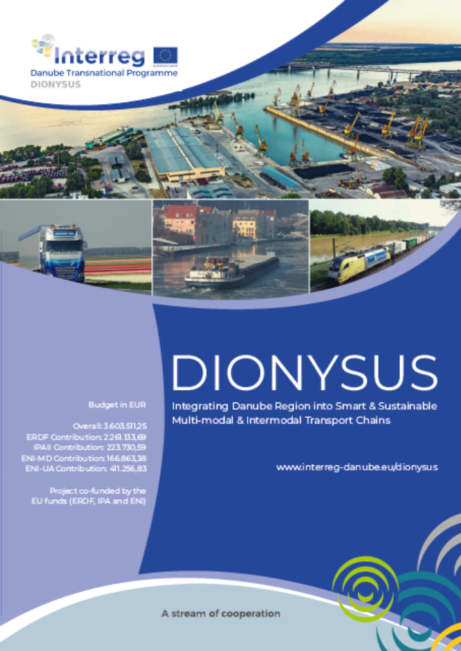




DIONYSUS Project: Key facts
18 Project partners (ERDF, IPAII, ENI) and 8 Associated partners
9 Countries – AT, SK, HU, HR, RS, RO, BG, MD, UA
Start date: 1 July 2020
End date: 31 December 2022
Overall budget: 3.603.511,25 EUR

Slide 3
DIONYSUS: Project partners
Romania
Pro Danube Romania
Austria
Ennshafen Port
iC Consulenten ZT
Slovakia
Public Ports JSC
Ministry of transport
National company Maritime Ports Administration SA Constanta
Wieser Consult SRL
Pro Danube Management
Hungary
Hungarian Federation of Danube Ports
Croatia
Public Institution Port Authority Vukovar
Bulgaria
Bulgarian-Romanian Chamber of Commerce and Industry
Bulmarket Port
Romanian River Ship Owners and Port Operators Association
Serbia
Port Governance Agency
Faculty of Transport and Traffic Engineering
Moldova
Technical University of Moldova
Ukraine
State Enterprise Ukrainian Sea Ports Authority

Slide 4

Project’s background
The Danube and its navigable tributaries offer significant free capacity for freight and passenger flows.
A prospering waterborne transport sector contributes to a sustainable transport system and regional growth.
A growing consensus recognizes the need for a smart and sustainable Danube port development planning
Comprehensive infrastructure planning and investment solutions are required (port infra and super structure and multimodal connections)

Slide 5
Project’s objectives
Overall goal:
To faciliate DR’s region integration into multimodal and intermodal freight and passenger transport systems
Specific objectives
Danube ports – key elements of the extensive DR transport system
Enhancing the Danube Corridor’s connectivity with the EU Eastern Partnership and with the Black Sea riparian countries
Supporting the multi-/intermodal development of the transport corridors within the Danube Region (port development and IWT connections with rail & road)
Creating the pre-requisites for further development of the Danube Transport Corridors

Slide 6
Project’s structure
Transport corridors and IWT markets
MPAC
Transport Corridors (Status of Planning & Gap Analysis)
Danube Inland & Sea Ports Analysis and Recommendations
PGA
Multi-/Intermodal Facilities & Services
Integrated Port Development
HFIP
Matching Regional Economic Development / Transport Infrastructure
Pilot Cases
EHOO
IWT Market Analysis (Cargo and Passenger
Case Study Container Liner Service
Danube Corridor Promotion and Enhanced Connectivity
Rail & Road Connectivity
Port Tariffs – Tool for port and hitnerland transport development
Danube Port Digitalization
Case Study Agriculutral Products (Ports and Access Infrastructure needs)
Project Capitalization through Danube Ports Network
Infrastructure Master Plan for River Cruise Industry
Port Development plans for selected ports in AT, HU, RO, BG, HR, RS, UA, SK, MD

Slide 7
DIONYSUS: Port Development Plans
Enhacement of logistical capabilities
Improved competitive advantages
Sustainable development
Aligned with Transport & Regional Economic Development Strategies
Aligned with National Action Plans

Slide 8
Project’s main result
Efficient infrastructure planning and strengthening of the DR transport and logistics system
Increase the accessibility, efficiency and multi-& intermodal transport connections of river and seaports in the DR
Support high-quality logistics, services and sustainable business opportunities
Investment needs will be aligned with Transport Infrastructure and Regional Development plans
Enhancing port infrastructure and service quality
Reducing transport costs
Increase connectivity, faciliate trade and boost trade flows in the DR

Slide 9


Results and Outputs
Elaboration of transport corridor development policies
Identification of shortcomings in rail & road access infrastructure
Consolidation of investment needes based on Market Analyses
Recommendations for matching port planning with transport infrastructure and Regional Economic Development Plans
Specific case studies for Container Liner Services and Agricultural products
Infrastructure Master plan for RCI
Port Development Plans
Operational and Business Models
Outputs will support quality, sustainable development and investment decisions.
Alignment with specific EU Transport, TEN-T and Cohesion Policy objectives will be ensured.
DIONYSUS – key instrument to contribute the EUSDR implementation.

Slide 10



PGA and DIONYSUS
Work Package leader - Danube Inland & Sea Ports Analysis and Recommendations
Activity leader - Port Development plans
Host of two regional workshops (Agriculture Products & River Cruise Industry) and the 4th Set of Project management meetings.

Slide 11
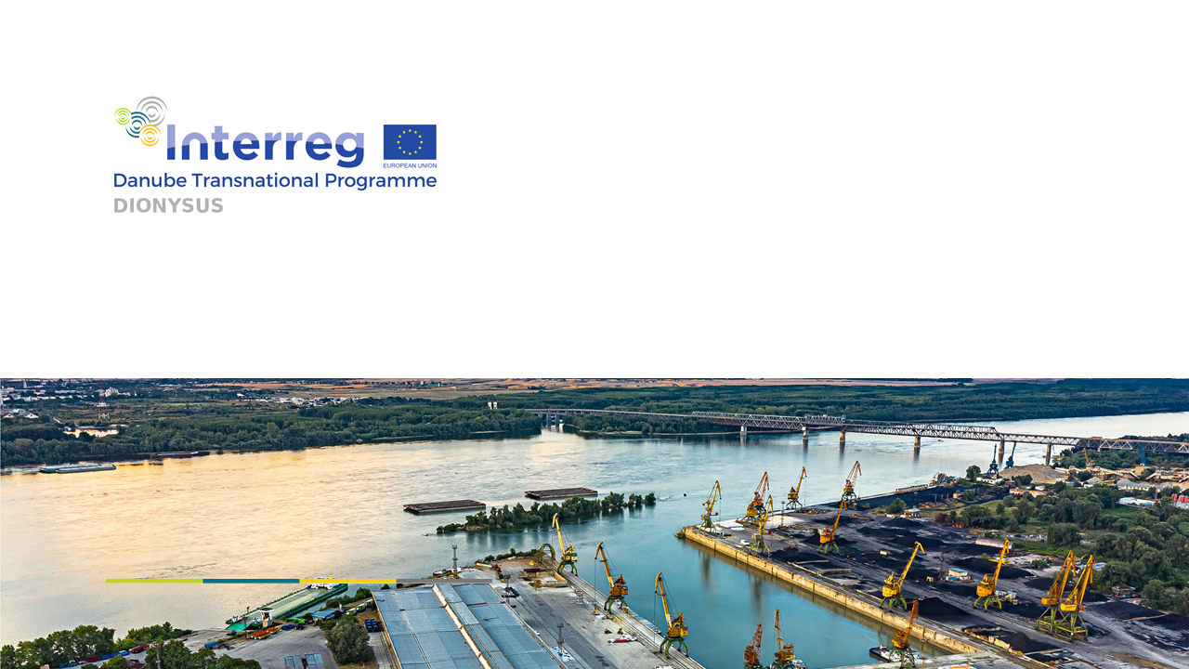
PGA Team
Port Governance Agency
Nemanjina 4, 11000 Belgrade
SERBIA
T +381 11 6556 531
E dionysus@aul.gov.rs
DIONYSUS – Integrating Danube
Region into Smart & Sustainable
Intermodal Transport Chains

