Slide 1
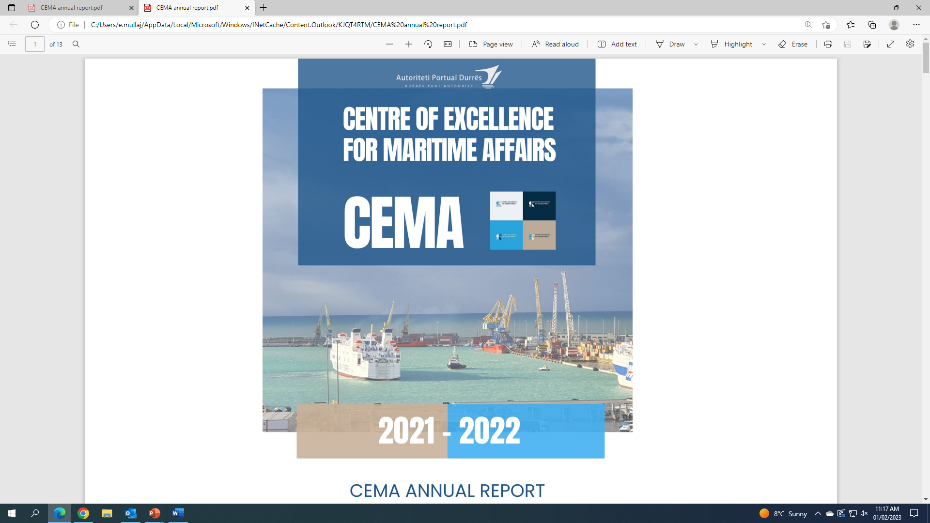
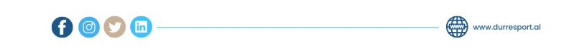
      Main highlights in 2022 & objectives for 2023

Slide 2


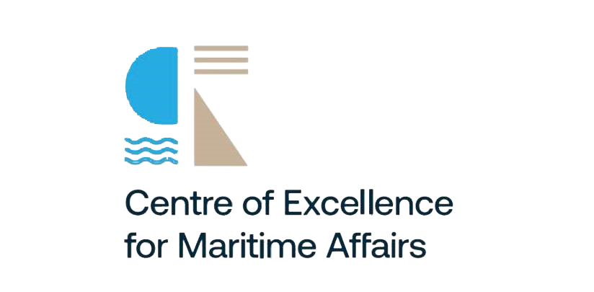
The main highlights of CEMA in 2022

Slide 3
1
During the 2022, CEMA has conducted a total of: 32 trainings/conferences/workshops/provided Postgraduate Master’s Degrees for its staff). Among the most important, we list:
2
• 4-day training from Siemens Simatic company
• 1-month course from OSCE-BMSC
• IMO Training on "International Convention for the Control of Harmful #AFS Anti-Fouling Systems on Ships"
• Hydrographic Survey Category B
• 4 Master's Degrees in different disciplines for APD employees at Aleksandër Moisiu University - Durrës.
• 8 trainings conducted at APEC - Port Training Centre, Belgium.
• Smart Digital Ports of the future 2022 Conference
• Conference Empowering Europe’s Ports
• Meeting with EUWB6_TCT, Antwerp, Belgium
• Meeting with EUWB6_TCT, Belgrade, Serbia
• Forum of the Adriatic Sea, Bari, Italy
• Risk in Maritime Sector - Conference
• Anticorruption Conference
• Inter-institutional training on the formation of institutions, reforms, review and administrative procedures
Building Capacity through Training and Qualifications

Slide 4
3
CHARTS

Slide 5

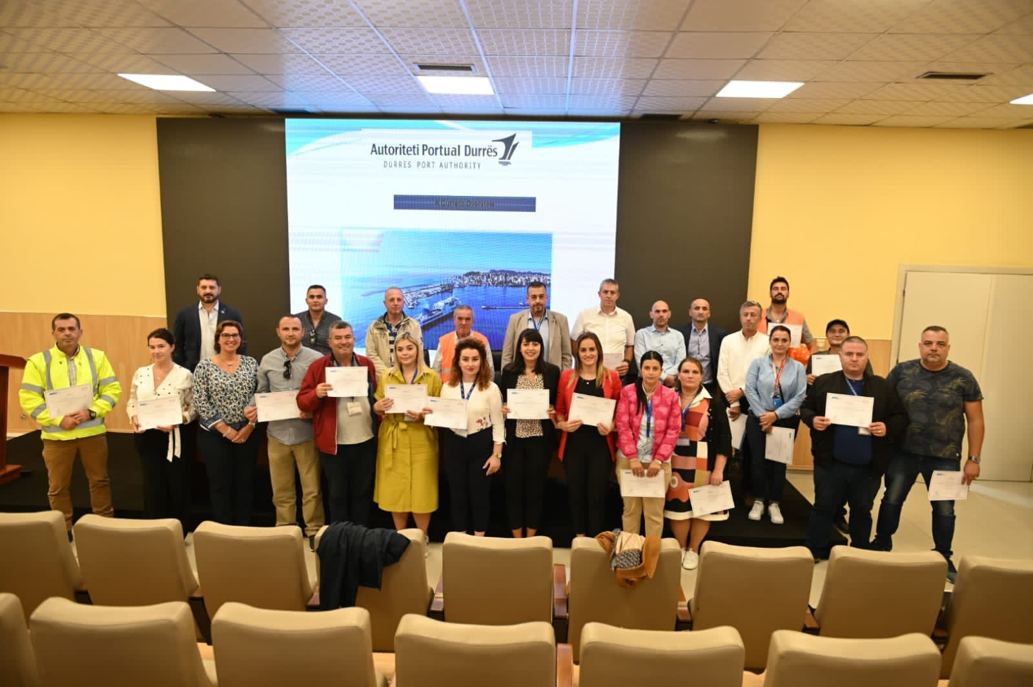
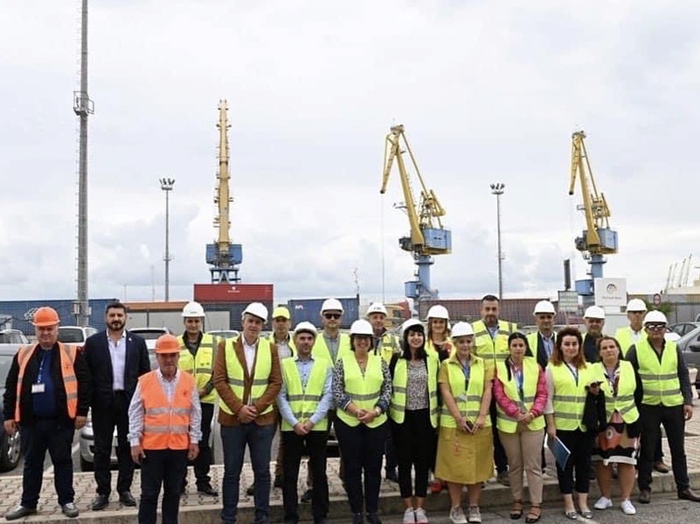
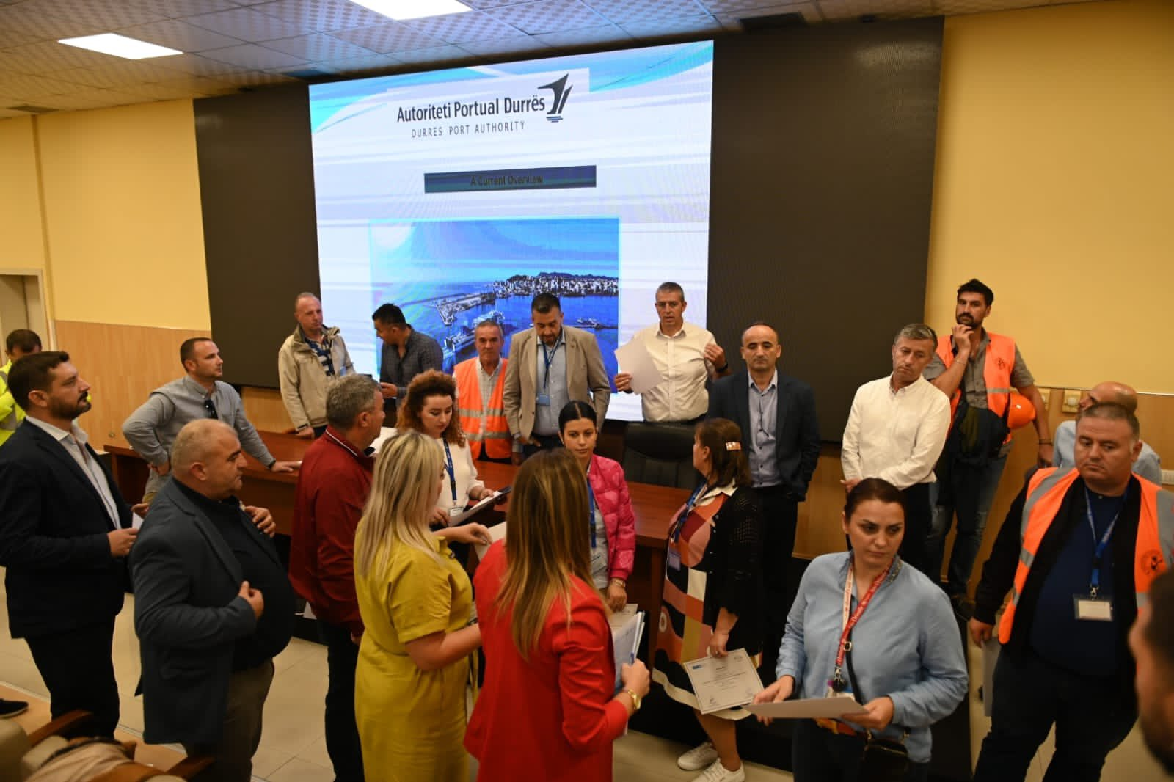
4
5
The seminar covered the technical and regulatory aspects of anti-pollution systems and assessed whether Albania has an appropriate national legal framework that allows the implementation of the AFS Convention.
A national workshop to assist Albania in the implementation of the IMO Convention on Anti-Fouling Systems (AFS) was held at the Port of Durres on 28th-29th of September 2022.
The AFS Convention established the means of control for several harmful substances in anti-fouling systems, including organotin compounds (TBT) and, from 2023, cybutrine. The lectures were conducted through the IMO's Integrated Technical Cooperation Program (ITCP).
About 20 government officials were made aware on the actions that Albania needs to take at the national level to fully implement the ILO Convention.
WORKSHOP

Slide 6

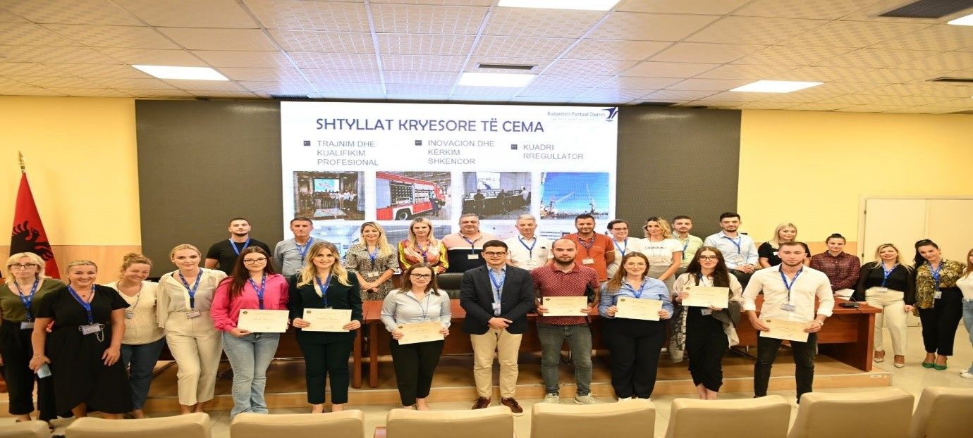
6
CEMA certifies the 10 intern specialists of the Program of Specialization and Professional Practices in Durres Port Authority
CEMA certified the first group of interns who benefited from professional practice at the Durrës Port Authority.
2 interns were selected as potential candidates to go through the recruitment procedure for employment
CERTIFICATIONS & TRAININGS

Slide 7
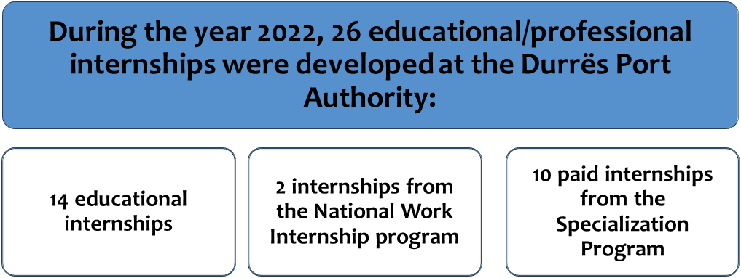
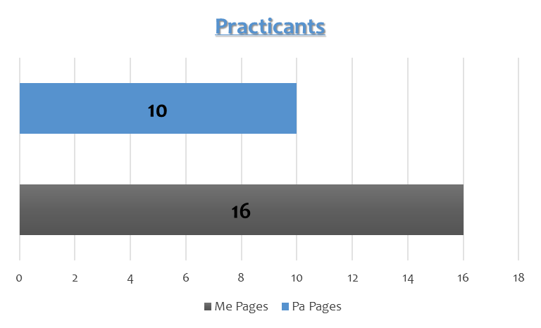
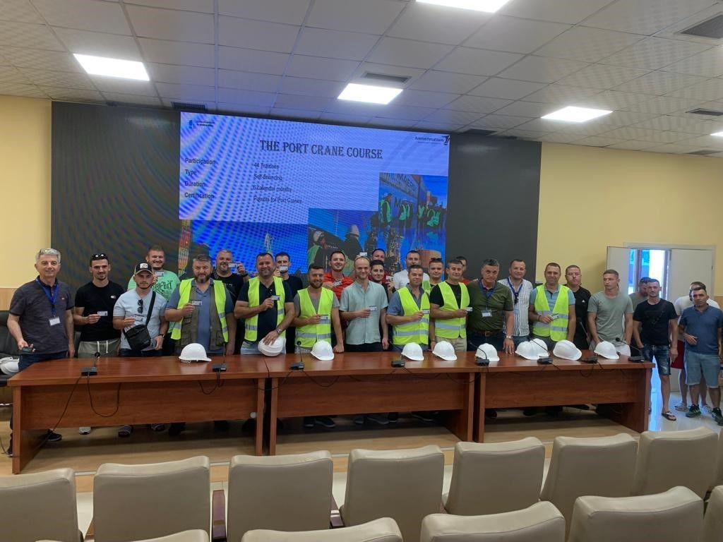
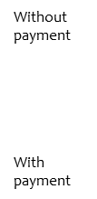
7
Certification of the trainees who successfully complete the training as: Port Crane Operator
8
After an intensive 6-month course of combined theoretical and practical knowledge, the Durrës Port Authority through the CEMA, successfully finalized the certification of the first group of Port Crane Operators.
Educational & Professional Practice

Slide 8
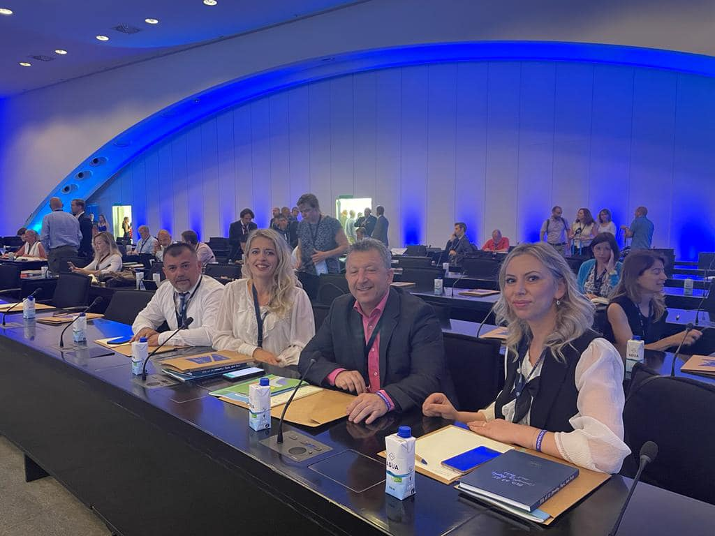
9
Empowering Europe Ports Conference
During the 2022, 26 activities with different subjects were developed at the Durrës Port Authority under the supervision of CEMA, among the main ones we list:
The theme of 2022 edition was "Strengthening Europe's Ports".
The conference featured a range of keynote speakers and experts, but also provided an excellent platform for discussions and exchanges between port professionals, port stakeholders, academics and EU policy makers.
During the year 2022, the Durrës Port Authority was represented by 4 high level MANAGERIAL STAFF.
Meeting of the Coordinating Council of the Center of Excellence for Maritime Affairs
The Job Fair organized by the National Employment and Skills Agency - AKPA.
The cooperation agreement between the Durres Local Education Office and the CEMA.
The job and career fair developed by the Aleksander Moisiu University Durrës - in cooperation with the Durres Port Authority.
Cooperation agreement between the Center of Excellence for Maritime Affairs and Digit Sapiens
Visit of Amerigo Vespucci Ship
Visit of Logos Hope Ship
Certification of trainees who successfully complete the training for the Port Crain Operator
Conference Europe Empowering Ports, Espo Valencia 2022.
Cooperation Agreement between the Security Academy and the Center of Excellence for Maritime Affairs.
ACTIVITIES

Slide 9
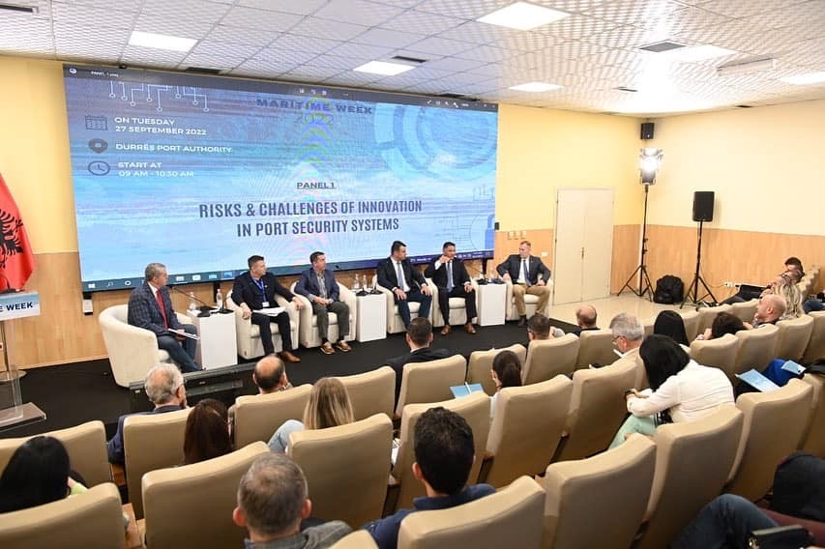
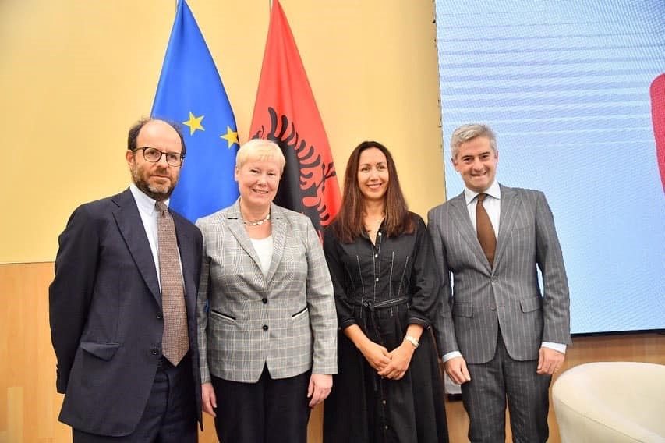
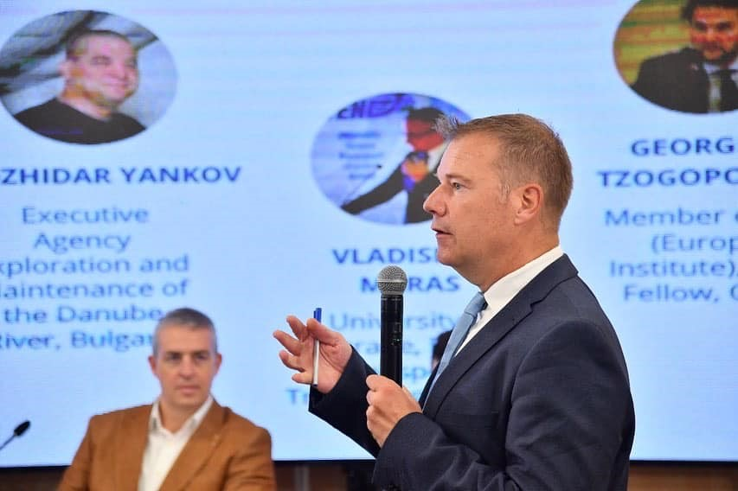
10
MARITIME WEEK
A full week dedicated to industry and maritime transport has gathered in the Port of Durrës:
35 local and foreign panelists
6 panels and training sessions
10 partner institutions
200 participants
MARITIME WEEK

Slide 10
the objectives for 2023

Slide 11
11
CEMA is “PER SE”, an excellent example of COOPERATION CATALIST of cooperation between the Government, Academia, Civil Society and Private Sector
Durres Port Authority
MIE ; Transport Community Permanent Secretariat
University “Aleksander Moisiu” Durrës
Cooperation and Development Institute
Digit Sapiens Private Sector
CEMA

Slide 12
12
13
Academia
The main purpose of the cooperation with “Aleksander Moisiu” University of Durrës is to help CEMA to:
Take advantage of the academic staff, the know-how and R&D facilities of University AM Durrës.
With the help of UAMD, publish more research studies regarding the Maritime Sector.
Together with UAMD, to become capable of applying for more funds for Projects in Programs like IPA, ERAZMUS, HORIZON, etc.
Update and further development of the Maritime Legal Framework in Albania.
Civil Society
The main purpose of cooperation with Cooperation and Development Institute is to help CEMA to:
Apply for more funds in Programs like IPA, ERAZMUS, HORIZON, etc.
Become capable of identifying potential donors, public and private, interested in the Maritime Sector.
Utilize each others’ stakeholders and network in a way that benefits both our institutions
Become capable of impacting the public opinion with regards to the maritime sector’s concerns.

Slide 13
14
Public Sector (the stakeholders)
1. Durres Port Authority is the institution of the Public Sector who provides the main support by providing the budget, staff and logistics, offices, everything that is needed for the everyday function of CEMA. It is providing also the premises and logistics for the today’s conference, as well.
2. Ministry of Infrastructure and Energy of Albania
3. Transport Community Permanent Secretariat.
The three above mentioned public institutions are the main creators or supporters of CEMA, with regards to the Public Sector, proceeding from the 2021 MoU.
Other stakeholders:
Regional Education Office - Durrës
National Employment and Training Agency – AKPA
The Security Academy in Tirana,
Naval Force of Albania
The
15
Private Sector
The main purpose of cooperation with DIGIT SAPIENS, is to help CEMA to:
Assess what is needed for the improvement of work processes and automatization of Port operations.
Assess what is needed for the integration of Port Community Systems with Terminal Operating Systems and Albanian customs
Potentially implement artificial intelligence AI instruments for intermodal transport operations.
Develop specific tailor-made tech software for port operations

Slide 14
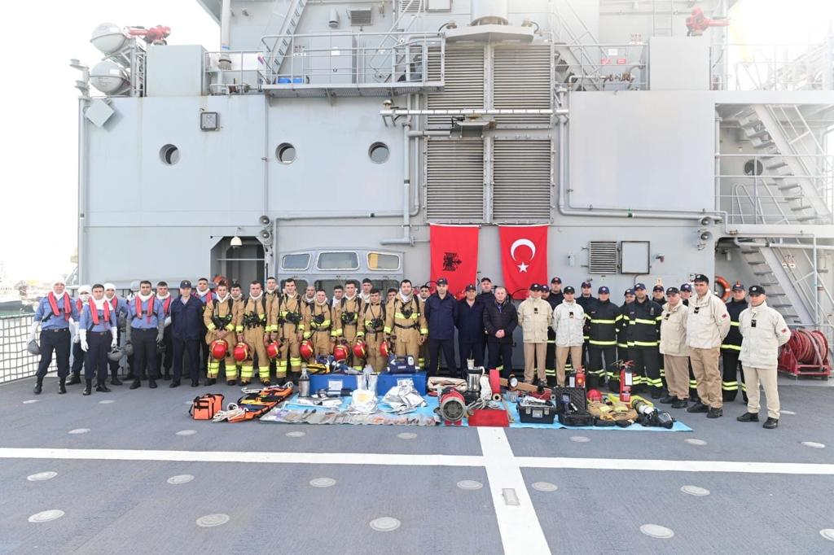
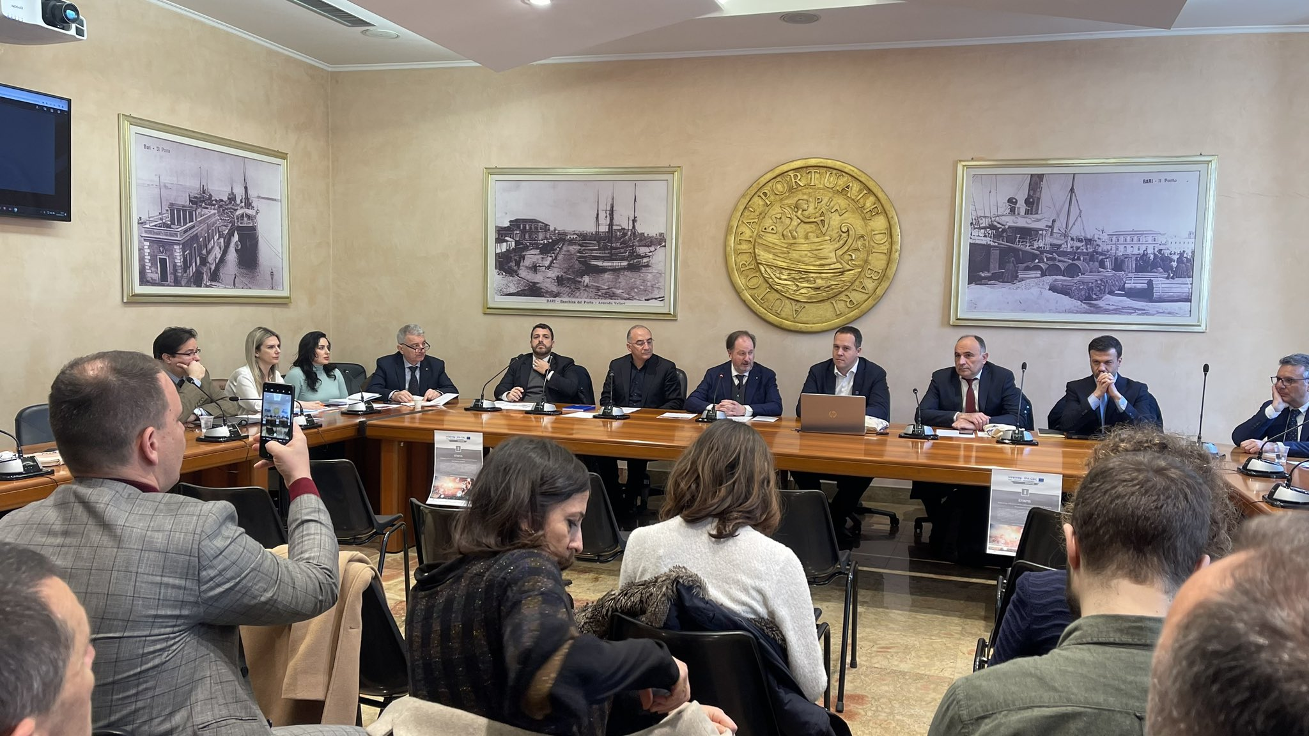
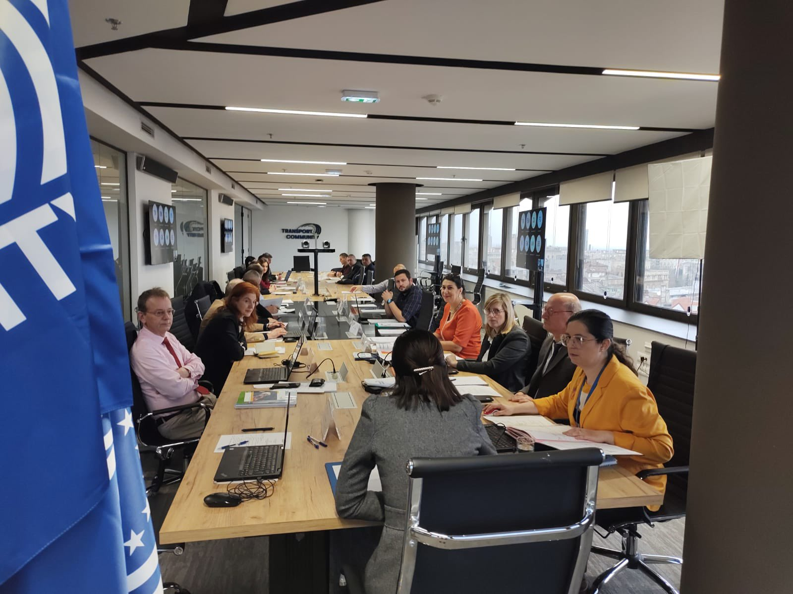
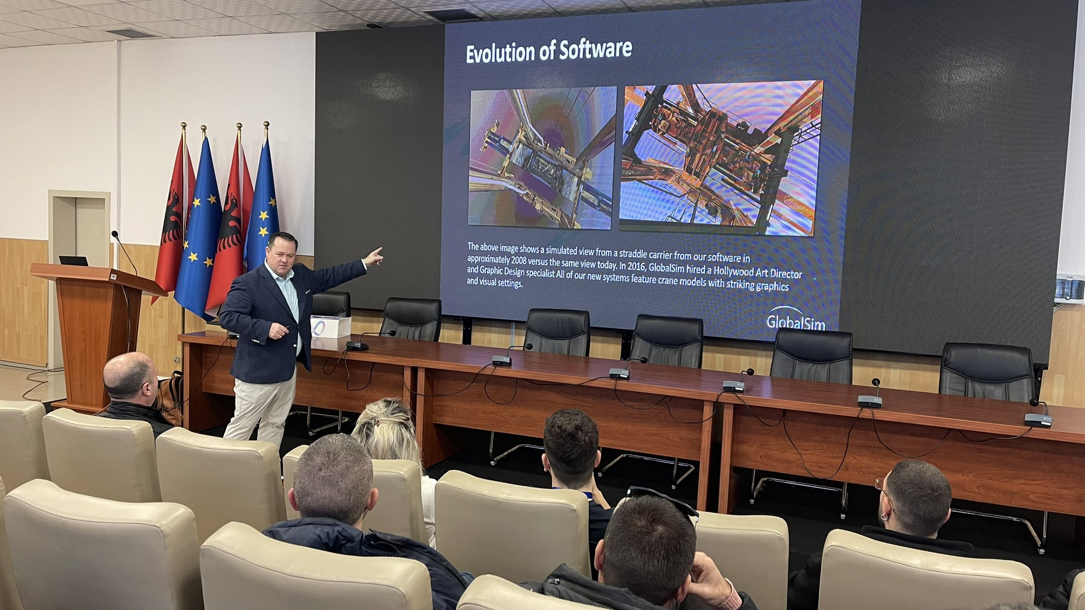
16
On 24th of February, our Freighter Unit was trained on a NATO ship with a live fire simulation.
An insight into crane stimulation & software solutions occurred in collaboration with Global Sim Inc, an US company specialized in crane production.
The final conference of Project_efintis at Port of Bari, 02 March 2023. “Enhancing efficiency of the intermodal transport flows by improved ICT systems”
CEMA’s Head of Vocational Training Unit attending conference on Dangerous Goods, in Beograd, from 1 – 5 March 2023
CEMA’s Director will participate at the “5th Waterborne Transport and Multimodality Technical Committee - Belgrade, 16 March 2023”.
Our Seafarer Day 2023
Maritime Day 2023
Performed and planned activities 2023

Slide 15
17
1st Objective of CEMA for 2023 is: Capacity Building of the Albanian maritime sector through the necessary vocational trainings
CEMA aims to achieve this objective through:
Transforming CEMA into national training center for all the maritime sector
Stay focused on the targets of the National Sectoral Plan of Maritime Transport and Port Infrastructure.
Train and prepare today the future staff of the new port of Porto Romano
Create CEMA’s own pool of trainers, curricula and know-how
Continue the cooperation with national institutions like the Academy of Security, Naval Forces, Local Education Offices, the National Employment and Skills Agency – AKPA, other Universities, Embassies.
Continue the cooperation with international institutions like the APEC Port Training Center, European Sea Ports Association and other EU institutions, International Maritime Organization, etc.
CEMA’s OBJECTIVES

Slide 16
18
2nd Objective of CEMA for 2023 is: develop and update of the Albanian national maritime legislation
CEMA provides technical assistance in drafting and aligning national maritime legislation with international legislation (including the EU acquis) on maritime affairs, connectivity and related fields in accordance with the best protocols and practices international goods.
For Durres Port Authority it is very important to create a pool of professional lawyers specialized in Maritime Law, EU acquis and international maritime legislation

Slide 17
19
  3^{d} Objective of CEMA is: provide R&D and Innovation for Albanian maritime sector:
CEMA in cooperation with TRANSPORT COMMUNITY and with full support from the Ministry of Infrastructure and Energy of Albania and all other relevant maritime institutions and stakeholders in Albania is working on Research Project: “Revised Roadmap for improving Albania flag’s status in relation to Paris MoU on Port State control”.
In cooperation with UAMD, the DPA is a partner in the Research Project: “Use of renewable energy in the Marine Fisheries”, financed by AKKSHI. This Research Project aims at resilience to climate change by providing alternative methods of clean energy and reducing CO2 emissions
In cooperation with UAMD, the DPA is a partner in the Research Project: Project: IoT Green Transformation for Academic Society and Business Oriented Ecosystem in Western Balkans Consortium.
DPA signed an Cooperation Agreement with DIGIT SAPIENTS, a private limited company, which will help CEMA and DPA to provide innovative solution for the improvements of the following operational port operations:
        make an assessment of what is needed for the improvement of work processes and automatization.
        make an assessment of what is needed for the integration of Port Community Systems with Terminal Operating Systems and Albanian customs
        potential implementation of artificial intelligence AI instruments for intermodal and synchro modal transport operations
        to develop specific tailor-made tech software for port operations

Slide 18




Thank You
CENTRE OF EXCELLENCE FOR MARITIME AFFAIRS
L 1, Rr Tregtare, Durres Albania
info@durresport.al
www.durresport.al

