Slide 1
MINISTRY OF ECONOMY AND SUSTAINABLE DEVELOPMENT
OF GEORGIA
MARITIME TRANSPORT AGENCY OF GEORGIA

Slide 2

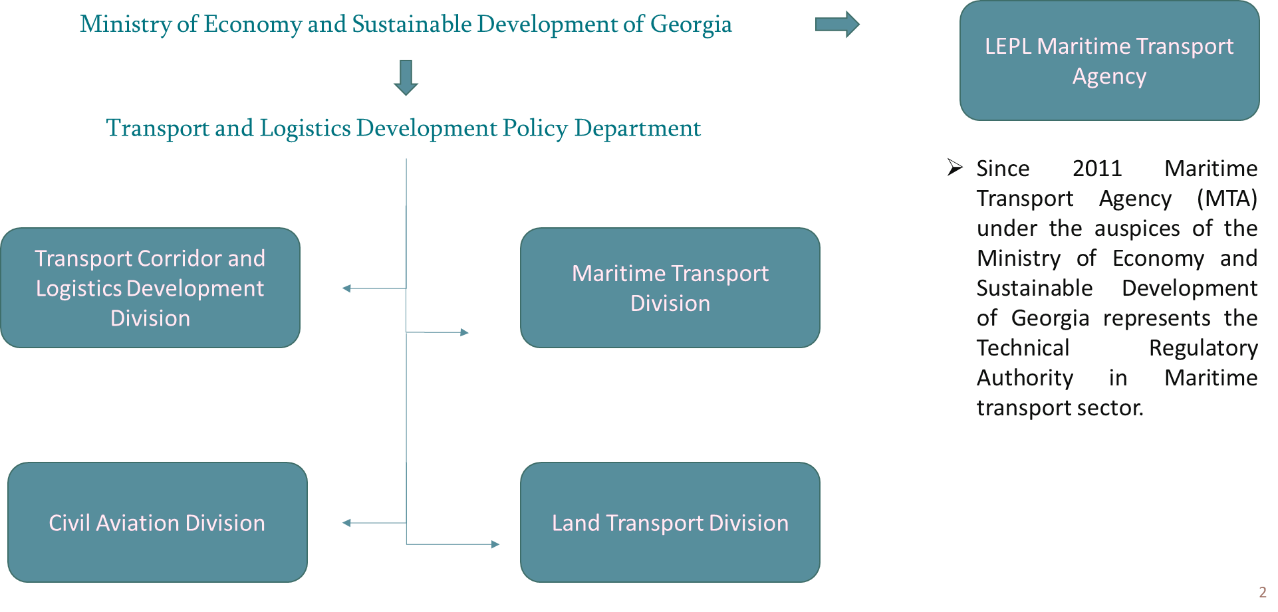
STRUCTURE OF TRANSPORT AND LOGISTICS DEVELOPMENT POLICY DEPARTMENT

Slide 3

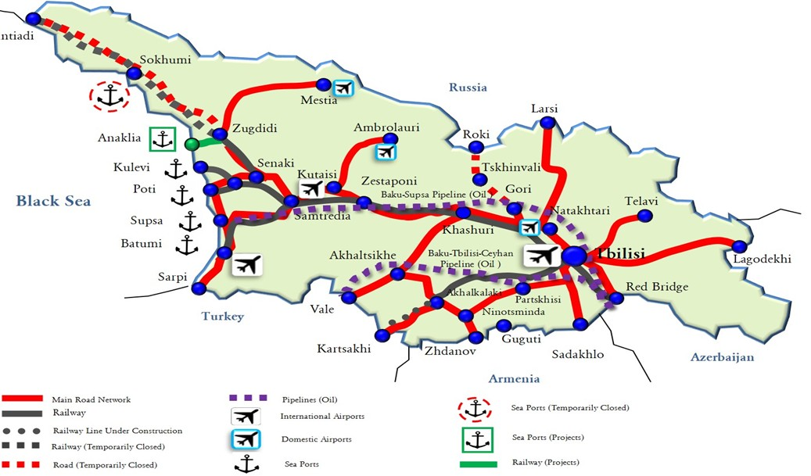
SEA PORTS OPERATING IN GEORGIA
Poti Sea Port (APM Terminals)
Batumi Sea Port (BIH) Kulevi Terminal (SOCAR) Supsa Terminal (BP)

Slide 4
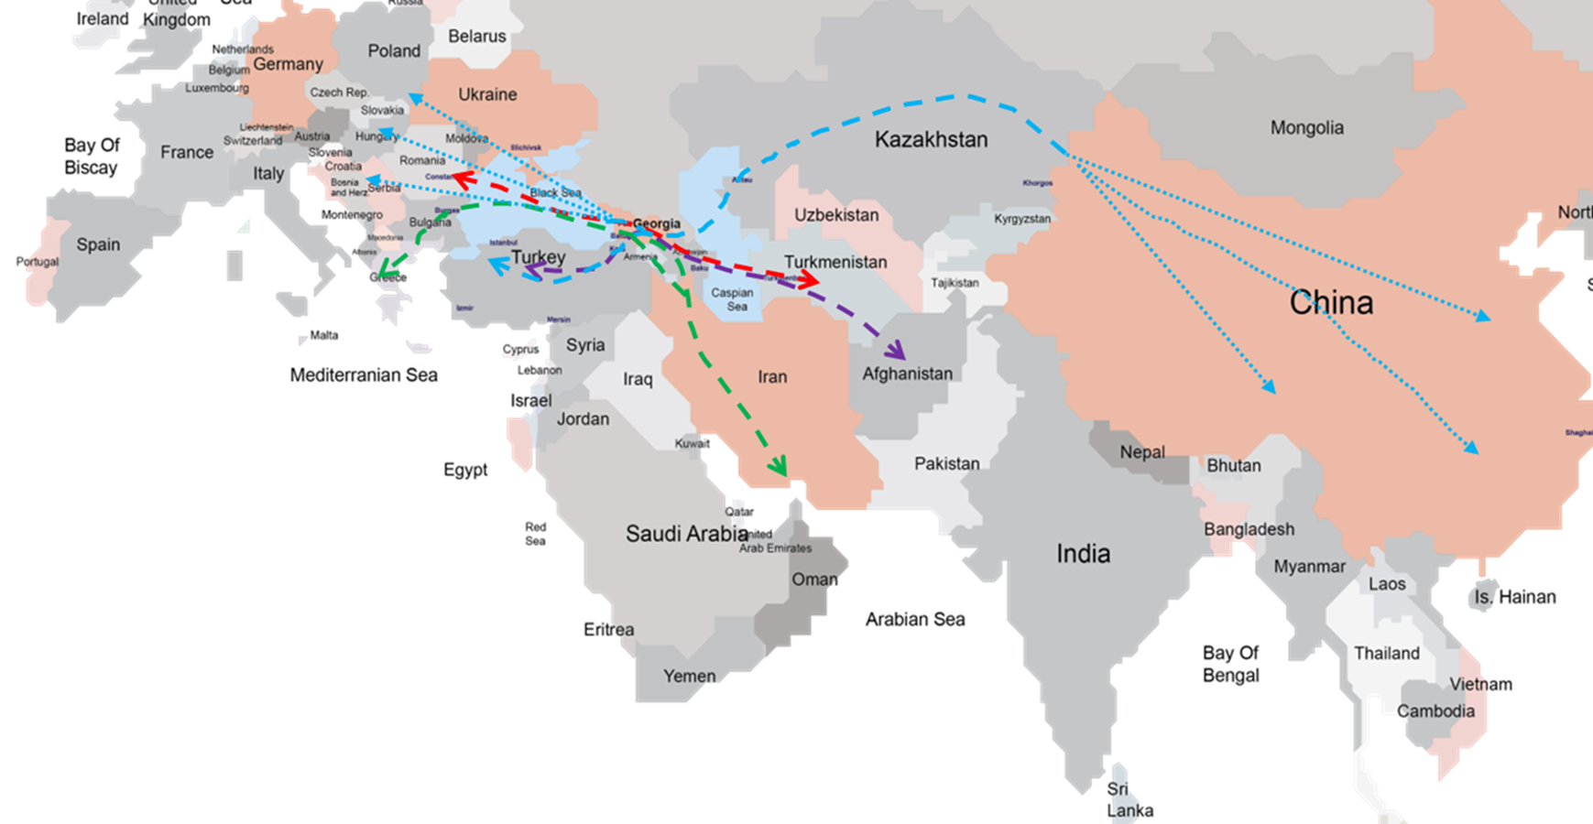


TRANSPORT ROUTES AND CORRIDORS
Main Priority:
Improving Connectivity
on the Black Sea
Middle Corridor
Black Sea - Caspian Sea Corridor Persian Gulf-Black Sea Corridor

Slide 5
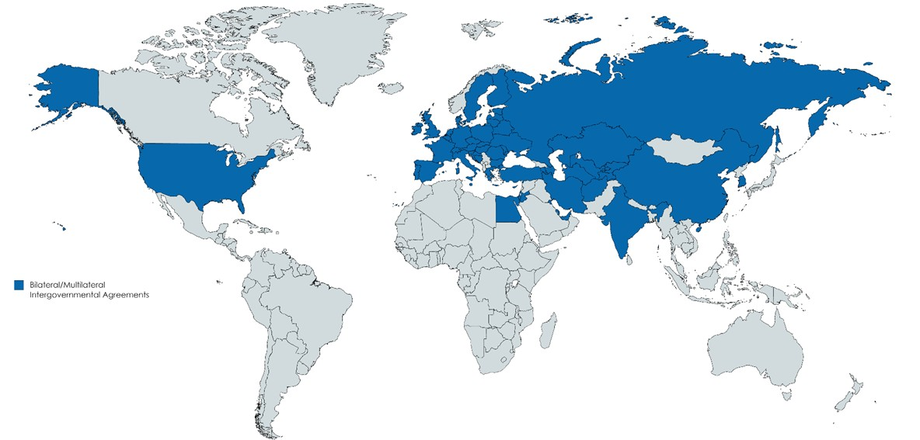
INTERNATIONAL AGREEMENTS AND CONVENTIONS
Bilateral agreement with 17 countries. Moreover, Bilateral agreements are planned to be concluded with 4 countries.
Georgia is a member of the 1948 Convention on the International Maritime Organization (IMO)
Since 2002, Georgia has become a member of Athens Convention Relating to the Carriage of Passengers and Their Luggage by Sea
From December 2022, Georgia has become member of the Maritime Labour Convention (MLC)

Slide 6
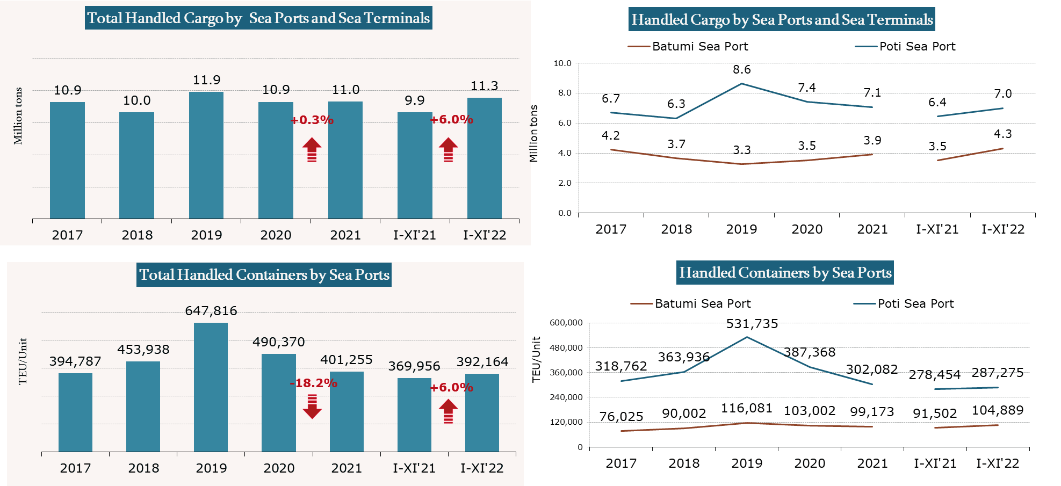
NUMBER OF CARGOES AND CONTAINERS HANDLED AT SEAPORTS AND TERMINALS

Slide 7
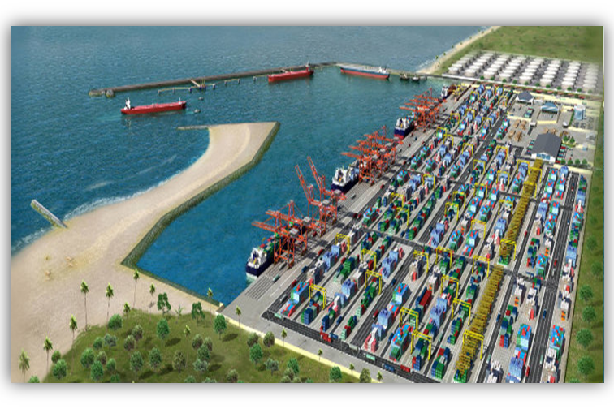
IMPLEMENTATION OF MAJOR INFRASTRUCTURE PROJECTS
OPPORTUNITIES:
Strategic location
Ability to receive large ships
Providing services on the principle of "one window"
Development of logistics services Development of industrial cluster
POSITIVE IMPACTS:
Creating favourable conditions for the development of logistics services and industrial zone in the adjacent area.
Giving the opportunity for development of value added services
Significant increase in cargo turnover through the territory of Georgia.
Creating thousands of new jobs in western part of Georgia.

Slide 8







The 2016 Association Agreement between the European Union and the European Atomic Energy Community and their Member States, of the one part, and Georgia, of the other part includes a set of provisions ensuring the development of national legislation of Georgia through harmonization of EU Law and strengthening future relations
AA includes implementation of EU acquis in Maritime Transport Sector and regulating body for maritime transport is the Maritime Transport Agency of Georgia.

Slide 9


IMPLEMENTATION OF
EU DIRECTIVES/REGULATIONS
14 DIRECTIVES
8 REGULATIONS

Slide 10

Number of Directives and Regulations to be implemented – 22 according to the AA
14 Directives (Directive 1999/35/EC of 29 April 1999 directive is no longer in force from 19 January 2017. Thus, Georgia in cooperation with European Union agreed not to implement this directive);
8 regulations.
IMPLEMENTATION STATUS – 20 DIRECTIVES/REGULATIONS
ALREADY IMPLEMENTED (ONE REMAINING, ONE NOT IN FORCE)

Slide 11


EU ACQUIS IMPLEMENTED BY GEORGIA COVERS FOLLOWING DIRECTIONS:
Maritime Education and Training- the whole Maritime education, training and certification system has been reformed meeting the requirements of the IMO and EU;
Maritime Safety and Security – the national implementation of ISPS and ISM Codes have been achieved;
Safety of navigation achieved with the establishment of a Vessel Traffic Monitoring System;
The government has signed the Black Sea MoU and has implemented the Directive on port State control to the maximum extent possible.

Slide 12

Port Reception facilities;
Social aspects – In fall 2022, the implementation of 1999/63/EC and 1999/95/EC started with the initiation of the ratification of MLC along with the implementing national legislation;
Ship inspection and survey;
Introduced safe practices and standards for the safe operation of
Oil tankers (phasing in of double hull tankers); Bulk Carriers;
Passenger ships.

Slide 13

MTA has initiated the national
procedures regarding the ratification of the MLC 2006 and the adoption of draft
ENSURING SOCIAL RIGHTS FOR SEAFARERS
legislation on the “Employment of Seafarers.”
The remaining automatically be
two EU deemed
directives will implemented, as
the
their provision are prescribed both in
Convention and its implementing legislation. The latter will ensure the protection of social rights of Georgian seafarers and Seafarers employed on the ships flying the national flag of Georgia.

Slide 14

REMAINING ACQUIS UNDER THE ASSOCIATION AGREEMENT
EU regulation 2019/1239, which replaced 2010/65/EU on reporting formalities for ships arriving in and/or departing from ports of the Member States and repealing Directive 2002/6/EC directive establishing European Maritime Single Window environment will enter into force on 15 August 2025

Slide 15


DIGITALIZATION OF THE MARITIME TRANSPORT
DIGITALIZATION
The digitalization is high on the Government’s Agenda;
The introduction of MSW will be followed by the implementation of a Port Community System in Georgia ports;
The systems shall be integrated in order to achieve full digitalization of the maritime transport and logistical process in Georgian ports (intermodal transport clearance).

Slide 16



DEVELOPMENT OF MARITIME SINGLE WINDOW (MSW)
The ships’ clearance process for arrival/departure from
Georgian ports will be digitized and processed through one single window principle;
In 2020 a feasibility study for the development of the MSW in Georgian ports has been successfully conducted;
The implementation phase is due to start in 2023, which will develop the hardware and software components of the system;
The system shall be operational for 2024.

Slide 17
PORT COMMUNITY SYSTEM (PCS)
This will result in faster processing times, helping
reduce ship and truck turn around and waiting times and the length of cargo dwell; Streamlining customs procedures; and, in turn, significantly enhancing the regional competitiveness of Georgia’s seaports.

Slide 18
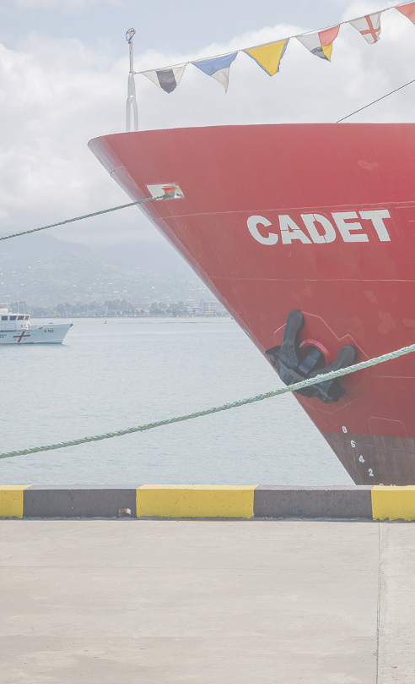

In 2019, Georgia began developing a Maritime Strategy Document. 200,000 Euros were allocated by the European Union for the development of this
document.
EU experts assisted Georgia in implementing directives and
developing a Maritime Strategy in accordance with the AA.
EU
Project was carried out in the following directions :
Georgia Maritime Strategy;
On safety rules and
standards for passenger ships;
Harmonized requirements and procedures for the safe
loading and unloading of cargo on ships.
AT THIS STAGE, THE DOCUMENT IS BEING ADAPTED TO MARITIME TRANSPORT STRATEGIC DEVELOPMENT CONCEPT DUE TO BE APODTED BY THE GOVERNMENT OF GEORGIA IN 2023.
MARITIME TRANSPORT STRATEGY
Developed with the EUD to Georgia Technical Assistance in 2020

Slide 19
The concept will lay ground for the development of baseline indicators and KPIs for the eventual adoption of Maritime Transport Strategy
MARITIME TRANSPORT STRATEGIC DEVELOPMENT CONCEPT
The Concept will set strategic objectives for the Country in the following directions:
Seafarers
Maritime education
Port Capacity Development Ship Registry
Development of RoRo ferry connections
Support the development of Ship shipbuilding industry
Maritime Inovation and Research Maritime finance
Cruise shipping
repair and

Slide 20




AUDIT OF THE EUROPEAN MARITIME SAFETY AGENCY
During the period of 02-12 May 2022 an audit was conducted by the European Maritime Safety Agency (EMSA);
The Audit assess compliance of Seafarer’s education, training and certification in Georgia with the relevant International and European standards;
Georgia has previously successfully completed the EMSA audit in 2013, which resulted in EU’s recognition of Georgian issued seafarers certificates.

Slide 21


SECTORAL INTEGRATION AND COOPERATION WITH EU
Georgian maritime transport sector have experienced significant positive changes in recent years. Effective cooperation with the European
Commission, the European Maritime Safety Agency (EMSA) have created effective links of communication and assistance for Georgia, both in terms of technical assistance and capacity building process;
In 2016 Georgia joined the SafeSeaNet system which enables Georgia to instantly detect the facts of sea pollution from the vessels and to carry out actions under Georgian legislation.

Slide 22

Georgia was the first non-member among the Eastern Partnership countries to join the European Union’s countries with ship’s long range identification and monitoring system (LRIT CDC);
Georgia received technical assistance through the EU support projects such as SASEPOL, TRACECA, Maritime Safety and Security II which were then followed by the EMSA’s Black and Caspian Sea project I and II;
EMSA’s material assistance has proven vital in this field, as per the donation agreement between EMSA and MTA ensured the delivery of 2 AIS station and one central node to Georgia in 2019;
EMSA is planning to deliver Oil Pollution Response Equipment to Georgia.

Slide 23


THANK YOU
LEPL MARITIME TRANSPORT AGENCY
50 , BAKU ST. BATUMI. GEORGIA
+ 995 422 27 49 26
+ 995 422 27 39 29
INFO@ MTA. GOV. GE WWW. MTA. GOV. GE WWW. GEORGIANSEAFARERS. GE

