Slide 1



5th Waterborne and Multimodality Transport Technical Committee Meeting
Nava
Nirca Tatiana, Ministry of Infrastructure and Regional Development of the Republic of Moldova
Belgrade, March 16, 2023

Slide 2

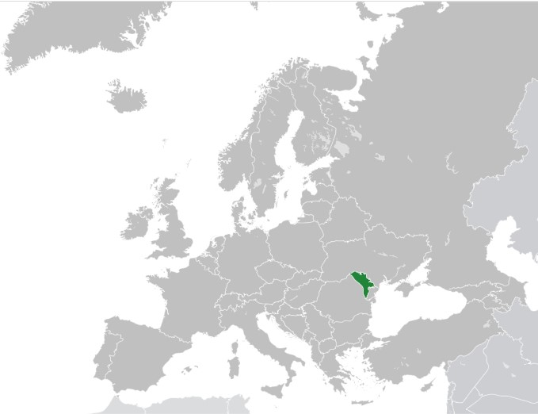
●●●●
General information*
Republic of Moldova is a landlocked country in Eastern Europe. It is bordered by Romania to the west and Ukraine to the north, east, and south
Area: 33,851 km²
Population: 2,603,813 mln (2022)
Infrastructure:
Public roads – 9472 km
Railway lines – 1150 km
Navigable waterways – 410 km
*National Bureau of Statistics of the Republic of Moldova

Slide 3

●●●●
The institutional framework
EU Policy
IMO
Partnership Agreements
The Parliament
The Government
Authority
Ministry of Infrastructure and Regional Development
Naval Agency
Safety Authority
Law 599/1999
Law 176/2013
Infrastructure
Giurgiulesti Port Complex
Giurgiulesti International Free Port
Passenger and Goods Port Giurgiulesti

Slide 4

●●●●
River network
Ocnița
Bălți
Râbnița
Giurgiulesti Port Complex
Ungheni
Chișinău
Tighina
Cuciurgan
128 m
1200 m
Basarabeasca
Prut 2
Giurgiulești

Slide 5
●●●●
Giurgiulesti Port Complex (infrastructure)
Republic
of Moldova
Road to Chisinau
Grain
Storage
Ukraine
MD
Railway
Park
Customs
N
500 m
Railway
Bridge
128 m
Railway Line to RENI
Galați
1200 m
Romania
Romania

Slide 6
●●●●
Statistics, relative 2022-2021 (January-September) ↗
Port calls
Total cargo
Cereals
Petroleum

Slide 7
●●●●
Difficulties
The Black List of Paris MoU
Underdeveloped legal framework
Poor legal transposition capacity
Limited capacity of storage spaces
The minimum guaranteed depths
The insufficiency of port facilities

Slide 8
●●●●
Description of completed actions to implement TCT Annex 1.4
Transposed
Directive 2009/15/EC
Regulation (EC) 391/2009
Regulation (EU) 530/2012
Government Decision 2/2020 for the approval of the Regulation on common rules and standards for ship inspection and survey organizations and for the relevant activities of maritime administrations and repealing GD 1608/2003 on the recognition of the international ship classification societies
Government Decision 733/2016 for the approval of the Regulation on the establishment of requirements for double hull or equivalent design standards for single hull oil tankers.
Directive 2009/21/EC
Regulation EC/336/2006
Government Decision 414/2020 for the approval of the Framework Regulation on compliance with flag State requirements.
Government Decision 76/2020 on the implementation of the International Safety Management Code for the Safe Operation of Ships and for Pollution Prevention
Directive 2002/59/EC
Directive (EU) 2016/802
Government Decision 413/2021 regarding the approval of the Regulation on the establishment of the System of information and monitoring of the traffic of maritime vessels entering/leaving the national navigable waters of the Republic of Moldova
Government Decision 414/2016 for the approval of the Regulation on the reduction of the sulfur content of certain liquid fuels

Slide 9
●●●●
Ongoing actions to implement Annex 1.4 and Annex 1.5
Ongoing
2023
Directive EU/2016/1629
Directive 2005/65/EC
Regulation (EC) 725/2004
The draft Government Decision approving the norms and standards on the technical examination of connected inland navigation vessels and the recognition of inland navigation classification societies was drafted and currently is in the process of approval.
The draft Government Decision on the approval of the Regulation on enhancing port security and security on board the ships of the Republic of Moldova was drafted, which will implement the measures to improve security in ports and on board the ships in the face of threats of security incidents.
Regulation EU/2019/1239
The draft Government Decision on the reporting formalities applicable to ships on arrival in and / or departure from the ports of the Republic of Moldova, in order to eliminate administrative barriers and improve the respective procedures according to the one-stop shop principle.

Slide 10
●●●●
Brief statement of policy intent - next steps and timing
June
1
Draft Law on amending Law 176/2013 on domestic shipping of the Republic of Moldova, and Law 599/1999 for the approval of the Commercial Maritime Code of the Republic of Moldova, which includes a series of adjustments to the provisions of the mentioned laws, according to the international practices in the field, and to the provisions of the international treaties.
March
2
Draft GD approving the new Rules for the registration of sea, mixed and inland waterway ships. Project that will provide more stringent requirements regarding the vessels and owners, transparent procedures for registering ships and updated certificates related to inland water navigation requirements and maritime international practices.
December
3
Draft GD on the approval of the recommended rules in order to facilitate international maritime traffic. This project will transpose the provisions of the Convention on Facilitation of International Maritime Traffic (FAL), adopted in London on April 9, 1965.
March
4
Draft GD on the approval of the Framework Regulation on compliance with port State obligations.

Slide 11
●●●●
Brief statement of policy intent - next steps and timing
December
5
Draft GD on the approval of the Rules for navigation on the inland waterways of the Danube River and on the inland waterways of the Republic of Moldova.
December
6
Draft GD on the approval of the Common Rules on the Safety of Maritime Navigation. The draft transposes the provisions of Chapter V of the SOLAS Convention.
December
7
Draft Regulation on the procedures for determining the minimum safe manning of maritime and mixed ships under the flag of the Republic of Moldova and the Regulation on the rules for establishing the minimum safe manning for inland waterway vessels under the flag of the Republic of Moldova.
December
8
Draft GD on amending GD 706/2018 on the creation of the Naval Agency of the Republic of Moldova, in order to increase the capacity of the Naval Agency of the Republic of Moldova by creating the conditions for attracting qualified and adequately remunerated personnel, increasing the staff and adjusting the organizational chart.

Slide 12
●●●●
Technical Assistance
Transposition of general principals and norms of MARPOL Convention
Transposition of general principals and norms of SOLAS Convention
Drafting normative acts on transposing the international resolutions and EU directives regarding the certification of the inland waterways personnel also the ES-QIN standard
EMSA
USAID through MISRA project

Slide 13
●●●●
Future needs
Development a Government Decision on a overall strategy for the implementation of the Republic of Moldova of the IMO Conventions and international obligations and responsibilities as well as a mechanism of monitoring the effectiveness of implementation and enforcement by the responsible institutions by the area of competence
Legal support and expertise through the elaboration of draft legal/normative acts transposing/adapting international regulations into the national legal order
Technical assistance in elaboration of a gap analysis and Action Plan on Inland Waterways legislation

Slide 14

●●●●
NATIONAL AGENCY OF ROAD TRANSPORT
The authority subordinated to the Ministry of Infrastructure and Regional Development
ensures the implementation of public policy documents and national development strategies in the field of road transport
controls and supervises compliance with national and international legislation by domestic and foreign transport operators on the territory of the Republic of Moldova and by the enterprises that carry out activities related to road transport
issue permissive documents for road transport activities or for activities related to road transport, provided by the legislation

Slide 15

●●●●
Multimodal transport
By approving of Parliament Law no.1310 from 26.07.2002, on 10 October 2002 the Republic of Moldova acceded to the European Agreement on large international combined transport lines and related facilities (AGTC).
Republic of Moldova is a Member State of the Multilateral Agreement on International Transport for the Development of the Europe-Caucasus-Asia Corridor (TRACECA), by approving Parliament Decision No. 601 from 30.09.1999
Republic of Moldova is a Member State of the Organization for Democracy and Economic Development (GUAM), within which new opportunities are being developed to facilitate and increase the field of transport through the development of the GUAM Transport Corridor.
In order to promote multimodal transport in relation to conventional transport (road, naval, railway), Republic of Moldova initiated negotiations with Republic of Turkey, Republic of Bulgaria and Republic of Azerbaijan for the collaboration in relation to development of bilateral multimodal transport.

Slide 16
●●●●
//
Thank you for your Attention.

