Slide 1

LAW
ON TRANSPORT OF DANGEROUS MATERIALS
OF THE REPUBLIC OF SRPSKA

Slide 2
Law on transport of dangerous materials
(„Official Journal of RS“, No. 15/16)
Defines
conditions for transport of dangerous materials in certain modes of transport,
rights and obligations of persons that participate in transport,
conditions regarding packaging and vehicles,
issuance of approvals for transport,
conditions for appointment of safety advisors,
jurisdiction and conditions for training of persons that participate in transport,
jurisdiction of ministries regarding this type of transport in the Republic of Srpska and
monitoring over the implementation of this Law.

Slide 3
The goal:
To provide safe transport of dangerous materials in order to protect health and property of people and environment in:
  road transport,
  railway transport and
  transport in inland waterways.
All in accordance with international agreements published and translated on internet page of Ministry of Transport and Communications of the Republic of Srpska
https://www.vladars.net/sr-SP-Cyrl/Vlada/Ministarstva/ msv/Documents/ADR_2021_Tom_I_440021257.pdf
andhttps://www.vladars.net/sr-SP-Cyrl/Vlada/Ministarstva/msv/ Documents/ADR_2021_Tom_II_458011314.pdf
As well as RID 2021 (volumes 1 and 2) and ADN 2021 (volumes 1 and 2)

Slide 4
Transport of radioactive materials is performed in accordance with regulations on radiation and nuclear safety in Bosnia and Herzegovina.

Slide 5
Infringement of the provisions of transport of dangerous materials
Infringement of the provisions of transport of dangerous materials are classified in three categories.
Category I infringement is infringement of the highest level of risk,
Category II infringement is infringement of the middle level of risk and
Category III infringement is infringement of the lowest level of risk.
Ministry of Internal Affairs has proscribed infringements according to the risk categories- Rulebook on infringements of provisions on transport of dangerous goods (“Official Journal of RS“, No. 7/17).

Slide 6
PROVISIONS RELATED TO ALL MODES OF LAND TRANSPORT
Conditions related to packaging and vehicles
PACKAGING IS USED FOR TRANSPORT OF DANGEROUS MATERIALS
Packaging is container or more containers or cargo section constructed in accordance with international agreements, intended for packaging or filling of dangerous materials:
that matches, by quality and construction, amount and particularity of dangerous materials that are being transported,
in which is allowed to transport dangerous materials in accordance with the provisions of international agreements,
which is checked and approved in accordance with the provisions of international agreements and
which has warning signs, labels, markings and labels for danger marking, and other data on dangerous materials and packaging in accordance with the provisions of international agreements.

Slide 7
LABELLING OF PACKAGING
Manufacturer of packaging for dangerous materials labels that packaging in accordance with international agreements and obtains approvals for the packaging.
Participant in the transport of dangerous materials uses packaging which is in accordance with international agreements and other regulations and which have approval and label.
APPROVAL FOR PACKAGING
Approval for packaging for transport of liquid flammable materials and gases, tanks fixed to vehicle in road transport is issued by legal person previously authorised by minister of transport and communications.
Approval for pressure vessels for transport of dangerous materials is issued in accordance with regulations that define area of transportable pressure vessels.
Approval for other types of packaging for transport of dangerous materials is issued by legal person based on decision of the minister of industry, energy and mining.

Slide 8
Obligations of transport participants
Preventive measures and procedure in the case of accident,
Obligations of despetchers,
Obligations of transport organizer,
Obligations of packagers,
Obligations of fillers,
Obligations of owner or user of cargo area,
Obligations of loader,
Obligations of carrier,
Obligations of recipient,
Obligations of carrier in the case of loss of dangerous materials,
Measures in the case of spillage or leakage of dangerous materials.

Slide 9
Approval for transport
Procedure of approval issuance
Approval for transport of explosive materials in inland transport is issued by Center of public safety, that is Station of public safety of the Ministry of the area from which explosive materials are sent, and in international transport competent organisational unit of the Ministry.
If spacial transport measures are proscribed by the approval for transport of radioactive and nuclear materials issued by State regulatory agency for radiation and nuclear safety, Ministry shall act in accordance with specialy oredered measures.

Slide 10
Request for approval issuance
Legal or natural person which in the scope of its activity performs mining works, in the request for issuance of approval for transport of explosive materials shall attach contract on performance of mining works together with data defined by law.
Additional conditions for approval issuance
In order to protect people, environment, or transport from unauthorised persons, approval may contain additional conditions for transport or special safety measures (direction and time of transport, escort of sender or escort of police officials).
Special approval
In order to test dangerous materials or because of special conditions of transport defined by international agreements, and in order to protect and save, Minister may issue special approval for transport of dangerous materials if acceptable level of safety is secured.

Slide 11
Limitations
Transport ban
Ministry may ban transport of certain dangerous materials, that is may allow transport under special conditions when it is necessary for transport safety, maintenance of public order and protection of persons and environment.
Ban of vehicle labelling and packaging
It is prohibited to label packagings, that is vehicles which perform transport of dangerous materials with warning signs, inscriptions, markings and labels used for marking of danger according to international agreements.

Slide 12
SAFETY ADVISOR AND PERSONS THAT PARTICIPATE IN TRANSPORT OF DANGEROUS MATERIALS IN ROAD TRANSPORT, RAILWAY TRANSPORT AND INLAND WATERWAYS
Safety advisor
Duties of the advisor are:
To follow and implement regulations in the area of transport of dangerous materals,
To supervise handling with dangerous materials in legal persons or natural persons in accordance with regulations that regulate transport of dangerous materials,
To advise responsible persons in legal persons or natural persons,
To advise persons that participate in transport of dangerous materials in legal persons or natural persons,
To supervise and monitor professional training of persons in legal persons or natural persons that participate in transport of dangerous materials, and to keep records on trainings,
To implement adequate measures in order to prevent accidents, that is serious infringements of regulatins,
To order and start adequate measures in the case of accidents and
To made annual report and to perform other actions related to transport of dangerous materials.

Slide 13
Professional training of persons that participate in transport
Person that participate in transport of explosive materials, flammable liquids and gases, or participate in packing, loading, unloading, filling or emptying related to that type of transport is professionally trained in accordance with regulations on transport of explosive materials and flammable liquids and gases.
Person that participate in transport of dangerous materials, excluding explosive materials, flammable liquids and gases, or participate in packing, loading, unloading, filling or emptying related to that type of transport is professionally trained in accordance with international agreements and in accordance with characteristics of its working obligations and responsibilities and obligations of participants in transport of dangerous materials where he/she works, and he/she owns proof of such training.
Minister of Labor, War Veterans and Disabled Persons' Protection made Rulebook that proscribes manner and procedure of professional training of persons that participate in transport, conditions that fulfill institutions that perform professional training, and conent and period of validity of professional training certificate.

Slide 14
SPECIAL PROVISIONS ON TRANSPORT OF DANGEROUS MATERIALS IN ROAD TRANSPORT
Obligations of carriers
Obligations of despatchers
Conditions and obligations of drivers
Safety measures and cooperation
Minister of Transport and Communications, Minister of Spatial Planning, Construction, and Ecology, Minister of Agriculture, Forestry and Water Management, Minister of Industry, Energy and Mining and Minister of Health and Social Welfare nominate coordinators for implementation of this Law, аnd those coordinators deliver data and information on dangerous materials from their jurisdiction to the Ministry, as a contact institution.
Inspection of vehicle
Inspection of roadworthiness of the vehicle and processing of documentation based on which is issued certificate on roadworthiness of vehicle for transport of certain dangerous materials is performed by legal person authorised by the Ministry of Transport and Communications.
Legal persons perform inspection of roadworthiness of vehicles, process documentation and issue certificates on roadworthiness of vehicle for transport of certain dangerous materials, in accordance with international agreements and provisions of this Law.

Slide 15
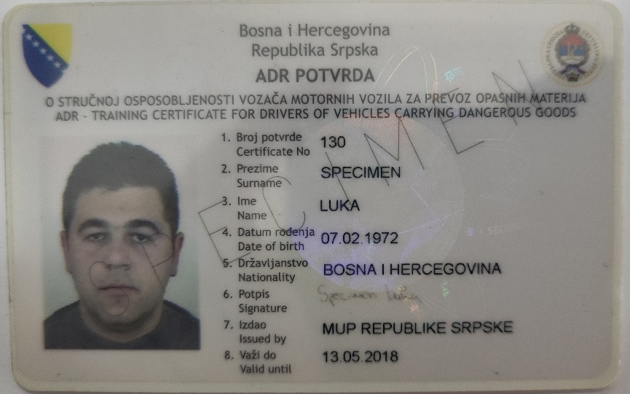
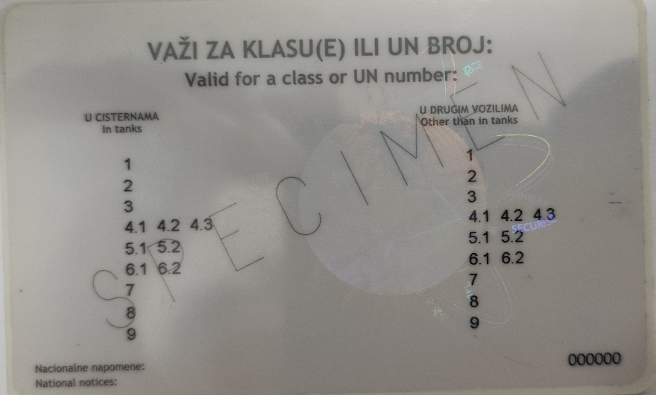
Professional training of drivers
Professional training of drivers in accordance with international agreements performs legal person authorised by the Minister.
Inspection of professional competence of driver is performed by the Ministry and the Ministry issues certificate, which specimen can be find at the internet page
https://unece.org/adr-certificates-0#accordion_7.

Slide 16
Temporary ban, that is termination of transport
In case when other competent authority during the inspection of transport of dangerous materials establish deficiencies that can affect safety of people, property, or environment, it will inform competent inspection and attach data on vehicle and dangerous materials.
Supervision of despatchers, carriers, or recipients
Inspector may, preventively or during the supervision over the transport of dangerous materials, in case of deficiencies, perform supervision of despatchers, carriers or recipients of dangerous materials, or other legal or natural persons that perform activity of transport of dangerous materials.

Slide 17
Entry into the territory of the Republic of Srpska
Police official of the Ministry shall exclude from traffic vehicle registered at the territory of the Federation of Bosnia and Herzegovina, Brčko District of Bosnia and Herzegovina or some other state if he/she establishes infingement of provisions on transport of dangerous materials and shall take other adequate measures, and continuation of transport will be possible after the deficiencies are eliminated.
Legal help
Inspector delivers data on serious and repeated infringements of international agreements to competent organisational unit of the Ministry that exchange data with competent authorities of the Federation of Bosnia and Herzegovina, Brčko District of Bosnia and Herzegovina, or other state where vehicle is registred.
Annual report
Inspectors that perform supervision over the transport of dangerous materials deliver to competent organisational unit of the Ministry annual report on performed inspections for previous year, not later than April of the current year.

Slide 18
SPECIAL PROVISIONS ON TRANSPORT OF DANGEROUS MATERIALS IN RAILWAY TRANSPORT
Types of permitted trains, transport of dangerous materials as hand luggage, reported luggage or vehicles loaded on train
Obligations of despatchers
Obligations of fillers
Obligations of carriers
Obligations of the manager of railway infrastructure
Places of loading, or unloading

Slide 19
SPECIAL PROVISIONS ON TRANSPORT OF DANGEROUS MATERIALS IN INLAND WATERWAYS
Transport in inland waterways
Inspection of loaded cargo
RECORDS
Keeping of records
Records on issued competence certificates for drivers for transport of dangerous materials in road transport is kept by the Ministry.
https://www.vladars.net/sr-SP-Cyrl/vlada/Ministarstva/msv/Documents
Manner of data collection
Data on legal and natural persons that nominated advisor shall be collected based on data delivered to the Ministry of Transport and Communications by those persons.
Ministry of Transport and Communications establishes and keeps cataloque of questions based on performed exams for advisors.

Slide 20
SUPERVISION OF INSPECTION AND OTHER AUTHORITIES
Supervision over the implementation of the Law
Supervision over the implementation of this Law and subacts made based on this Law shall be performed by the Ministry od Transport and Communications and the Ministry in the scope of thier jurisdiction.
Inspection
Inspection of the implementation of this Law shall be performed by competent organisational unit of the Ministry and Republic Administration for Inspection Affairs.
Roadside inspections
Inspection of transport of dangerous materials is performed by inspectors for explosive materials and fire protection in competent organisational units of the Ministry for class 1, and competent inspectors of the Republic Administration for Inspection Affairs for classes 2, 3, 4.1, 4.2, 4.3, 5.1, 5.2, 6.1, 6.2, 8 and 9.

Slide 21
Subjects over which is performed inspection and their obligations
Legal and natural persons over which is performed inspection are obliged to provide to authorised person insight into all subjects related to their actions in implementation of proscribed safety measures during the transport of dangerous materials and attach necessary data and informations on the implementation of this Law, regulations made based on this law and international agreements.
PENALTY PROVISIONS
Infringements of legal persons and contractors
Infringements of natural persons

Slide 22
Adoption of new regulations
Translation and publication of international agreements
Ministry of Transport and Communications secures translation of international agreements and their annexes on one of the official languages in the Republic of Srpska (Serbian language) and publishing on its internet page.
https://www.vladars.net/sr-SP-Cyrl/vlada/Ministarstva/msv/Documents
Published translations :
АДР_2021_Том 1
АДР_2021_Том 2
РИД-2021-Том 1
РИД-2021-Том 2
АДН_2021_Том 1
АДН_2021_ Том 2

Slide 23
THANK YOU FOR YOUR ATTENTION

