Slide 1

BOSNIA AND HERZEGOVINA
Federation of Bosnia and Herzegovina
The law on the transportation of dangerous goods

Slide 2
BOSNIA AND HERZEGOVINA federation of Bosnia and Herzegovina
The Law on the Transportation of dangerous goods regulates the conditions under which the transport of different categories of dangerous goods and actions related to the same are carried out (preparation of materials for transportation, loading and unloading and incidental manipulations) as well as the supervision of the implementation of this law
The goal of this law is to enable the safe transportation of dangerous goods in order to protect the health and property of people and the environment

Slide 3
BOSNIA AND HERZEGOVINA federation of Bosnia and Herzegovina
Anticipated classes of dangerous substances determined by this law:
Class 1a - explosive substances
Class 1b - Items filled with explosive substances
Class 1c - Igniters, fireworks and other items
Class 2 - Compressed gases, liquefied gases and gases dissolved under pressure
Class 3 - Flammable liquids
Class 4.1 - Flammable solids

Slide 4
BOSNIA AND HERZEGOVINA federation of Bosnia and Herzegovina
Class 4.2 - Substances prone to spontaneous combustion
Class 4.3 - Materials that in contact with water develop flammable gases
Class 5.1- Oxidizing substances
Class 5.2 - Organic peroxides
Class 6.1 - Toxins
Class 6.2 - Nasty and infectious substances
Class 7 - Radioactive substances

Slide 5
BOSNIA AND HERZEGOVINA federation of Bosnia and Herzegovina
Class 8 - Corrosive substances
Class 9 - Other dangerous substances
The law foresees common safety measures for all dangerous substances or for certain types of these substances and they relate to packaging, loading and unloading and transportation and special safety measures for the transport of certain types of dangerous substances (explosive substances, gases, flammable liquids, poisons, radioactive matter)

Slide 6
BOSNIA AND HERZEGOVINA federation of Bosnia and Herzegovina
Special safety measures have been established for the transportation of dangerous goods by branch of traffic (road traffic, rail traffic, inland waterways, maritime traffic, air traffic, postal traffic)
In addition to the law, there is also a regulation on the method of transporting dangerous goods in road traffic
The aforementioned rulebook regulates the preparation of dangerous goods for transport, vehicles for the transport of dangerous goods, documents for the transport of dangerous goods, special safety measures, procedures in the event of a traffic accident, measures of competent authorities for issuing approvals for the transport of dangerous goods, monitoring measures in the transport of dangerous goods

Slide 7
BOSNIA AND HERZEGOVINA federation of Bosnia and Herzegovina
Rulebook on the professional training of drivers of motor vehicles transporting dangerous substances and other persons participating in the transportation of such substances
The training is intended for persons who transport dangerous substances, receive dangerous substances for transport, load or unload dangerous substances, and supervise or organize work related to the transport of dangerous substances, according to the international agreement ADR (International certificate IRU Academy Geneva and license of the Ministry of Interior)

Slide 8
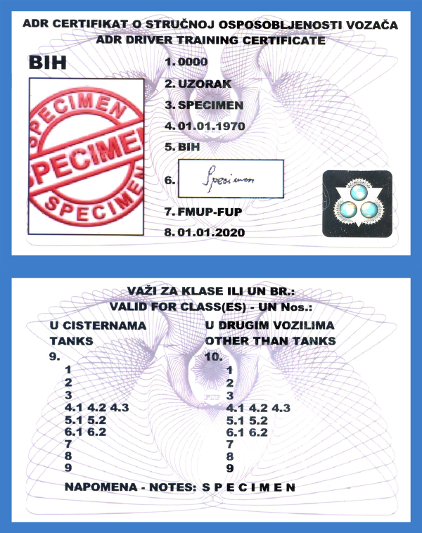
BOSNIA AND HERZEGOVINA federation of Bosnia and Herzegovina
ADR Driver training certificate

Slide 9
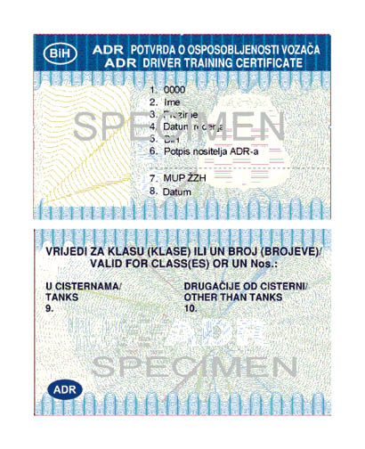
BOSNIA AND HERZEGOVINA federation of Bosnia and Herzegovina
ADR Driver training certificate

