Slide 1

LAW
ON TRANSPORT OF DANGEROUS GOODS
OF REPUBLIKA SRPSKA
RULEBOOK
ON INFRINGEMENTS OF PROVISIONS ON TRANSPORT OF DANGERОUS GOODS

Slide 2
Infringements of provisions on the transport of dangerous goods
Infringements of provisions on the transport of dangerous goods shall be classified into three categories.
Category I infringement is a high-level risk infringement,
Category II infringement is a medium-level risk infringement, and
Category III infringement is a low-risk level infringement.
RS Ministry of Interior defined infringements according to the risk categories – Rulebook on the infringements of the provisions on the transport of dangerous goods (“Official Gazette of RS“, 7/17).

Slide 3
This Rulebook defines infringements of the provisions on the transport of dangerous goods in accordance with the confirmed international agreements and contracts:
European Agreement Concerning the International Carriage of Dangerous Goods by Road-ADR, together with the integral parts thereof, Annexes A and B, and the Notification Act, shall apply to the transport of dangerous goods by road.
Convention concerning International Carriage by Rail-COTIF, and the Regulation concerning the International Carriage of Dangerous Goods by Rail-RID, shall apply to the transport of dangerous goods by rail.
European Agreement Concerning the International Carriage of Dangerous Goods by Inland Waterways-АDN, including relevant Annexes and amendments thereof, shall apply to the transport of dangerous goods by inland waterways.
and by-laws adopted under the Law, according to the risk level of occurrence of consequences in the transport of dangerous goods.

Slide 4
Under the Law, infringements of the dangerous goods transport rules shall be classified into three categories, as follows:
Category I infringement is an infringement creating a high-level risk a of death, serious personal injuries or significant damage to the environment (hereinafter referred to as: Category I),
Category II infringement is an infringement creating a medium-level risk of serious bodily injury to a person or substantial pollution of the environment, as well as of the environmental pollution over a large area (hereinafter referred to as: Category II), and
Category III infringement is an infringement creating a low-level risk of minor bodily injuries to a person or insignificant pollution of the environment (hereinafter referred to as: Category III).

Slide 5
The category I infringement in transport of dangerous goods by road shall exist if:
The dangerous goods being carried are forbidden for transport,
There was a leakage of dangerous substance,
Dangerous goods are transported in a way that is forbidden or by inappropriate means of transport,
Bulk goods are transported in containers not complying with technical and construction requirements,
Transport is carried out by a vehicle without appropriate certificate of approval for vehicle carrying certain dangerous goods (АDR Certificate),
Using a vehicle no longer complying with the approval requirements, thus presenting an immediate danger,
Non-approved packaging is used,
The packaging does not conform to applicable packing instruction,
The special provisions for mixed packing are not complied with,
Failing to act in compliance with the rules for the stowage and securing of the load and for mixed loading of packages.

Slide 6
The category I infringement in transport of dangerous goods by road shall exist if:
the maximum permitted degree of filling of tanks or packages have not been complied with,
the provisions limiting the quantities of load to be transported per transport unit have not been complied with,
transport of dangerous goods is carried out without any indication of their presence (for example, documents, marking and labelling on the packages, placarding, and marking on the vehicle),
transport of dangerous goods is performed without any placarding and marking on the vehicle,
Information enabling determination of a category I danger is missing in documentation (for example, UN number, proper shipping name, packing group),
there is no valid driver certificate,
fire or an unprotected light is being used, and
the ban on smoking is not being observed.

Slide 7
The Category II infringement in the transport of dangerous goods shall exist if:
A vehicle is composed of more than one trailer/semitrailer,
Required authorizations for a vehicle have expired and the vehicle fails to comply with the dangerous goods transport requirements but poses no immediate danger,
Vehicle is not fitted with a properly functioning fire extinguishers, as required: a fire extinguisher may be considered to function properly if a mandatory seal and/or validity date are missing, except in case when it is evident that a fire extinguisher is not functioning properly any more, i.e. pressure gauge reads “0“ value,
A vehicle is not fitted with the equipment required by the ADR or a written instruction,
Time limits with regard to using, testing and inspection of packaging, IBCs or large packagings have expired,
A package in a damaged packaging, IBS or large packaging, or a damaged uncleaned empty packaging are used.

Slide 8
The Category II infringement in the transport of dangerous goods shall exist if:
Packed goods are transported in the container not suitable by the virtue of its construction for that purpose,
Tanks/tanks-containers are improperly closed (including the empty or uncleaned ones)
A combination packaging with an improperly closed outer packaging is being transported,
A transport unit, packaging or package features improper and misplaced marks, labels and placards,
Written instructions in accordance with the ADR are missing or the existing written instructions are not compatible with the type of goods being transported, and
A vehicle is inadequately supervised or improperly parked.

Slide 9
The Category III infringement in transport of dangerous goods by road shall exist if:
The size of placards or labels or the size of letters, figures or symbols on placards or labels does not comply with regulations,
Information in the transport document other than that in the risk category I/(2) is not available , and
The ADR training certificate is not on board the vehicle but there is evidence that the driver holds it.

Slide 10
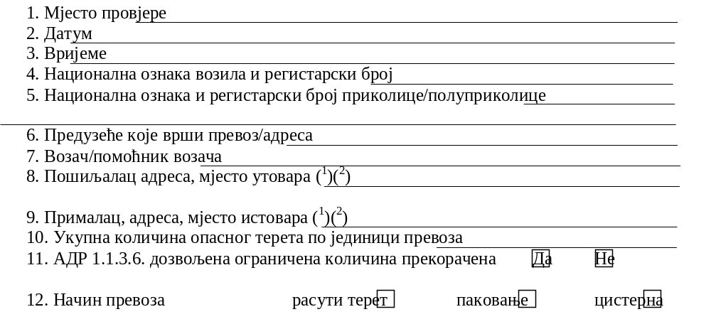
LIST TO DETERMINE INFRINGEMENTS OF ROAD TRANSPORT REGULATIONS
Документи о возилу

Slide 11
13. Transport document | ◻ Inspected | ◻ Infringement established | ◻ Not applicable
14. Iinstructions in writing | ◻ Inspected | ◻ Infringement established | ◻ Not applicable
15. Bilateral/multilateral agreement/national authorization | ◻ Inspected | ◻ Infringement established | ◻ Not applicable
16. ADR certificate for vehicle | ◻ Inspected | ◻ Infringement established | ◻ Not applicable
17. ADR certificate for driver | ◻ Inspected | ◻ Infringement established | ◻ Not applicable

Slide 12

18. Goods authorized for transport | ◻Inspected | ◻ Infringement established | ◻ Not applicable
19. Vehicle authorized for goods carried | ◻Inspected | ◻ Infringement established | ◻Not applicable
20. Provisions related to the mode of transport/bulk, package, tank) | ◻Inspected | ◻ Infringement established | ◻Not applicable
21. Mixed loading prohibition | ◻Inspected | ◻ Infringement established | ◻Not applicable
22. Loading, securing of the load and handling (3) | ◻Inspected | ◻ Infringement established | ◻Not applicable
23. Leakage of goods or damage to package (3) | ◻Inspected | ◻ Infringement established | ◻Not applicable
24. UN packaging number/UN tank marking (2)(3) (ADR 6) | ◻Inspected | ◻ Infringement established | ◻Not applicable
25. Package marking (e.g UN no.) and labelling (2) (ADR 5.2) | ◻Inspected | ◻ Infringement established | ◻Not applicable
26. Tank/vehicle placarding (ADR 5.3.1) | ◻Inspected | ◻ Infringement established | ◻Not applicable
27. Vehicle/transport unit marking(orange plate, elev. temperature) (ADR 5.3.2-3) | ◻Inspected | ◻ Infringement established | ◻Not applicable
28. General purpose safety equipment specified in ADR | ◻Inspected | ◻ Infringement established | ◻Not applicable

Slide 13
29. Equipment according to the goods carried | ◻Inspected | ◻Infringement established | ◻ Not applicable
30. Other equipment specified in the instructions in writing | ◻Inspected | ◻Infringement established | ◻ Not applicable
31. Fire extinguisher(s) | ◻Inspected | ◻Infringement established | ◻ Not applicable
32. The most serious risk category of established infringement of regulations, if any | Category I | Category II | Category III
Vehicle equipment
Remarks
Authority/Officer having carried out the inspection
(1) To be filled in only if relevant for an infringement
(2) To be stated under „remarks“ for groupage transport operations
(3) Check of visible violations

Slide 14
1. Place of check
2. Date
3. Time
4. Vehicle nationality mark and registration number
5. Trailer/Semitrailer nationality mark and registration number
6. Undertaking carrying out transport/address
7. Driver/driver‘s assistant
8. Consignor, address, place of loading (1)(2)
9. Consignee, address, place of unloading (1)(2)
10. Total quantity of dangerous goods per transport unit
11. ADR 1.1.3.6. quantity limit exceeded Yes No
12. Mode of transport in bulk package tank
Documents onboard
13. Transport document • Inspected • infringement established • not applicable
14. Instructions in writing • Inspected • infringement established • not applicable
15. Bilateral/multilateral
agreement/national authorization • Inspected • infringement established • not applicable
16. ADR certificate for vehicle • Inspected • infringement established • not applicable
17. ADR certificate for driver • Inspected • infringement established • not applicable
Transport activities
18. Goods authorized for transport •Inspected • infringement established • not applicable
19. Vehicle authorized for goods •Inspected • infringement established •not applicable
carried

Slide 15
20. Provisions related to the mode of transport /in bulk, package, tank)
• Inspected • infringement established • not applicable
21. Mixed loading prohibition
• Inspected • infringement established • not applicable
22. Loading, securing of the load and handling (3)
• Inspected • infringement established • not applicable
Leakage of goods or damage to package (3)
• Inspected • infringement established • not applicable
24. UN packaging number/UN tank marking (2)(3) (ADR 6)
• Inspected • infringement established • not applicable
25. Package marking ( e.g.UN no.) and labelling (2) (ADR 5.2)
• Inspected • infringement established • not applicable
26. Tank/vehicle placarding(ADR 5.3.1)
• Inspected • infringement established • not applicable
27. Vehicle/transport unit marking (orange plate, elev. temperature) (ADR 5.3.2-3)
• Inspected • infringement established • not applicable
28. General purpose safety equipment specified in ADR
• Inspected • infringement established • not applicable
29. Equipment according to the goods carried
• Inspected • infringement established • not applicable
30. Other equipment specified in the instructions in writing
• Inspected • infringement established • not applicable
31. Fire extinguisher(s)
• Inspected • infringement established • not applicable
32. The most serious risk category of established infringement of regulations, if any
Category I Category II Category III

Slide 16
Infringements of provisions related to the transport of dangerous goods referred to Articles 3 to 5 of this Rulebook shall be determined according to the lists included in ANNEXES
Infringements in the field of inland waterway transport and rail transport have also been determined:
  Category I infringement in transport of dangerous goods by inland waterways
  Category I infringement in transport of dangerous goods by rail
  Category II infringement in transport of dangerous goods by inland waterways
  Category II infringement in transport of dangerous goods by rail
  Category III infringement in transport of dangerous goods by inland waterways
  Category III infringement in transport of dangerous goods by rail.

Slide 17
THANK YOU FOR YOUR ATTENTION

