Slide 1

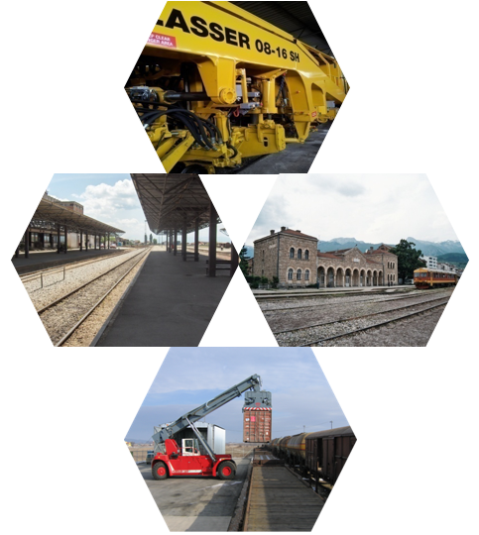
Kosovo Railways Infrastructure – INFRAKOS J.S.C
Marking 150 YEARS
OF RAILWAYS IN KOSOVO
19/03/2024
InfraKos
Naser Krasniqi, CEO

Slide 2
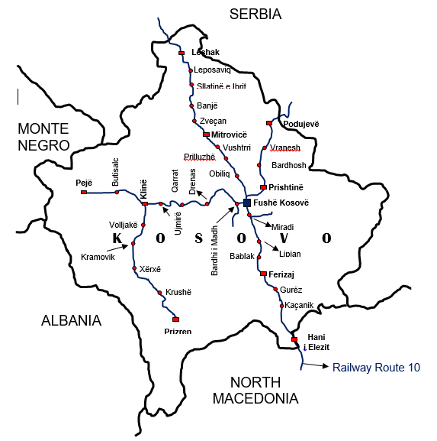
Short history
The first railway line in Kosovo was built in 1874 in the Hani i Elezit - Mitrovica route
Later on, the construction of other lines continued, so that in 1963 the construction of the entire railway network of Kosovo had been completed.
The Kosovo railway network spans the entire territory of Kosovo in a length of 333,451 km.

Slide 3
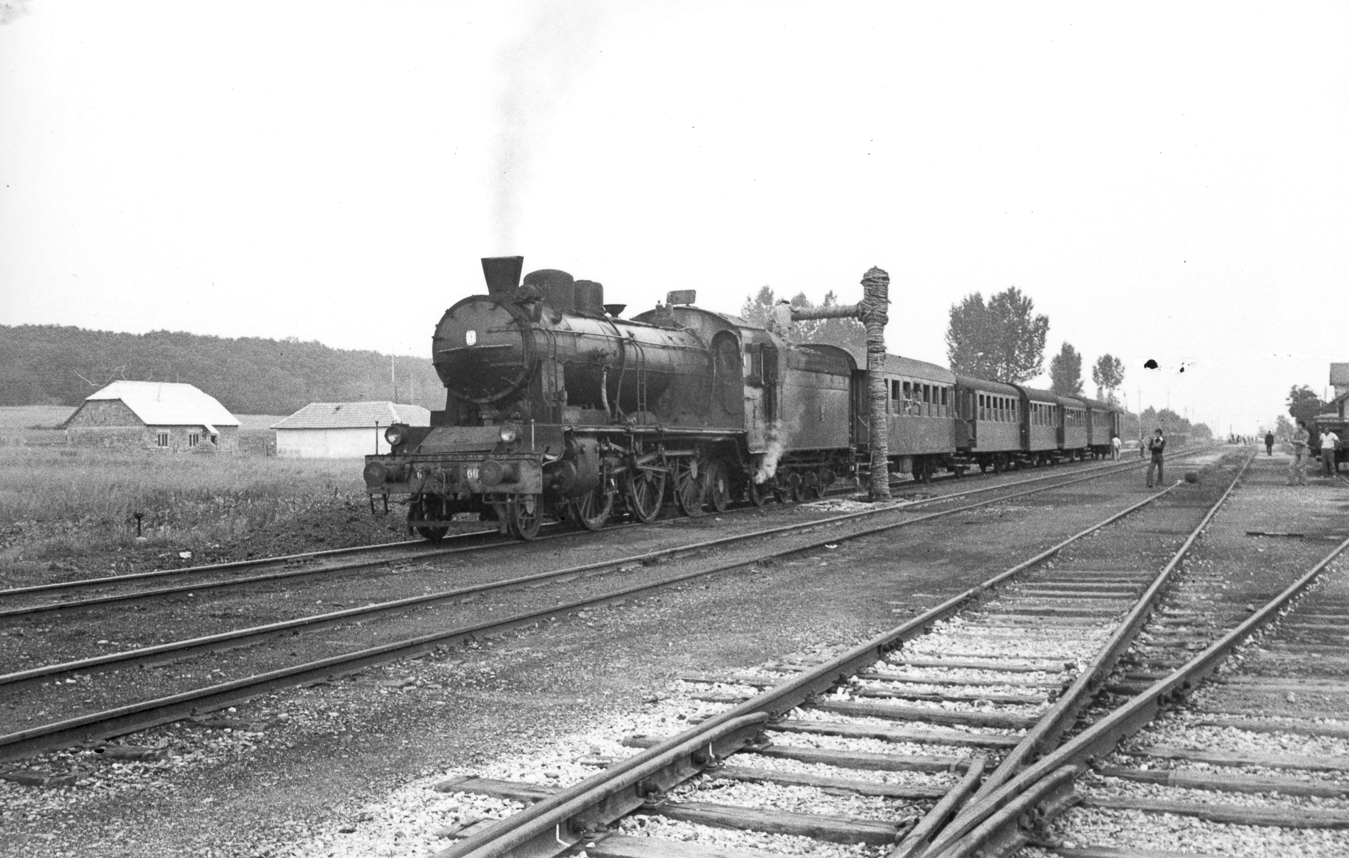
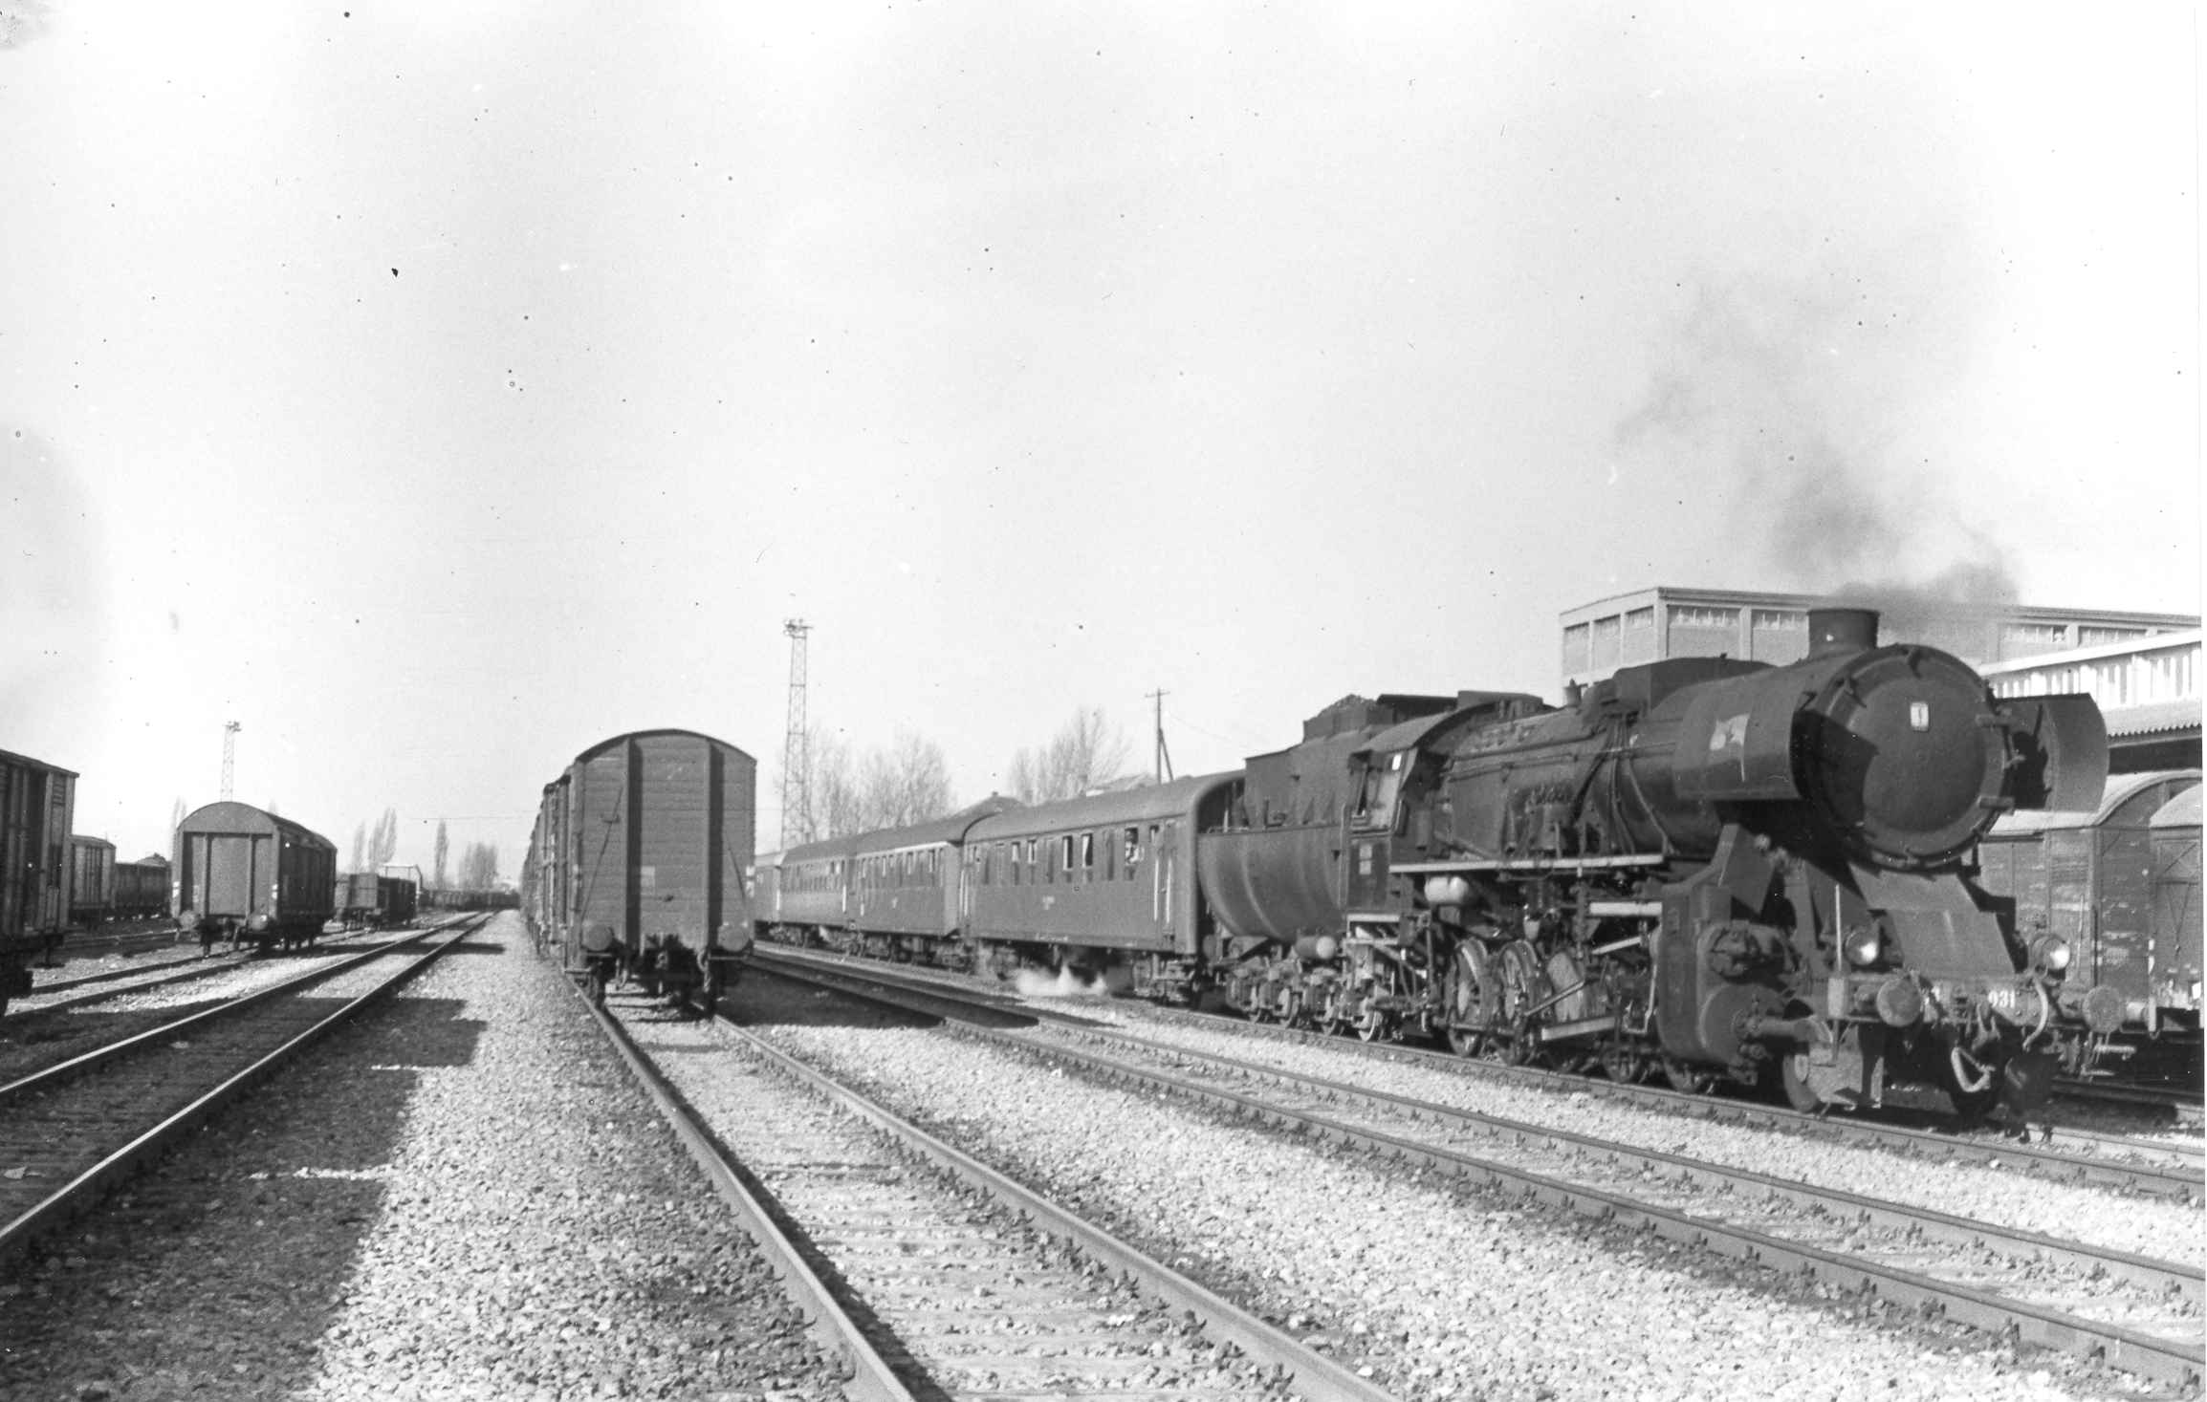
The past
The most difficult period for railways has been the decade of the 90s when the exploitation of these railways took place without performing the required investment in their maintenance and
The period of war when a good part of infrastructure was damaged.

Slide 4
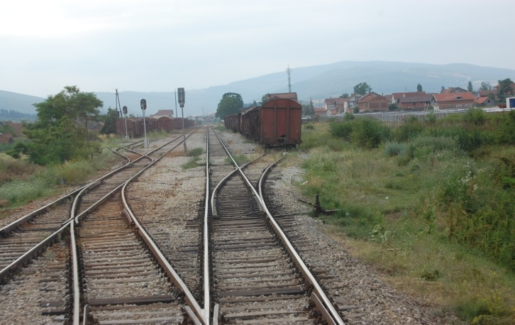
Situation after 1999
In year 1999, The railway network of Kosovo Railways was in a very bad condition;
Thanks to international community and investments from the Kosovo Government Budget, the situation has changed and is significantly better, however, not satisfactory;

Slide 5
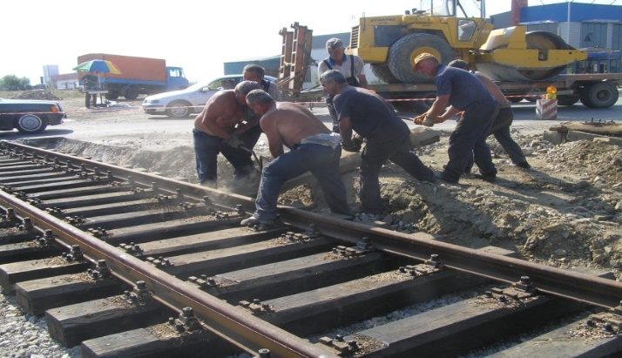
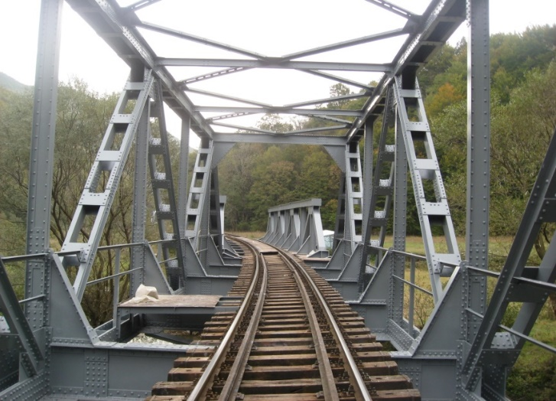
Situation after 1999
The emergent rehabilitation and insertion of railway main tracks to function (Leshak – Hani i Elezit, Prishtine – Peje, Kline – Xerxe and Bardh - Magure).
Retrofitting and rehabilitations in bridges in all railway lines, in order to protect them from corrosion, as well as rehabilitation of culverts (underpasses) throughout the entire railway lines.

Slide 6
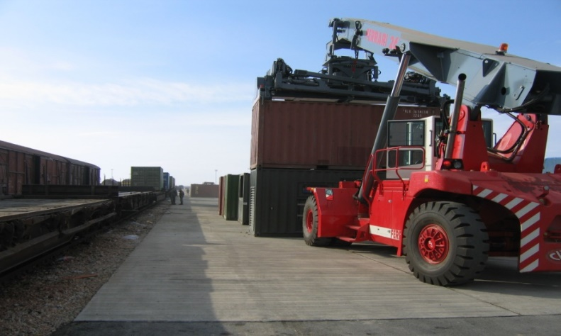
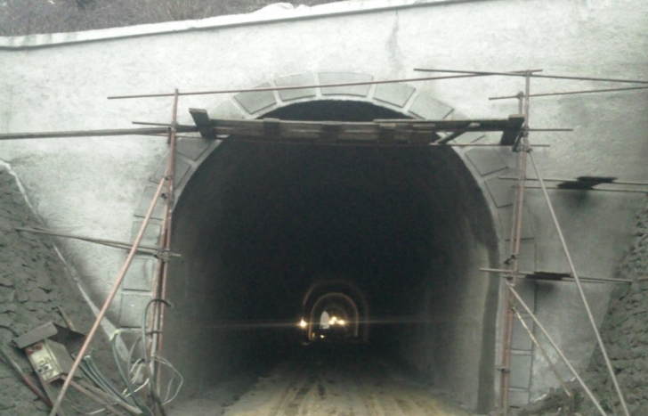
Key projects after year 1999
Construction of intermodal freight terminal at Miradi station.
Rehabilitation and extension of Gajre tunnel at Kaçanik gorge which was in a very bad condition due to landslide from the ceiling and the side walls.

Slide 7
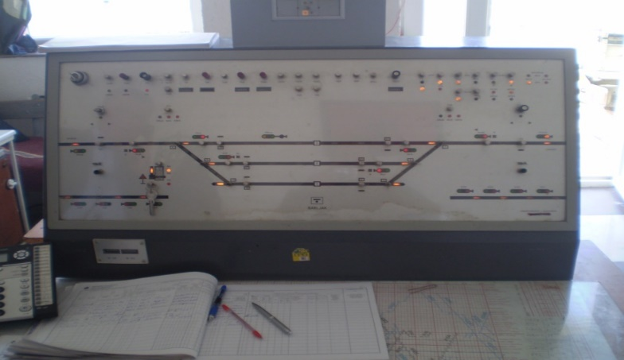
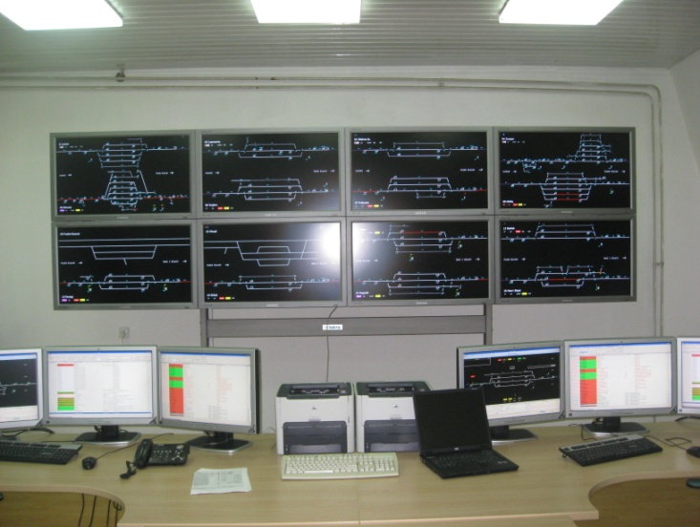
Key projects after year 1999
Rehabilitation and upgrading of signaling-interlocking equipment to function (through which the railway traffic regulation is performed) in all the stations of railway line Leshak – Fushe Kosove – Hani i Elezit
The Central Train Control system (CTC) for the line Mitrovice – Hani i Elezit, which is one of the most significant projects of the railway infrastructure, through which the train traffic in this line is being maneuvered and controlled by the center in Fushe Kosove.

Slide 8
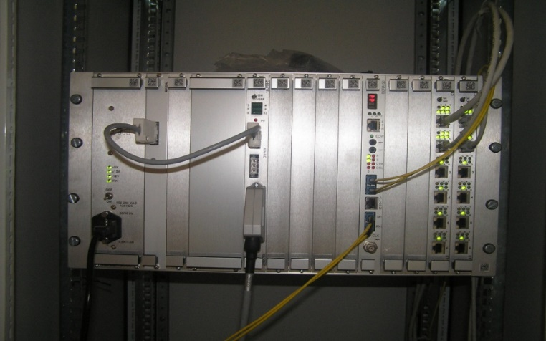
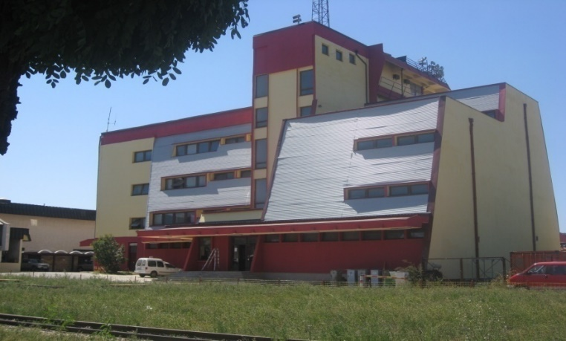
Key projects after year 1999
Cable routing and mounting of optical devices through which different information is transferred and the phone communication between the stations with the center is enabled.
Construction of radio-sets system through which the radio communication is covered between the railway stations, loco drivers and the CTC center in Fushe Kosove.

Slide 9
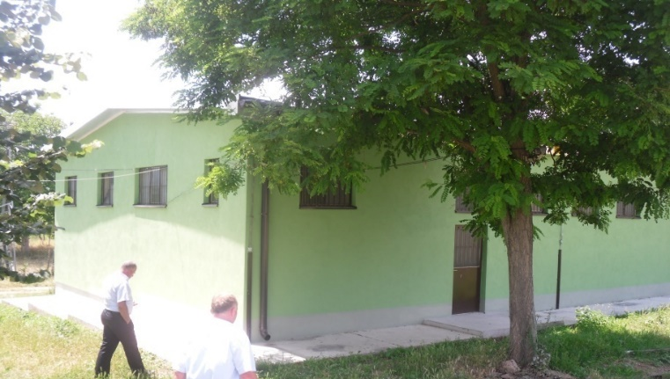
Key projects after year 1999
Rehabilitation of all buildings in which are placed the signaling, telecommunication and energy equipment at the Railway line 10 stations.

Slide 10
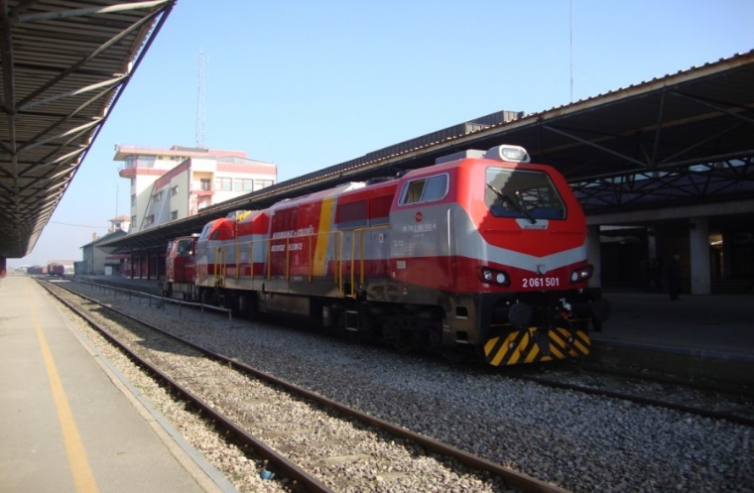
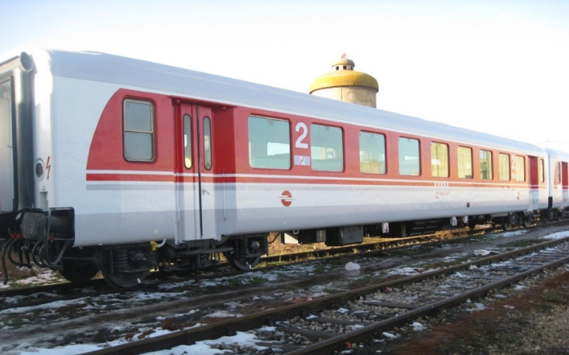
Key projects after year 1999
Rehabilitation of the locomotives that were out of function and which carried out the freight and passenger transport since year 1999
Rehabilitation of the second hand passenger wagons obtained as donation from Sweden and Austria and which carried out the freight and passenger transport since year 1999

Slide 11
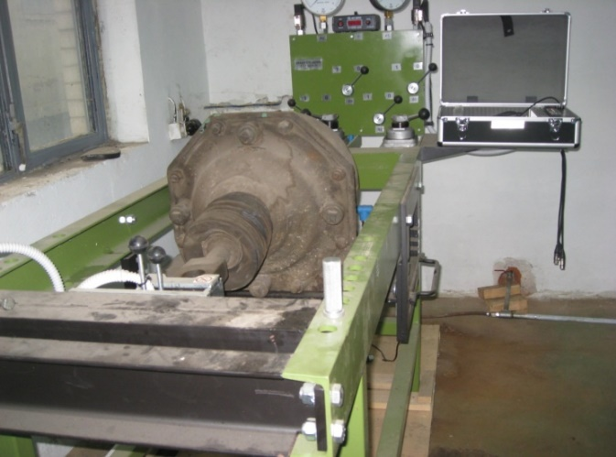
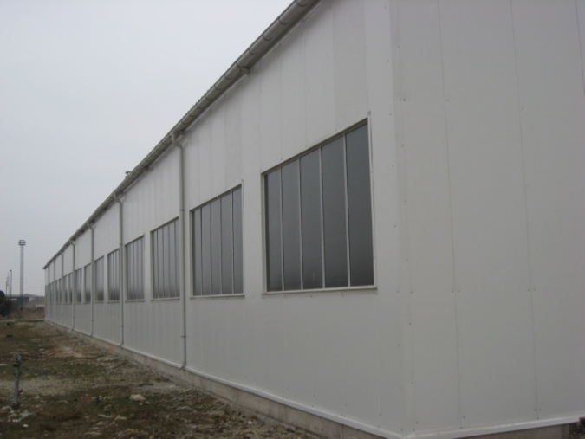
Key projects after year 1999
Purchase of modern electronic devices for testing of freight and passenger wagons. The measurement of certain wagon components is being done in order to carry out required interventions in eventual elimination of deficiencies
Construction of the new storage for maintenance of diesel train units and rehabilitation of workshops for maintenance of locomotives and wagons.

Slide 12
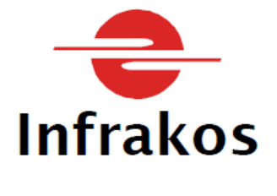

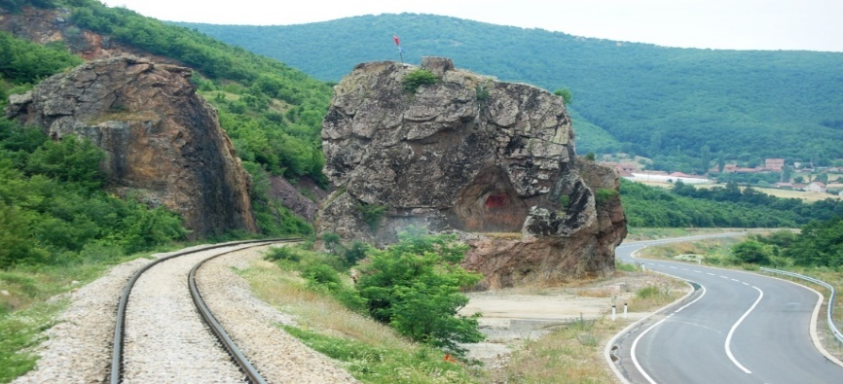
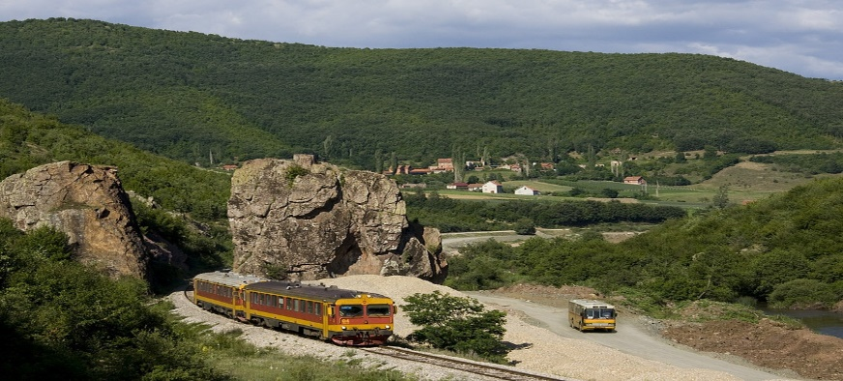
SEPERATION OF KOSOVO RAILWAYS
With the Kosovo Government decision dated 01.09.2011, the separation of Kosovo Railways J.S.C. into two new entities, has ben carried out
Kosovo Railways Infrastructure JSC – INFRAKOS
Kosovo Railways Train operation JSC - TRAINKOS

Slide 13
INFRAKOS, 2011-2024
Since the establishment and until today INFRAKOS went through major challenges, such as:
Lack of financial means required for rehabilitation of infrastructure;
Lack of investments required by the government and international financial institutions;
Damages and theft to infrastructure by irresponsible individuals.

Slide 14
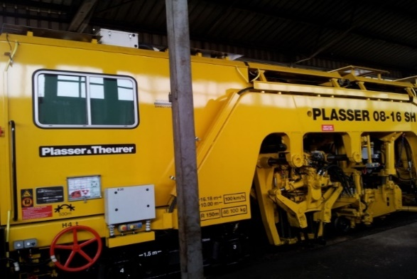
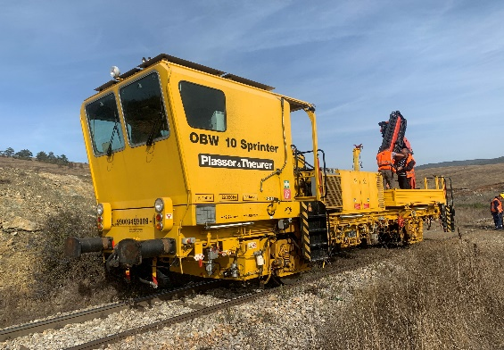
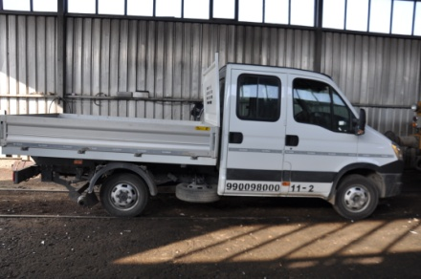
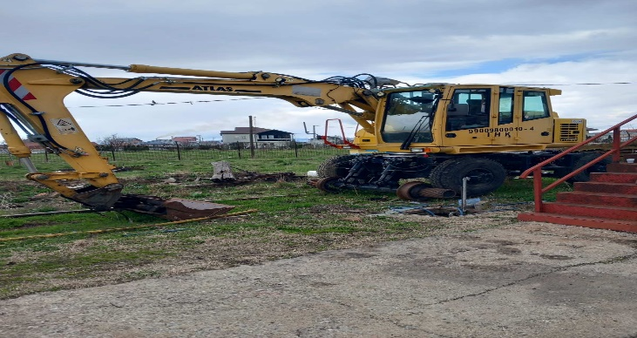
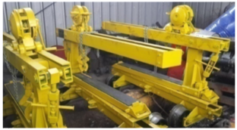
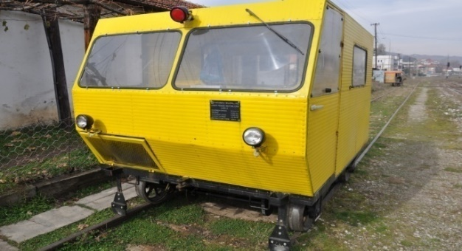
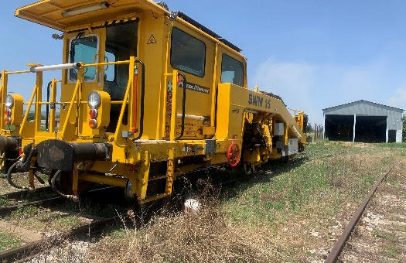
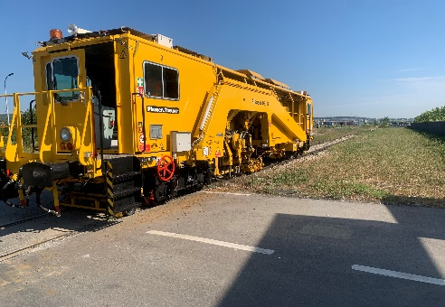
The key achievements after year 2011
New assets for maintenance of railway infrastructure

Slide 15
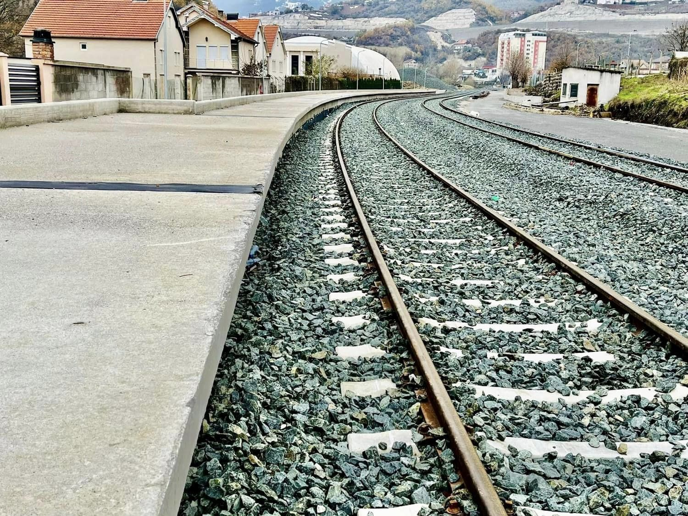
Key achievements
Extension of railway line 10 rehabilitation segment Fushe Kosove – Hani i Elezit border with North Macedonia, around 67 km.

Slide 16
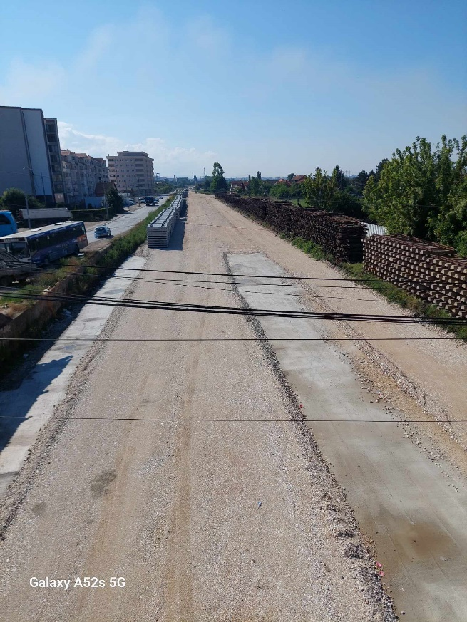
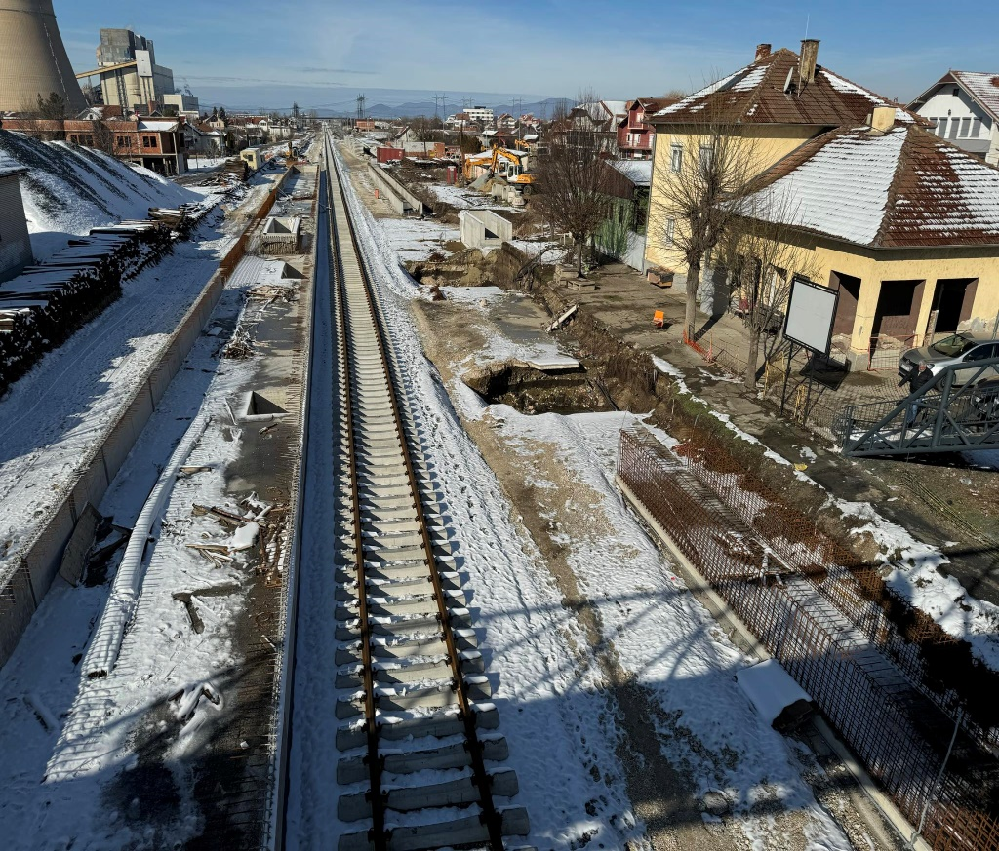
Key achievements
The works of second phase for the rehabilitation of railway line 10 have started on the segment Fushe Kosove – Mitrovice, 34.4km, in order to be modern and competitive.

Slide 17
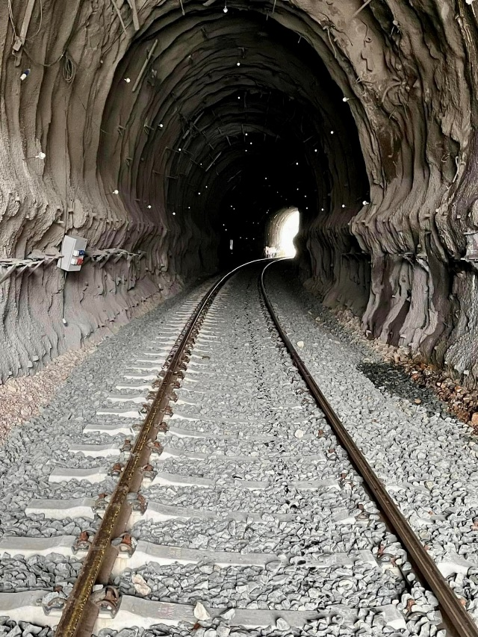
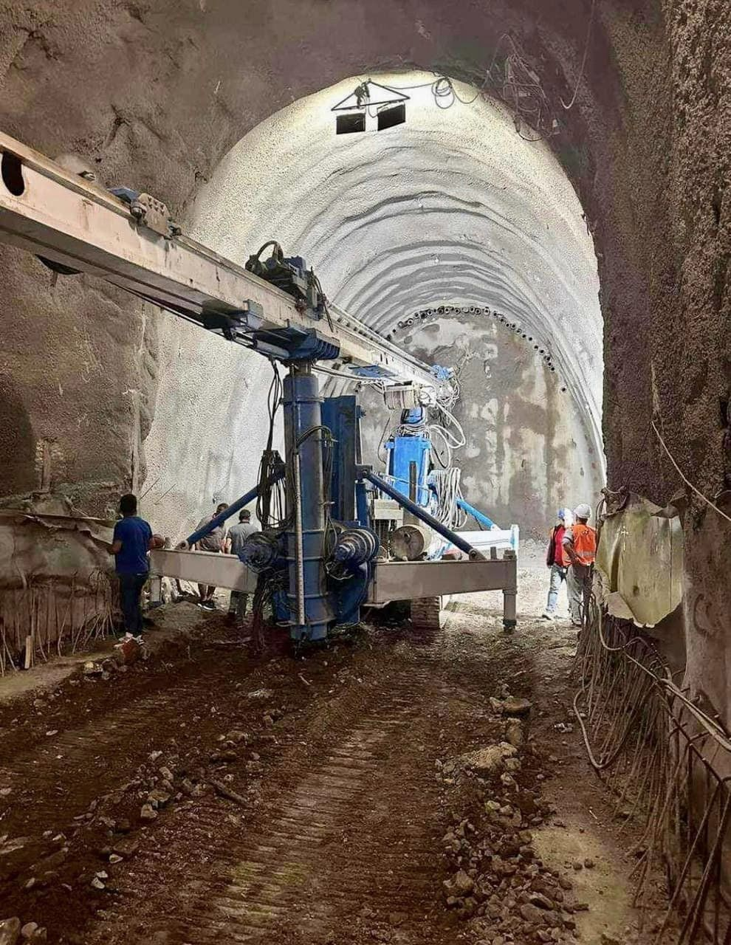
Key achievements
The opening of tunnel 6 with length 262m and tunnel 7 with length 122m, which were completely collapsed, has been carried out as well as the re-opening of railway segment Hani i Elezit – Fushe Kosove as part of railway line 10 Hani i Elezit – Leshak.

Slide 18
Key achievements
The Framework Agreement for Railway Infrastructure Funding has been signed for the first time for the period 2023-2027, which has been a lawful obligation since 2011.
The feasibility study and the project-idea has started for the railway link Durres – Prishtine.
Terms of Reference were drafted for the compilation of Preliminary Project Design for the Rehabilitation and Modernization of Railway Lines Fushe Kosove – Peje and Kline – Prizren, a project that is expected to begin this year.

Slide 19
DEVELOPMENT PROJECTS – PRIORITY LIST OF RAILWAY PROJECTS
No. | Projects | Estimated costs € | Weighted score
1 | General Rehabilitation and Modernization of the Railway Route 10 (Border with Serbia - Leshak - Fushe Kosove - Hani i Elezit - Border with North Macedonia); 149.11 Km. | 323,765,000.00 | 84
2 | General Rehabilitation and Modernization of the Railway Route 7 (Border with Serbia - Podujeve - Fushe Kosove); 45.198 Km. | 146,485,000.00 | 74
3 | Construction of the new railway line (Kosovo - Albania) with a length of 30 Km. in Kosovo part | 95,703,000.00 | 74
4 | Construction of the Dry Port Pristina (Inland Port for Cargo Distribution Hub) | 30,000,000.00 | 70

Slide 20
DEVELOPMENT PROJECTS – PRIORITY LIST OF RAILWAY PROJECTS
No. | Projects | Estimated costs € | Weightedscore
5 | Construction and modernization of a Railway Line Pristina - Fushe Kosove - Pristina Airport “Adem Jashari”; 16.872 Km. | 37,881,000.00 | 68
6 | General Rehabilitation and Modernization of the Western Railway Line (Fushe Kosove -Klinë - Pejë); 81.94 Km. | 261,395,000.00 | 64
7 | General Rehabilitation and Modernization of the South/West Railway Line (Kline - Prizren); 58.831 Km. | 187,675,000.00 | 64
8 | Construction of the new railway line (Ferizaj – Gjilan - Border with Serbia - Bujanovac) with a length of 59 Km. in Kosovo part. | 188,215,000.00 | 54
9 | Construction of the new railway line Kramovik (Kosovo) - Gjakove (Kosovo), 20 Km. | 63,802,000.00 | 52
TOTAL INVESTMENT
1,334,921,000.00

Slide 21
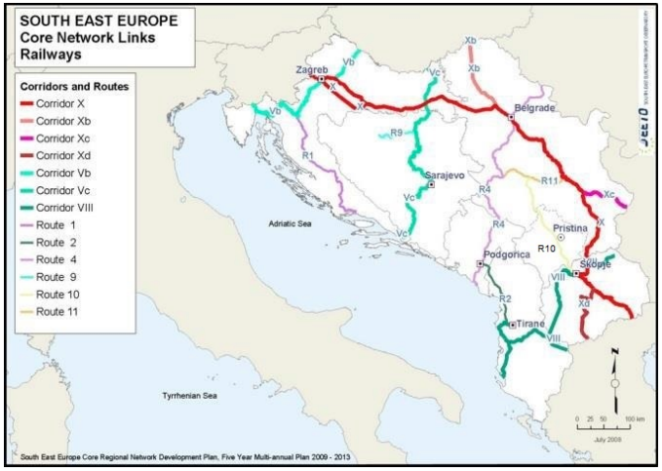
THE FUTURE OF INFRAKOS
INFRAKOS expects for the Kosovo Railway Network to be part of the European Integrated Network therefore it seeks the support of the Government of the Republic of Kosovo to achieve the Multimodal Transport Strategy 2023-2030.

Slide 22
Thank you for your
attention!

