Slide 1




Progress meeting
Marjan Dimec, Ivan Ristić
Pristina, 19th March 2024

Slide 2
Agenda
Overview of previous activities
Plans for the next project stages
Task 2 - Site visits (main findings)
Task 3 - Assessment of the current situation of the level crossings
Task 3 - Analysis of the risk level on level crossings
Task 3 - Final grouping of the level crossings
Plans for the next project stages
Open issues to be solved (discussed)

Slide 3
Overview
Task 1: Inception report and Development of an appropriate methodology
  Inception report - accepted
Task 2: Data collection and site visit for determining the current situation of the level crossings
  Summary report – submitted / in review
Task 3: Assessment of the current situation of the level crossings
  Summary report – submitted / in review
Task 4: Preparation of “matrix based” technical specification
  Matrix-based technical specification
Task 5: Preparation of Procurement Documents
  Compiled Administrative & Technical Parts
Task 6: Preparation of Final Report
  Final Report
Bosnia and Hercegovina: 25 (12 in Federation BiH and 13 in Republika Srpska)
Kosovo*: 21
Montenegro: 5
North Macedonia: 20
Serbia: 63

Slide 4
Task 2 – Site Visits
After confirmation of the final lists of level crossings (LC), the Consultant’s representatives conducted site visits and collected information on LCs.
Visited locations by Regional Partners were the following:
Albania: 3
Bosnia and Hercegovina: 25 (12 in Federation BiH and 13 in Republika Srpska)
Kosovo*: 21
Montenegro: 5
North Macedonia: 20
Serbia: 65
All together 139 LCs

Slide 5
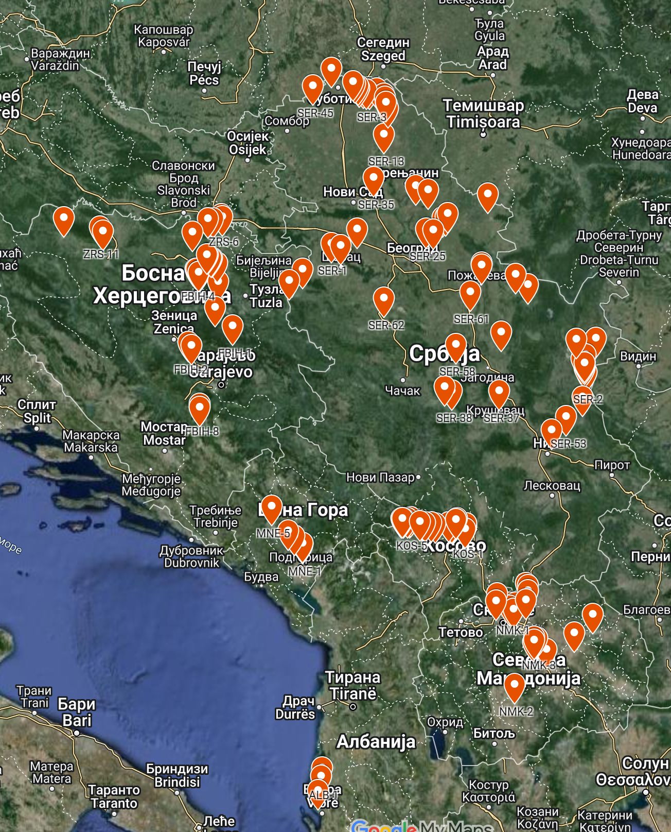
Task 2 – Site Visits
Interactive map of the visited LCs:
https://www.google.com/maps/d/u/0/edit?mid=1RL017HDgs_gylKS5UGC6ceWCjHM61j0&usp=sharing

Slide 6
Task 2 – Site Visits
The main findings during site visits can be summarized as follows:
Albania: no detailed provisions on the design and positioning of traffic lights and (half) barriers can be found in the current regulations;
Bosnia and Herzegovina: according to national regulations, if the corresponding road is parallel to the railway line at a distance of less than 8 meters, there must be a corresponding dependence between the LC interlocking device and semaphore device regulating the road traffic;
Kosovo*: During the site visits, the question of laying down the fibre optical cable for video surveillance on LCs was raised. Also, due to the narrowness and bad conditions of some of the roads on LCs, there will be a need for their reconstruction, not only within the railway land but also further away from the LC ;
Montenegro: The Consultant proposes to keep the existing rubber panels on LCs since they are in a very good state;

Slide 7
Task 2 – Site Visits
The main findings during site visits can be summarized as follows:
North Macedonia: Modernization of the railway line Tabanovce-Gevgelija is predicted through a separate project (including new station interlocking devices and ETCS system), so in further activities, there will be a need for a close collaboration between the Consultant, MZI and designers of this dedicated project, to incorporate the LC designs into the prospective signalling system;
Serbia: One LC in Serbia could not be found on the location due to the non-existence of the corresponding road (namely LC SER-46), and one due to the non-existence of the railway line (namely LC SER-56). The IZS representatives confirmed the intention to install new type of road warning signals (light semaphores with two lamps-red and yellow). The corresponding national regulations regarding this issue are not yet fully adopted.

Slide 8
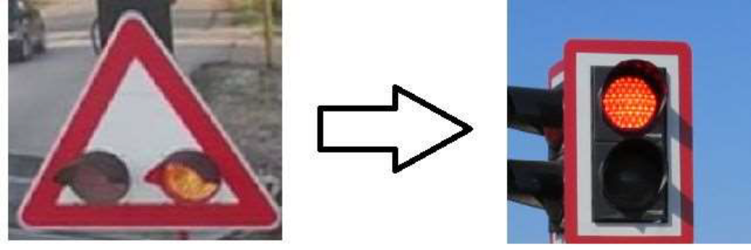
Task 2 – Site visits
In the Inception Phase, the Consultant collected the final lists of level crossings (LC) from Regional Partners for survey and further processing.
Some of the priorities for LCs were updated compared to the initial rankings defined by TCT.
Also, the initial project methodology submitted in the tender stage was updated with new elements that came into force subsequently (for example, a legal change of road warning signal layout in Serbia).

Slide 9
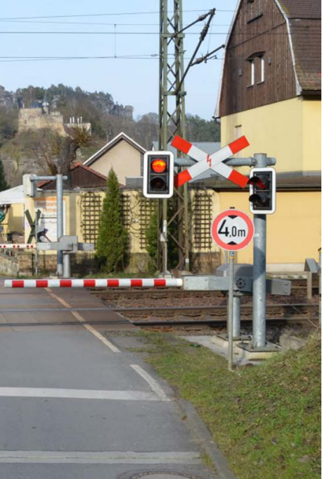
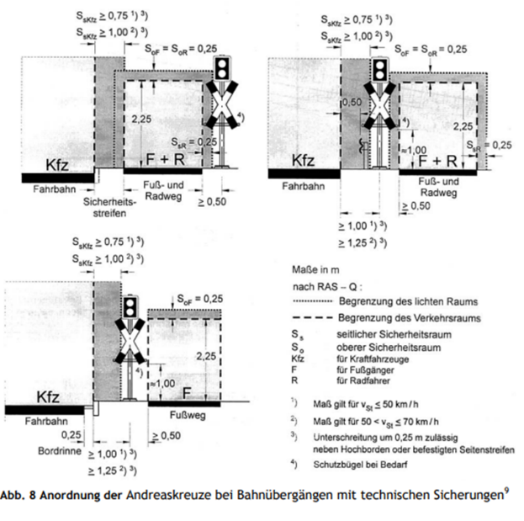
Task 2 – Site visits
Proposal for new road warning signal layout based on the regulations from DB (for Serbia only):

Slide 10
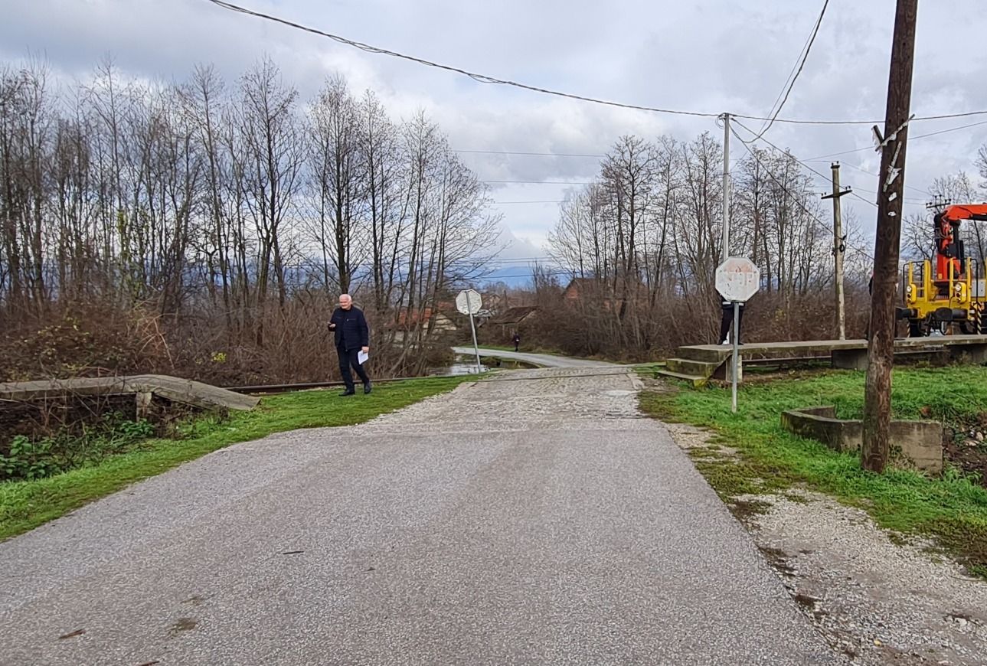
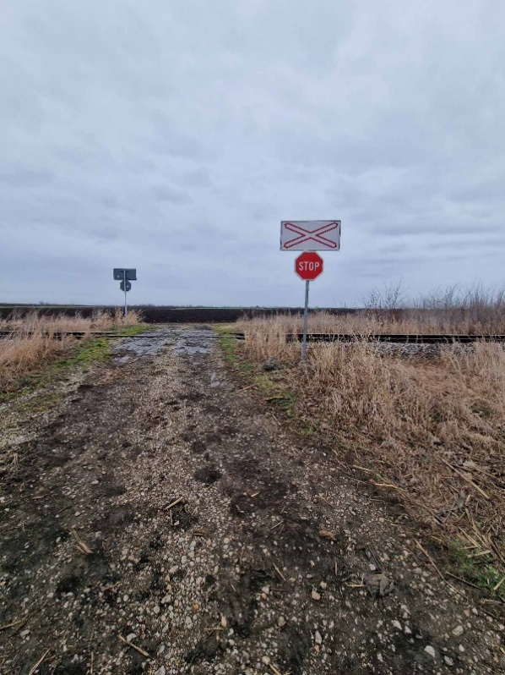
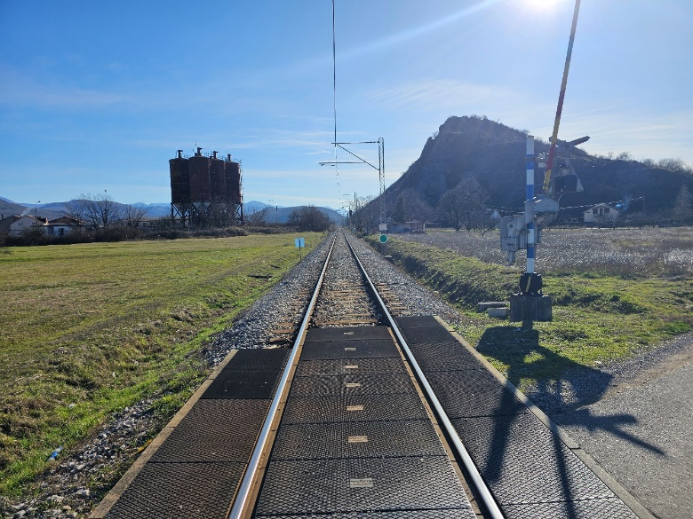
Task 2 – Site Visits (typical photos)
Example of LC in km 70+395 (KOS-3) in Kosovo* with a narrow road
Example of LC in km 38+417 (SER-28) in Serbia with the corresponding access road
Example of LC in km 42+908 (MNE-3) in Montenegro with a rubber panel in a very good state

Slide 11
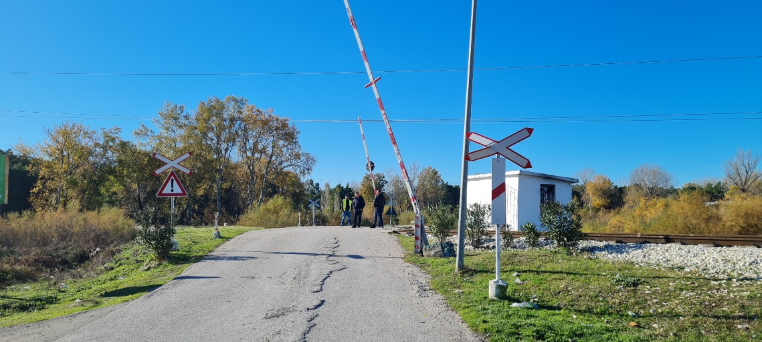
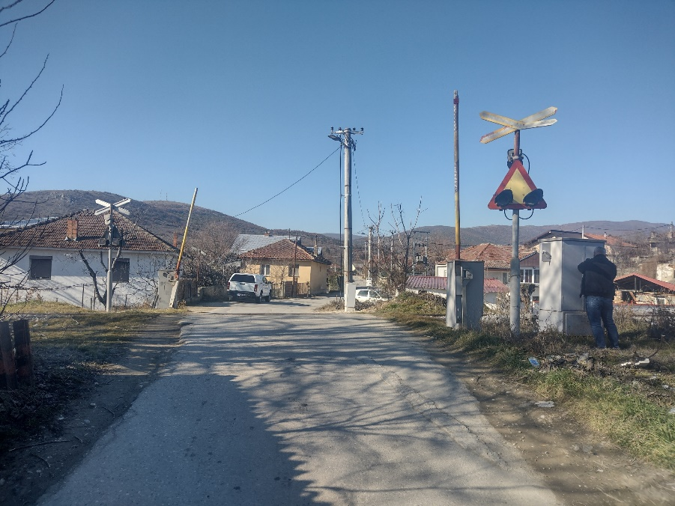
Task 2 – Site Visits (typical photos)
Example of LC in km 114+975 (ALB-3) in Albania with full barriers
Example of LC in km 323+015 (NMK-15) in North Macedonia on Corridor X with road signals only

Slide 12
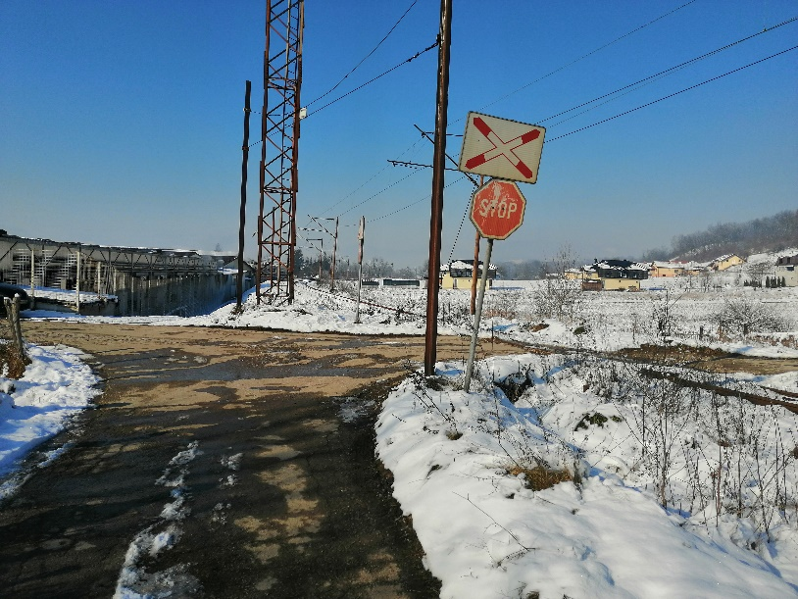
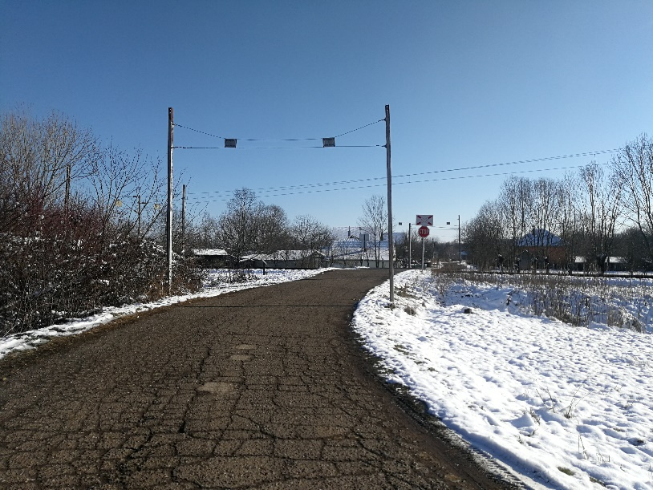
Task 2 – Site Visits (typical photos)
Example of LC in km 223+245 (FBIH-3) in Bosnia and Herzegovina (FBIH) with access road in proximity of railway line
Example of LC in km 32+279 (ZRS-6) in Bosnia and Herzegovina (ZRS) with protective gates

Slide 13
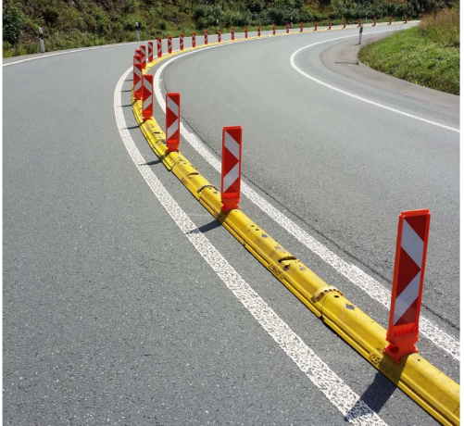
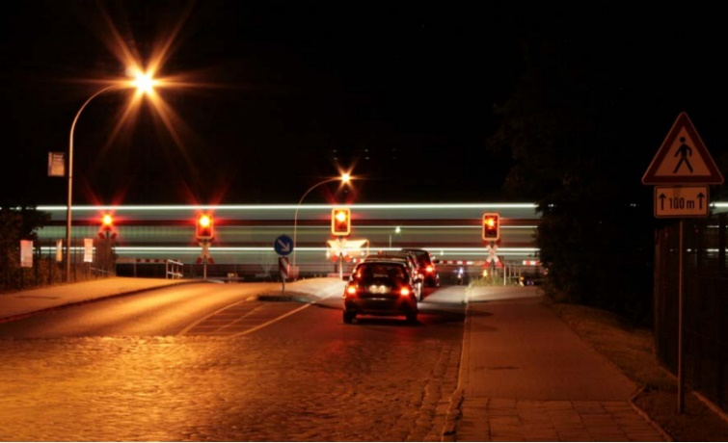
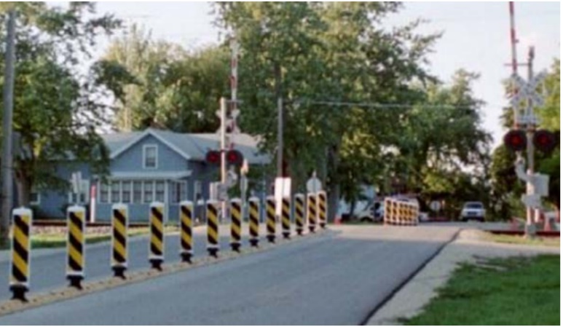
Task 2 – Site Visits (noticed problems)
One of the common problems noticed during site visits is the behaviour of the car drivers when passing between the lowered half-barriers. This can be mitigated in the designed state using the following tools:

Slide 14
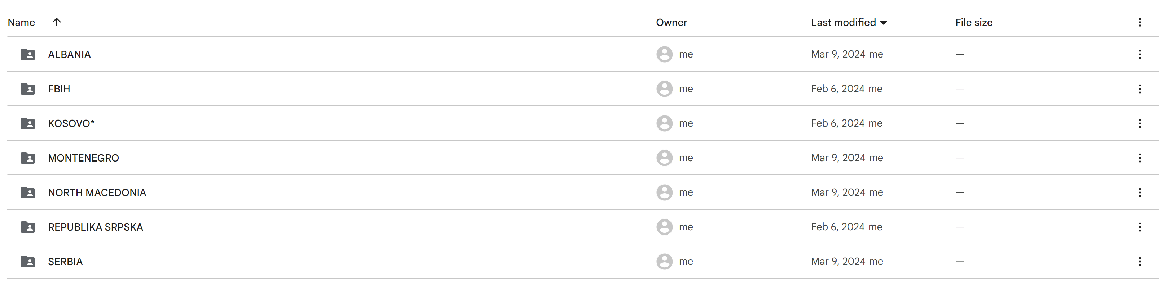
Task 3 – Assessment of the current situation of the level crossings
After collecting and storing data from site visits, the Consultant identified risk levels and prepared the final grouping of the level crossings based on their technical needs for improvement.
All collected data (photos and questionnaires) were stored on the Consultant’s user portal. The access to the portal will be made available to TCT and Regional Partners for further review:

Slide 15
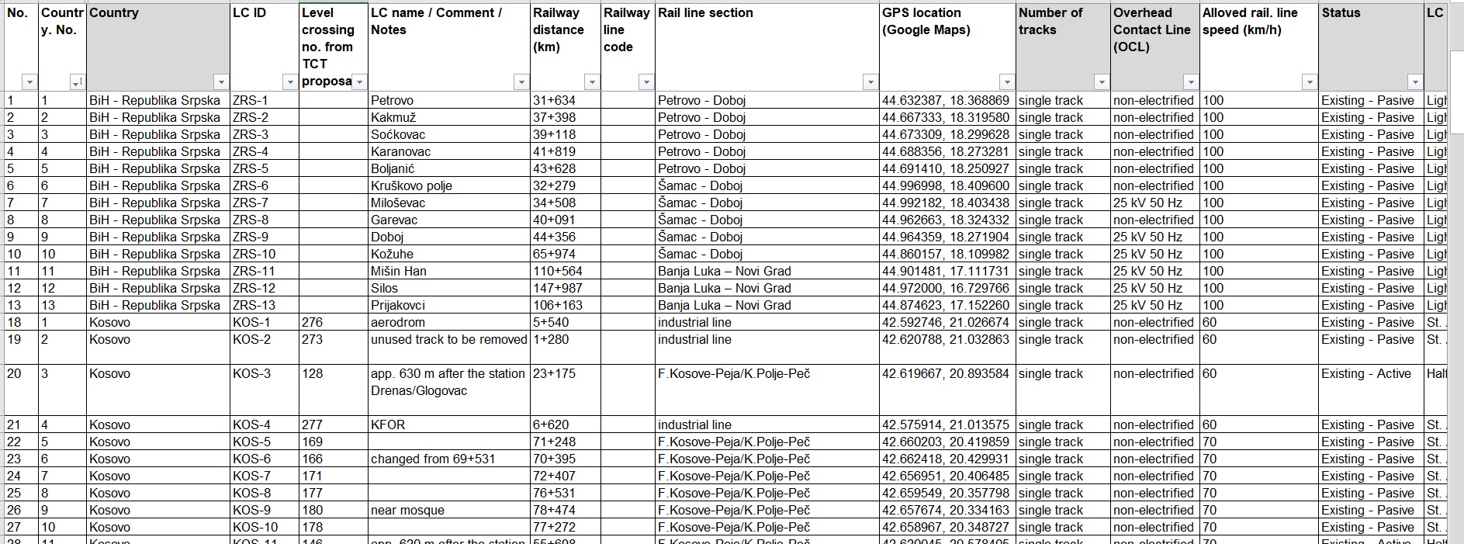
Task 3 – Assessment of the current situation of the level crossings
All collected data for visited LCs are also systematically entered into the database containing all necessary information:

Slide 16
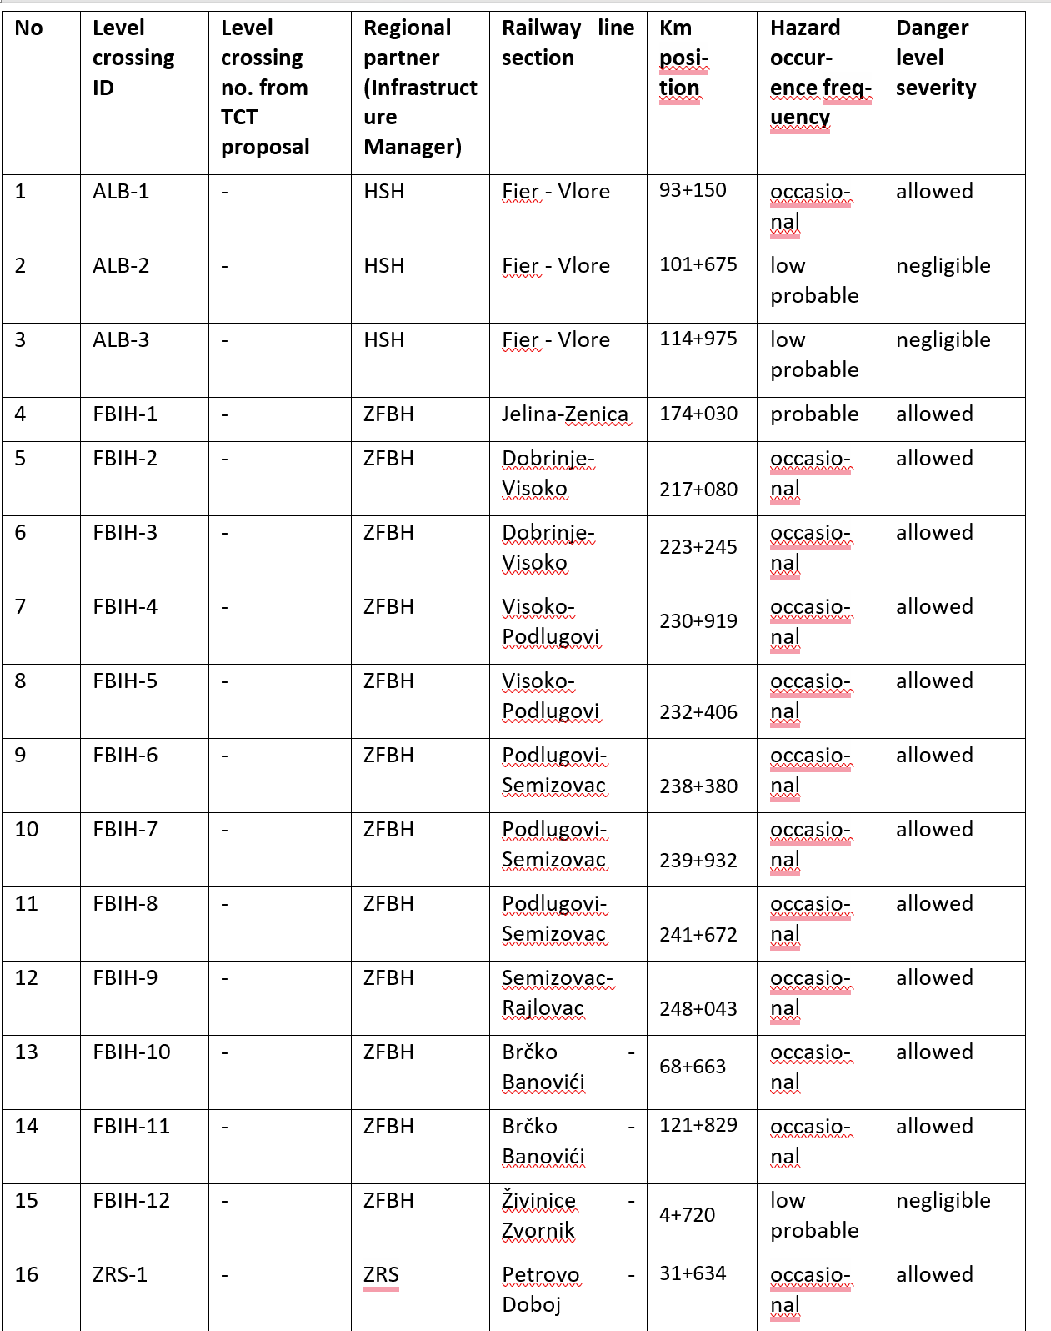
Task 3 – Analysis of the risk level on level crossings
Based on the collected information and processing of the relevant data, the corresponding hazardous event risk level was assigned to each LC:

Slide 17
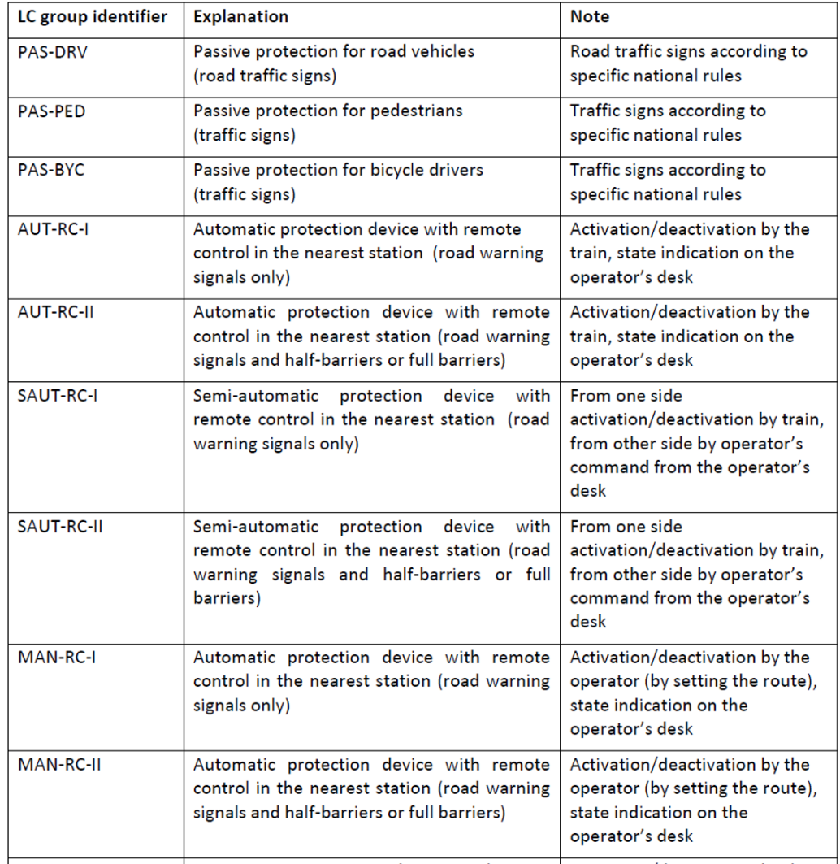
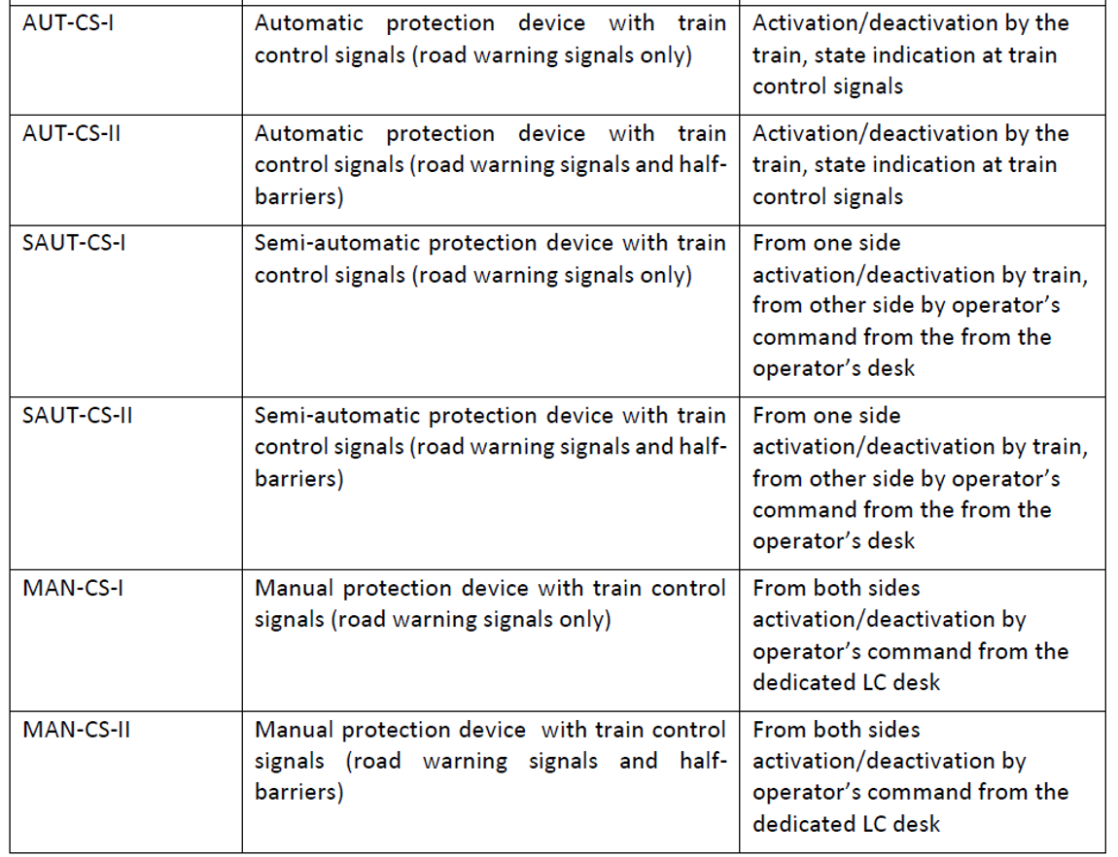
Task 3 – Final grouping of the level crossings
Finally, based on the previous considerations, the Consultant proposed all possible groups of designed LC solutions and allocated the corresponding grouping for each individual LC, by Regional Partners:

Slide 18
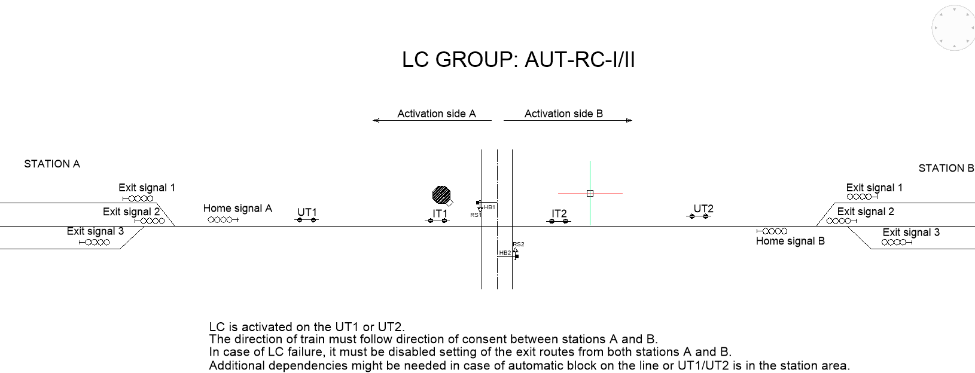
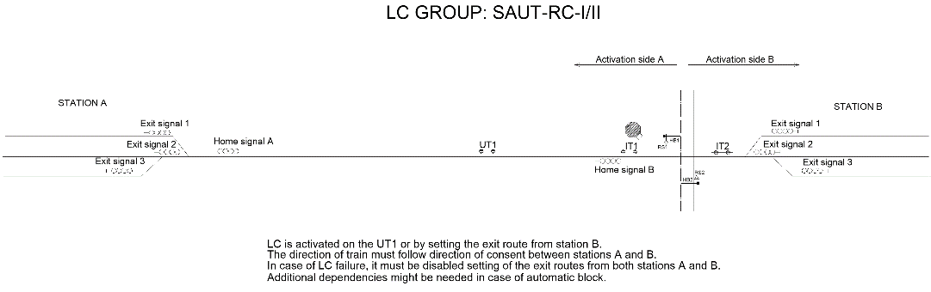
Task 3 – Final grouping of the level crossings

Slide 19
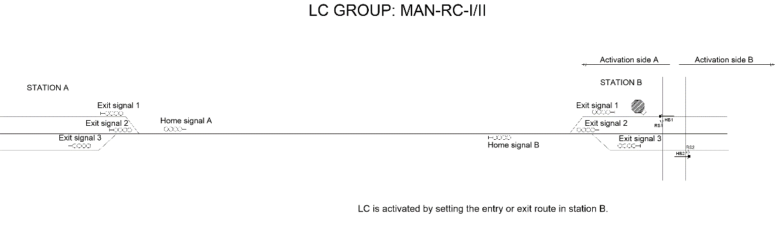
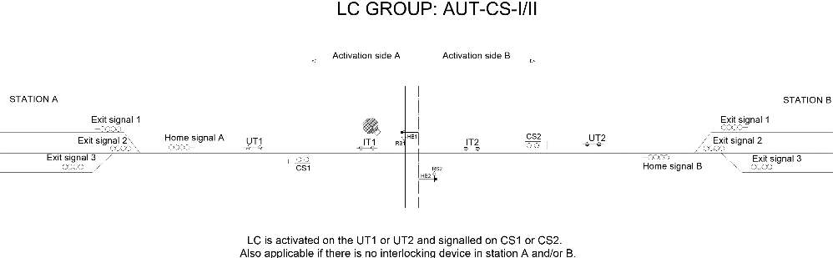
Task 3 – Final grouping of the level crossings

Slide 20
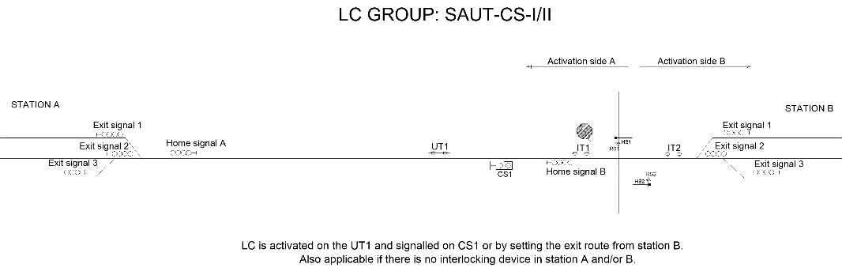
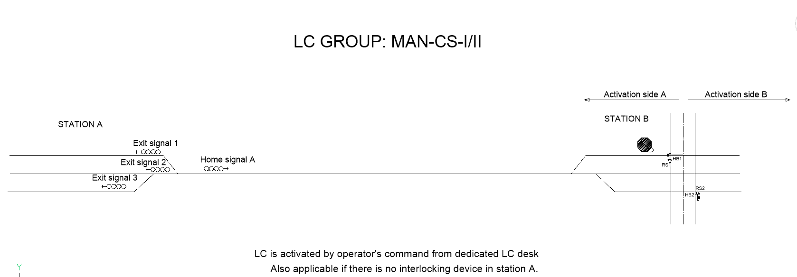
Task 3 – Final grouping of the level crossings

Slide 21
2. Plans for the next project stages
In the following period, the Consultant will share with Regional Partners deliverables from Task 2 and Task 3 for further review and comments.
The Consultant emphasizes the necessity of final approval of proposals given in the deliverables within the Task 3 before proceeding to activities in the Task 4.
After receiving approvals from TCT and Regional Partners on previous deliverables within Tasks 2 and 3, the Consultant will prepare the following for each Regional Partner:
Standardized technical specifications for equipment and works;
Corresponding basic drawings (for each specific LC category);
Bills of Quantities with Cost Estimates.

Slide 22
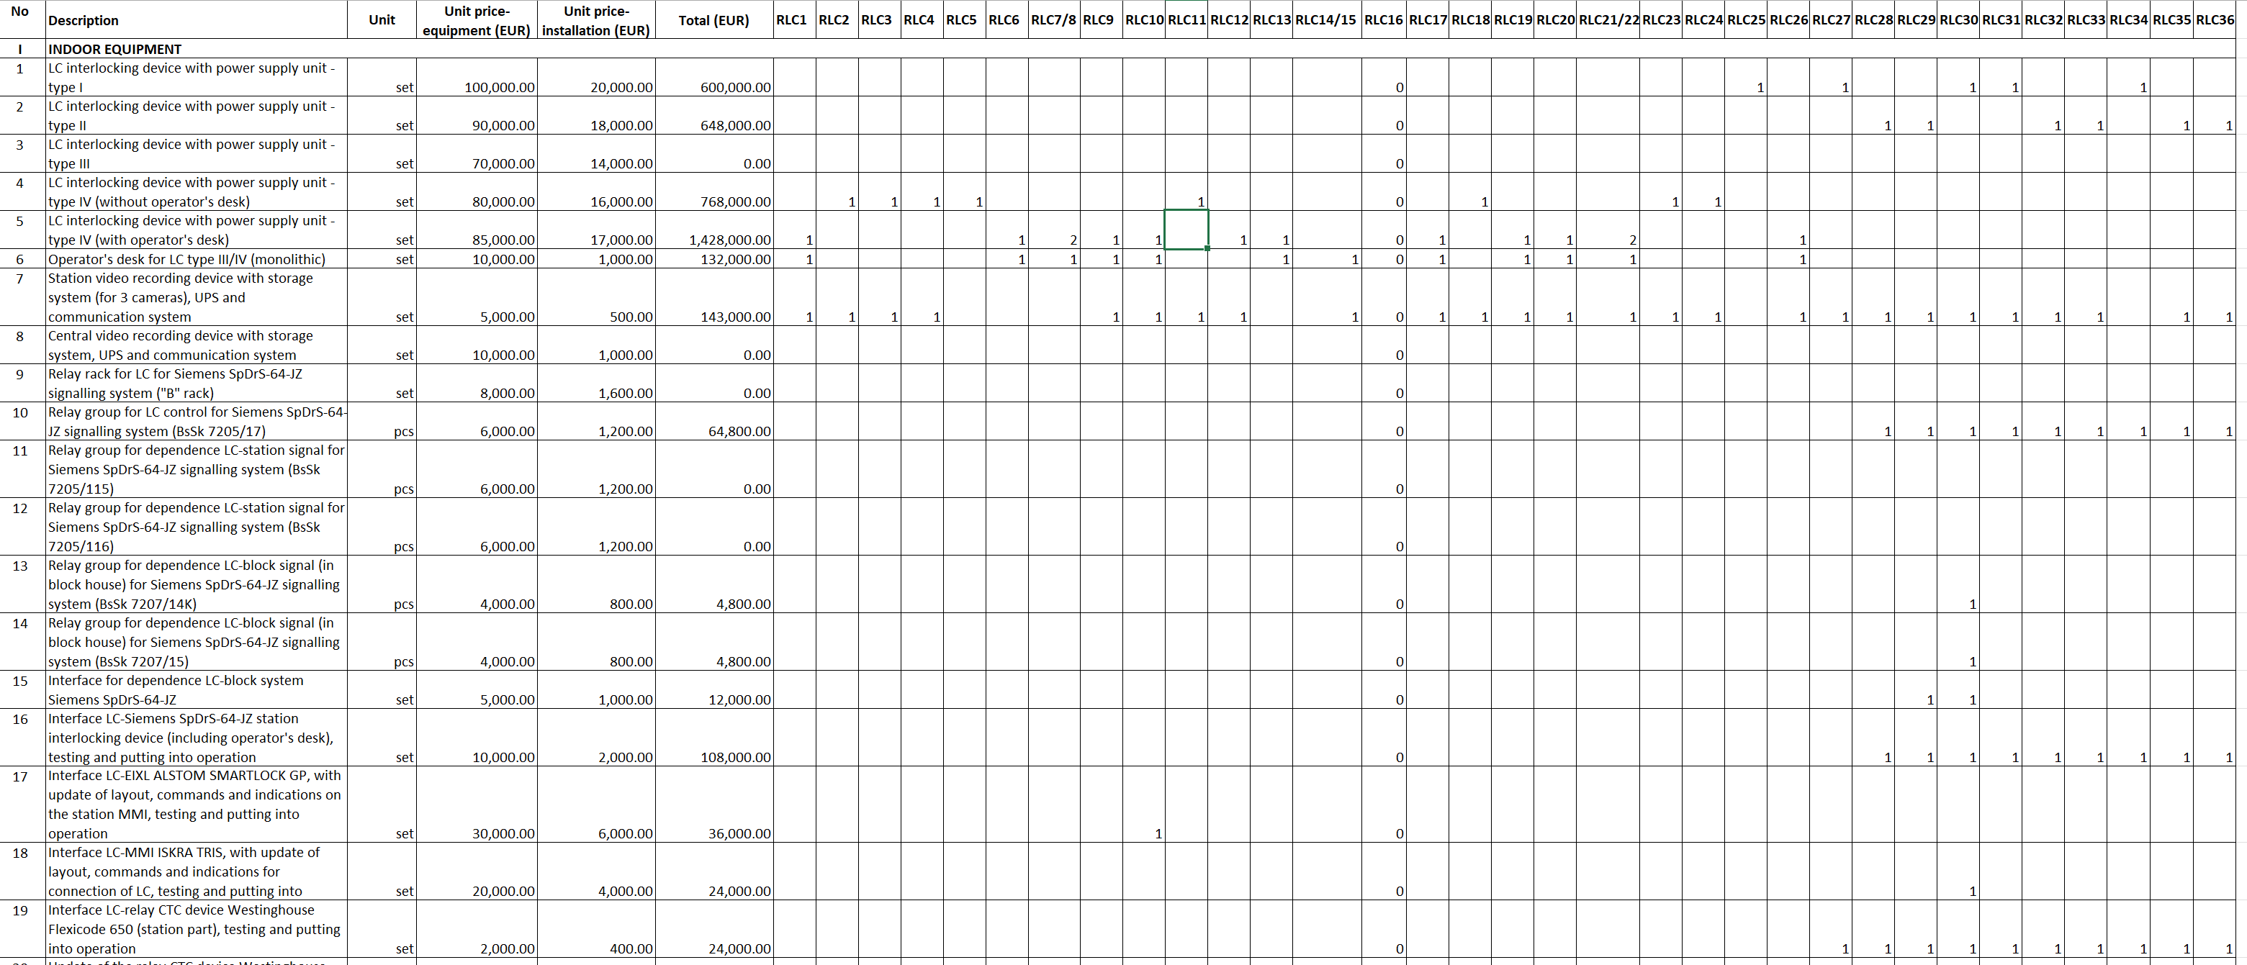
2. Plans for the next project stages
Task 4 – Preparation of the standardized equipment specifications, drawings and Bills of Quantities
An example of a possible BoQ format for a specific Regional Partner is the following:

Slide 23
2. Plans for the next project stages
Task 5 – Preparation of general procurement documents
The Consultant will prepare the corresponding procurement documentation, which will include, but will not be limited to, the following items:
General Procurement Strategy (for example, based on the Yellow FIDIC contract model or similar);
Procurement Plan and Guidance Note (including the contract type and tender procedure to be used, the explanation of the metrics that will be used to judge the supplier's performance, planned delivery or implementation dates for the services being provided, identification of the organizational standards that must be complied with, the estimated number of suppliers/vendors who will be involved and an explanation of how they will be managed, the alignment of lead times with the project schedule;
Compiled administrative and technical parts for all six Regional Partners, considering specific national requirements.

Slide 24
3. Open issues to be solved
In the follow-up period, the Consultant will hold meetings with each Regional Partner to clarify possible open issues, for example, the following:
Applicable regulations in case there are no corresponding national regulations (for example, Albania and Serbia are missing updated standards for LC road signals, and for Serbia the Consultant proposed application of the DB standard accordingly-see the image below);
Recommendations regarding the prospective civil works on the roads toward LC outside the railway land.

Slide 25
Thank you for your attention!

