Slide 1

G&G Plant Protection Ltd.
Presentation: Pristina, 19/03/2024
Notes:
introduction
- I’m pleased to have your valuable time and attention. So, be welcome at G&G Spraying Systems presentation and short demo. As far as I know, you all have a detailed technical knowledge in railway maintenance. So I won’t bore you with issues like how dangerous it is when weeds get onto the rail resulting in slippery patches, or when roots and dust erode the ballast which changes damping capability. Let me explain the reason we are here for. Our company offers complete solutions for pay­off chemical weed control along railway networks. This means: on one hand we provide services with our well­ performing machinery and professional crew, as some kind of labour hire. On the other hand we construct track maintenance vehicles and adaptors, even according to unique requirements. Why does G&G’s portfolio stand for the best available solution at this part of the industry and services?

Slide 2

GOALS AND PHYLOSOPHY
introducing economical and environmentally friendly technologies to railway weed control
saving our resources
protecting our natural environment
Notes:
Why does G&G portfolio stand for the best available solution at this part of industry and services? József Gaál, the founder of our company had a vision about introducing economical and environmentally friendly technologies into railway weed control. With help of the sophisticated and reliable spraying hardware, the real-time weed recognition with the latest technology we were able to reach chemical saving. I’m sure I don’t need to speak about the importance of environment friendly technologies. Saving our resources belongs the top 3 of mankind’s greatest problems which need to be solved very-very soon. Also protecting our natural environment belongs there.

Slide 3
RecoSpray technology basics
Notes:
Let’s see the overview of our spraying standard’s advantages.

Slide 4

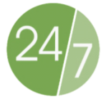

Real-time weed recognition and spot spraying uses less water and chemicals
24/7 operation, 2500 km/week
trackable, GPS-based documentation and control
Notes:
Using less water and chemicals improves performance.
Regarding efficiency, let me tell you some impressive details: by appropriate organisation and traffic management our weed control train and container system is able to treat up to 500 km of track per day. This number goes up to 2500km a week,
With the help of a comfortable living coach there is no need to worry about the workers' catering and accommodation; the system is ready to operate 24/7.
This way short, campaign-like work can be done,.
GPS-based documentation ensures traceability of the whole spraying procedure.

Slide 5
REDUCTION OF
ENVIRONMENT’S CHEMICAL LOAD
weed recognition - up to 75% chemical reduction
accurate GIS system
chemical injection, 4 chemicals for each independent sections (9)
world’s leader very quick dose change
most advanced anti-drift technology
24/7 operation (best application date)
Notes:
The benefits of the recospray system shown in the list

Slide 6
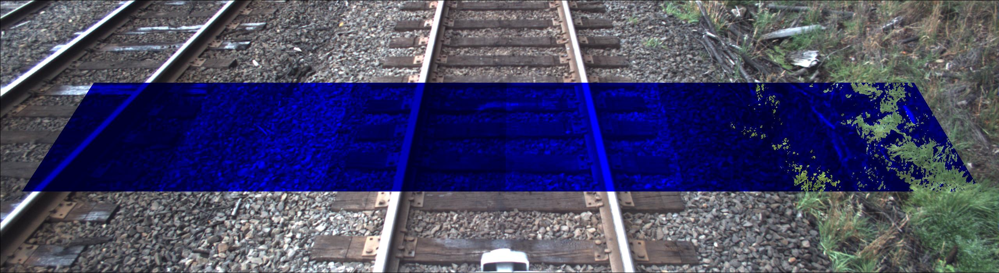
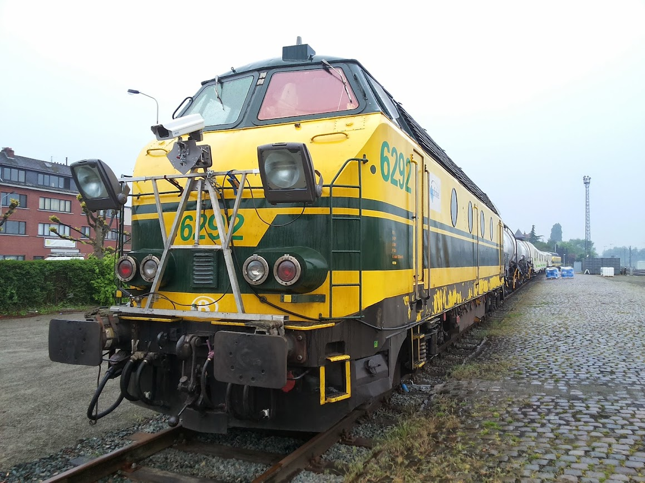
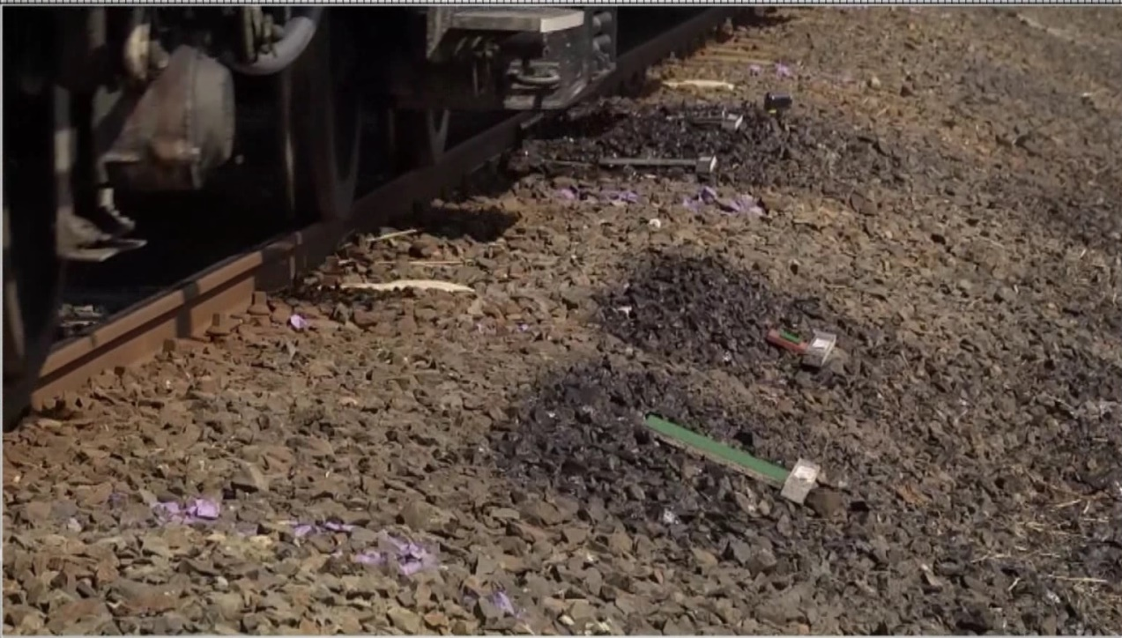
weed detection
10-15m width
Up to
100 km/h speed
Notes:
The weed recognition system detects the weeds realtime.
The system sprays only to the weed spots.

Slide 7
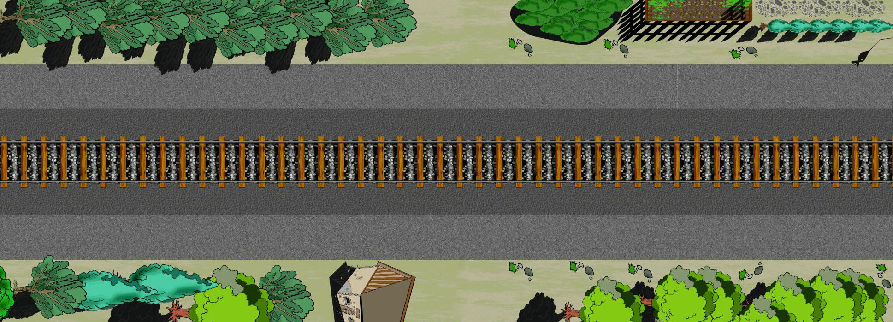
RECOSPRAY WEED RECOGNITION
Weed coverage vs. sprayed area
RECOSPRAY WEED RECOGNITION
Weed coverage vs. sprayed area
Spraying starts before the weed spot, ends after it
Both data are stored on the weed map.
Weed coverage: cca. 15% Sprayed area: cca. 25%
Weed coverage: cca. 15% Sprayed area: cca. 25%
Notes:
Massive chemical reduction could be archieved. Spot spraying starts just before the weed spot and stops after the spot.
So spraying area is usually bit larger than the weed covered area. On the weed map both data are stored.

Slide 8
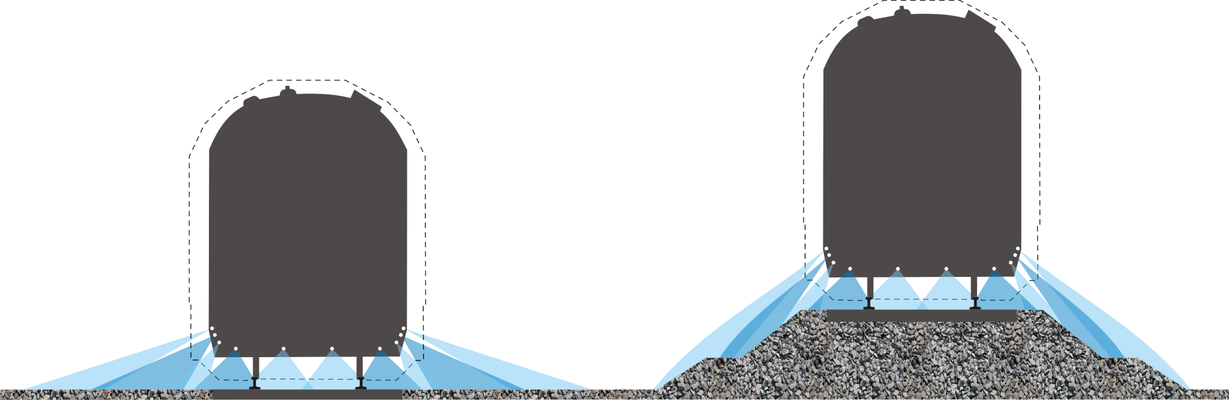
HIGH SPEED SPRAYING:
PLAIN AND SLOPE
6-10m
6-10m
Notes:
You can see here the spraying pattern for plain and slope, maximum width for these nozzle groups is 10 meters.
The spray width could be optimised for the customer’s needs.

Slide 9
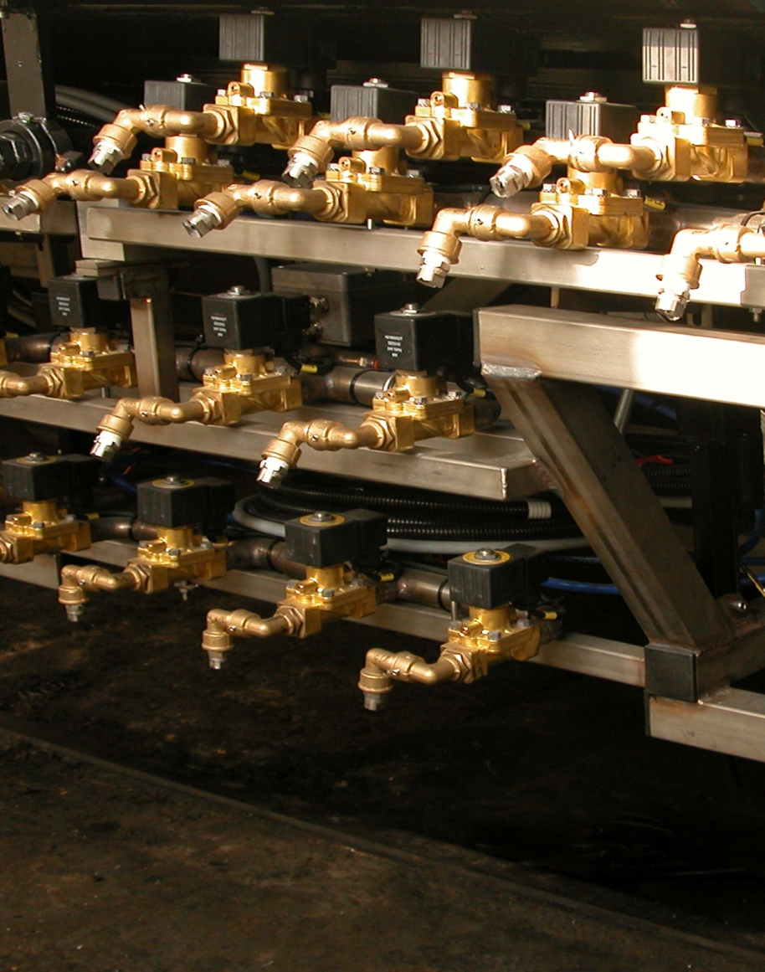
RECOSPRAY SPRAY SYSTEM
multi-section spraying: 9 sections
10 m spraying width
spot-spraying
4 different herbicides in different dosages
no direct contact with chemicals
pulverization and drifting: recommended speed is 60 km/h
high speed spraying is also possible
Notes:
Multi-section spraying is carried out by the nozzles mounted on the spraying frame. Each of the 9 sections have their own nozzle group and spraying module. These modules guarantee the proper dosage of water and inject the required herbicides directly into the nozzles. Spraying happens only when the right nozzle group passes over the weed spot.
Total spraying width is 10 meters. If necessary, it can be extended with special nozzle groups but without weed recognition.
It is possible to use four different herbicides in different dosages, section by section. As for safety issues, our spraying standard has another great advantage: there is no direct contact with chemicals at all during operation.
Working pressure: spraying with higher speeds is quite different then agricultural spraying. It is better to stay below 2.5 bars, otherwise pulverization of the fluids increases, just like drifting. With anti-drifting adjuvants, optimum work speeds can go up to 60 kmph. Spraying with higher speeds is also possible, but beyond 60 kmph precision of spot-spraying will fall down.

Slide 10

Only clean water and concentrated chemicals
smaller polluted area in case of an accident
no premixed chemicals – no remaining hazardous waste is generated
trays collect chemical contaminated waste water – which can be injected to the track in a controlled manner
closed system, chemical tanks can be sealed
Notes:
As for work safety issues, our equipments carry only clean water and concentrated chemicals.
This means: in case of accidents the polluted area is smaller. There are no premixed chemicals, so no remaining hazardous waste is generated.
Trays collect chemical contaminated waste water, which can be injected to the track in a controlled manner.
The system is closed, chemical tanks can be sealed.

Slide 11
Products overview
Notes:
G&G Ltd has various products which all cover different needs, and have their own advantages.
The three main products are the supersturcture for road-rail vehicles, spray system built into a railway wagon and the containerized spray equipment.
Let’s see the main features of these products.

Slide 12
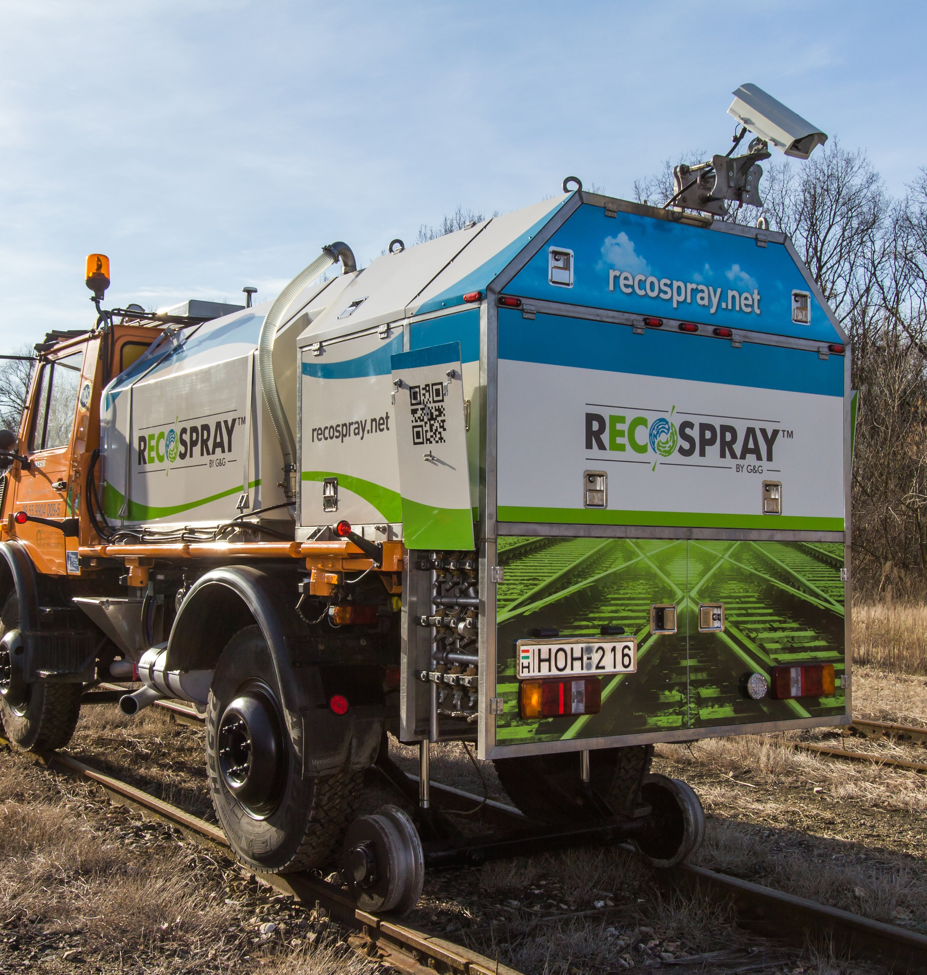
SUPERSTRUCTURE FOR ROAD-RAIL VEHICLES
BEST FOR LARGE STATIONS AND SHUNTING YARDS
EFFICIENY: UP TO 40 KM WITH A SINGLE REFILL
THE VEHICLE CAN GO ON WHEELS FROM ONE STATION TO THE OTHER
EASY TO GET ON AND OFF THE RAIL
Notes:
The superstructure mounted on road-rail vehicle. They are mobile and have some features specially for non­-main line usage.
Required staff is 1 person, still, we recommend having an assistant on the field. Optimal work speed is 40 kmph. As for efficiency, it can treat up to 20-40 km with a single fill-up. Without high performance lights, weed recognition is only possible at daylight, so treatable track length is limited to around 80 km a day.
As it can go on legs from one station to the other, it is a very flexible solution . It can stand easily on and off track which can be an advantage in case of heavy traffic (i.e. stations on high speed lines, etc.)

Slide 13
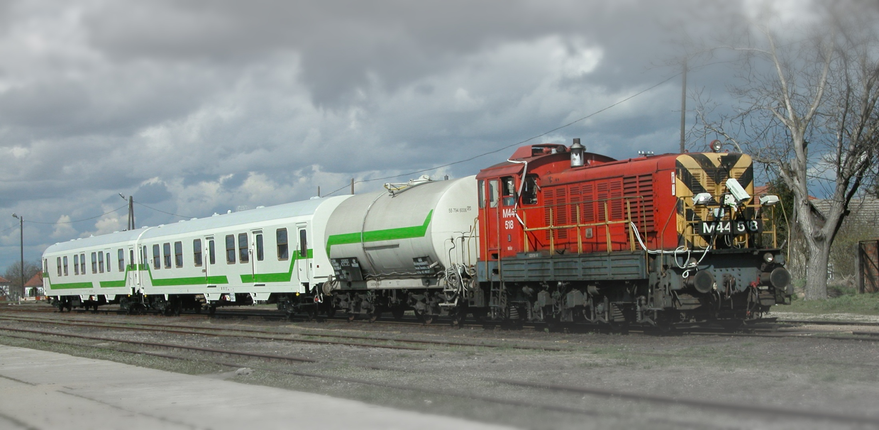
SPRAYING TRAIN
Features:
mainly for spraying open tracks
24/7 operation, night-work with high performance lights
2 operators /shift
optimal work speed up to 60 km/h
travelling speed 100 km/h
up to 2500 sprayed km/week
Notes:
The spraying train is a full capability product, suites mainly open tracks . With high performance lights it is possible to work in 24/7.
In a shift, two operators are necessary, optimal working speed goes up to 60 kmph, traveling speed is 100 kmph. Efficiency goes up to 2500 sprayed km/week, including water refill, machinery maintenance and other incremental issues.

Slide 14
SPRAYING TRAIN
Recommended setup:
control coach
social coach
storage coach
2 water tank wagons
2 locomotives
Notes:
The recommended assembly is the following: 2 locomotives, 2 water tank wagons, control coach, living coach for the staff and at least 1 storage coach, mainly for the chemicals.

Slide 15
RECOSPRAY CONTAINERIZED SYSTEM

Slide 16
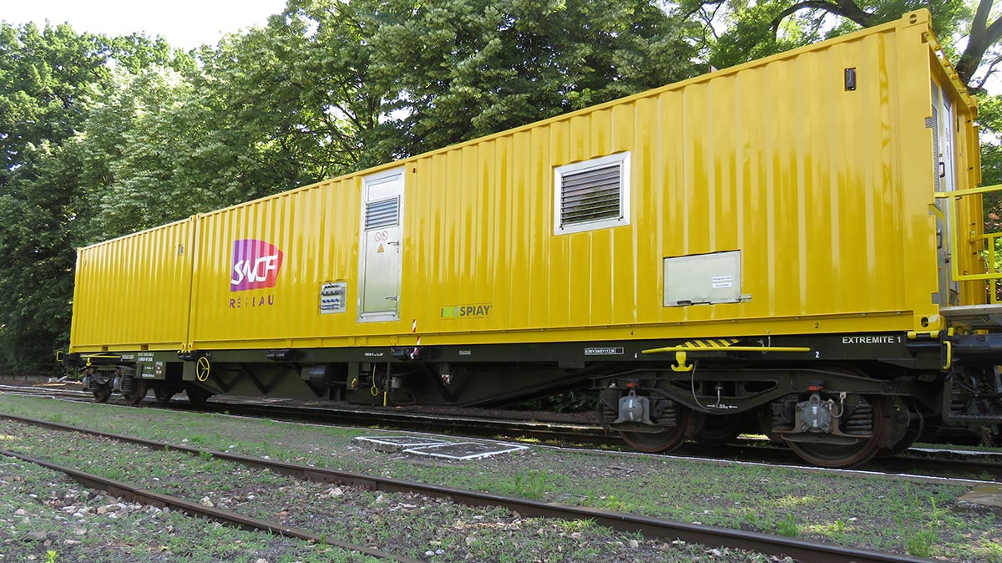
CON02 SPRAY CONTAINER
Notes:
One of the latest module shown on the picture.
The 60’ length flatbed wagon carries the containers.
Flexible and gauge independent solution.

Slide 17
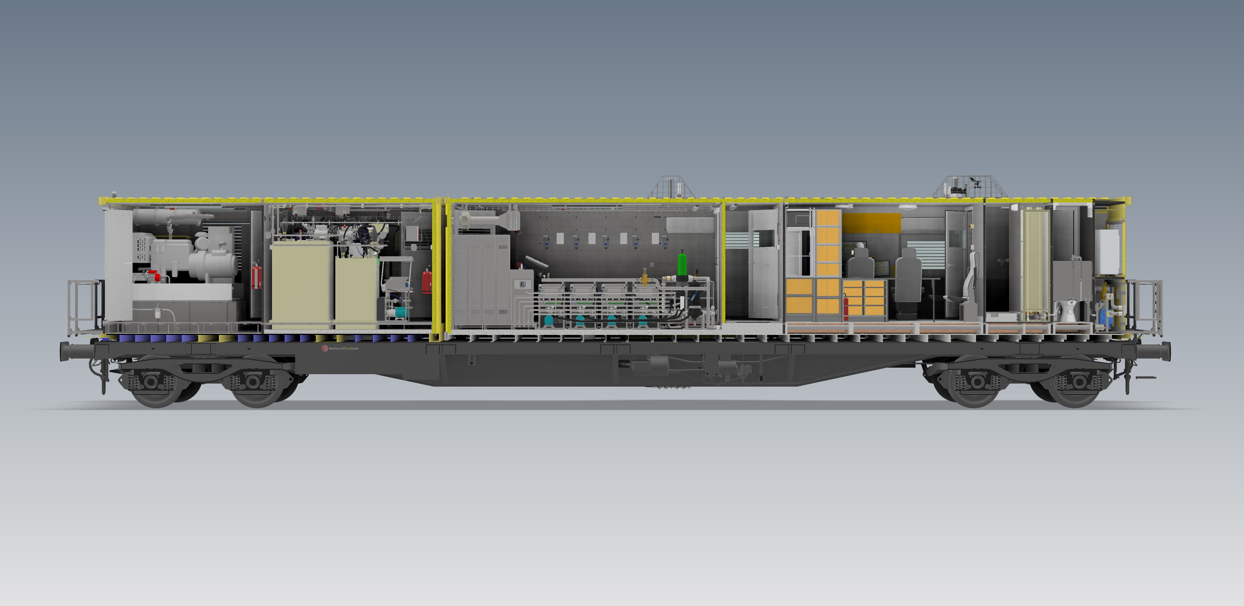
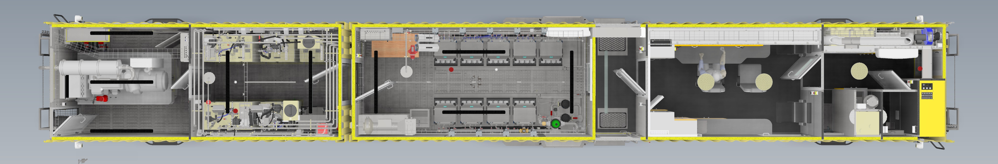
CON02 OVERVIEW
20’+40’container contains everything for spraying
only water tanker needed
Notes:
The layout of the containers.
The 20’ container (left) contains the noisy and dangerous things, generator and concentrated chemicals.
The 40’ container (right) is quiet and clean.
The chemicals and the water is controlled by the modules in the spray room.
The chemicals are injected to the water just before the nozzle.
The control room is clean and overpressurized with high quality filtered air.
The toilet and kitchen located in the right. Separate clean water and toilet tank also included.

Slide 18
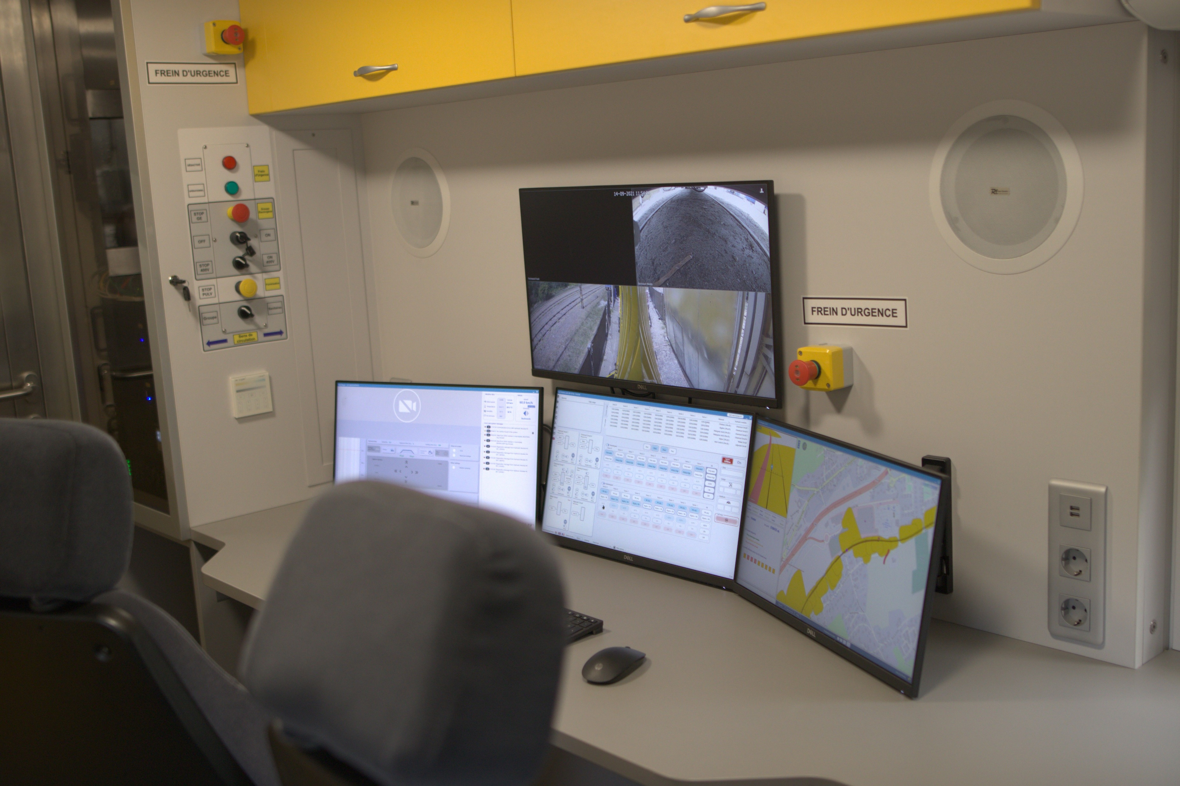
CONTROL ROOM
Ergonomic
Climatised
Filtered air
Overpressurized
Notes:
Air suspension seats for 2 operators.
Additional seats for 2 guests.
One operator can easily control the system.
Split monitor to see the side cameras.
Fully automated system, there is no need to switch the nozzles by hand.
Only needs intervention on special cases (people near to the track, etc).

Slide 19
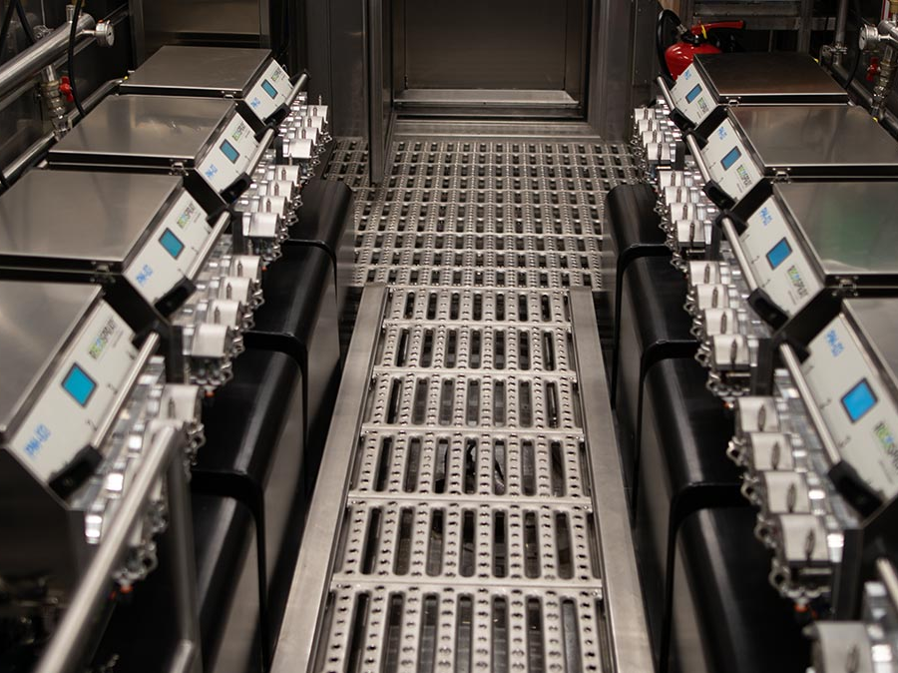
SPRAY ROOM
safe and clean
fully automated
9 section
4chemicals/section
up to 60km/h
Notes:
9 spray units.
Direct injection of the 4 herbicides.

Slide 20

Recospray™
GIS based solutions

Slide 21
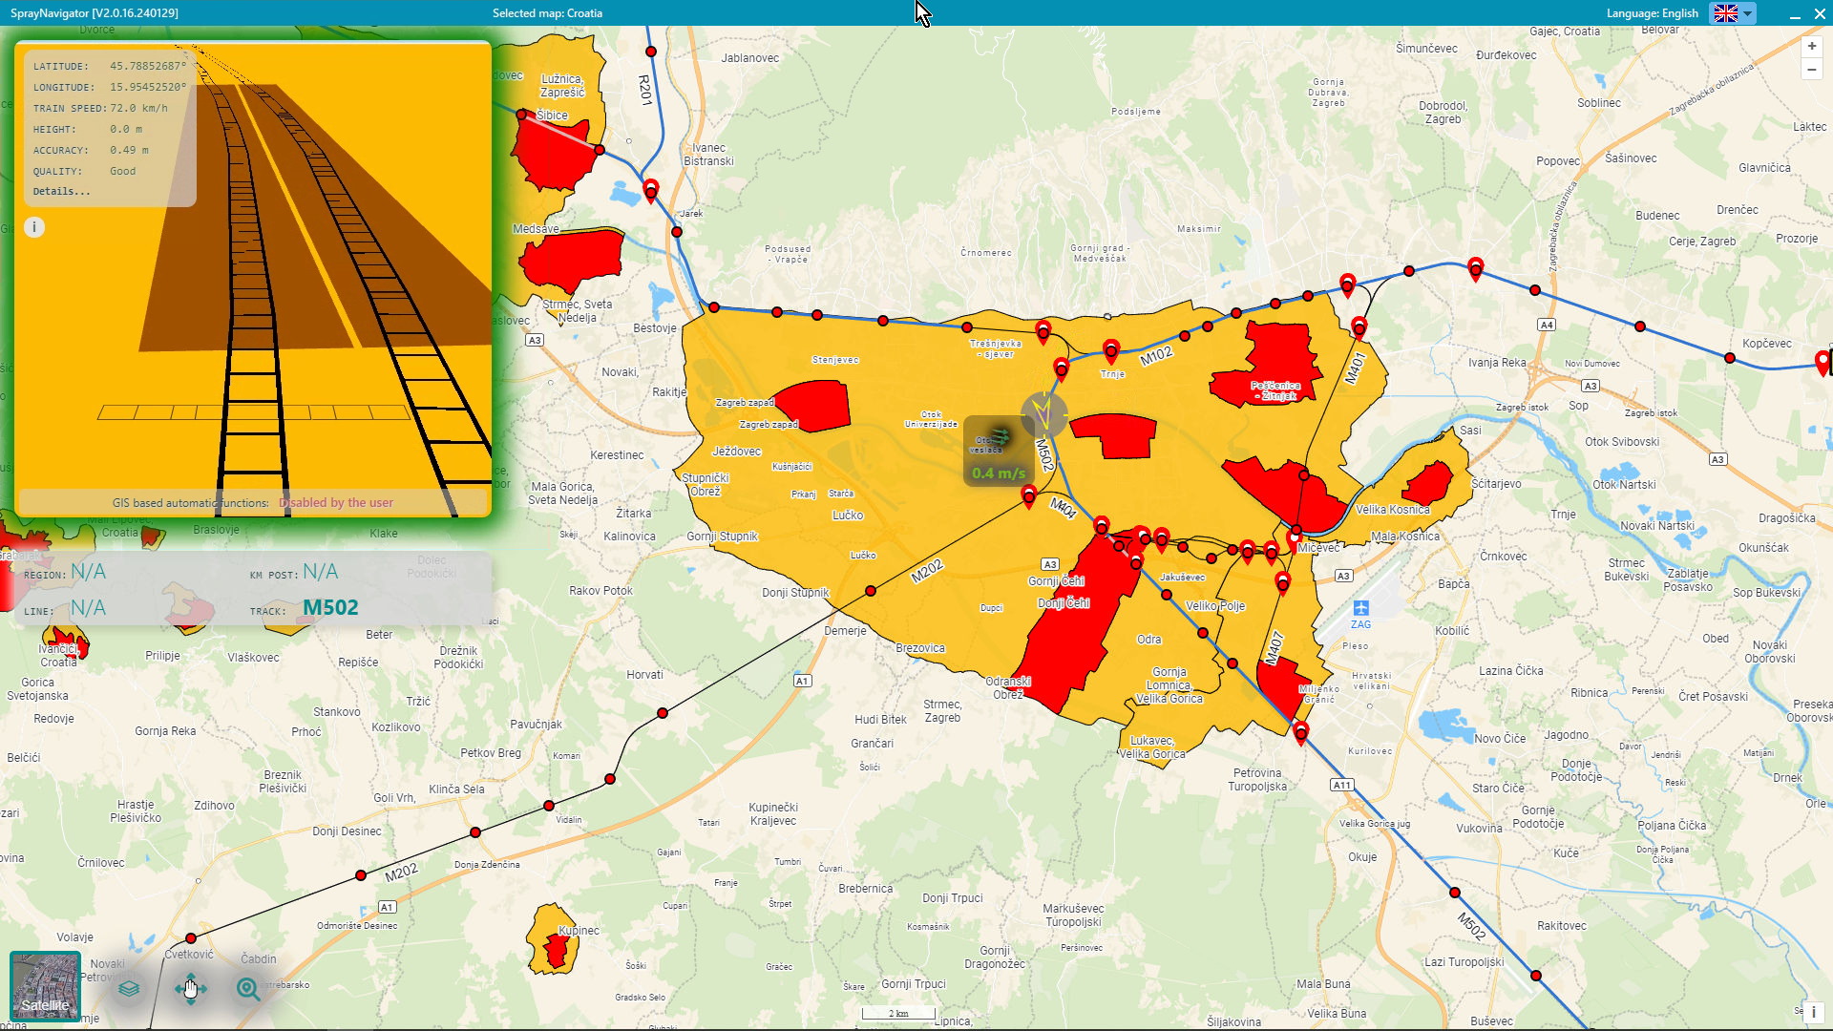
SPRAY NAVIGATOR on board GIS based mapping fully automated spraying
Automated control
No spray zones
Special chemical zones
Special needs
Notes:
Spray Navigator is a GIS based software.
It controls the spraying automatically.
In the no spray zones (RED) it switches off the spraying automatically.
In the special zones (Yellow) restricted chemicals will be switched off automatically.
No user intervention needed, everything is controlled via the high quality GPS system.

Slide 22
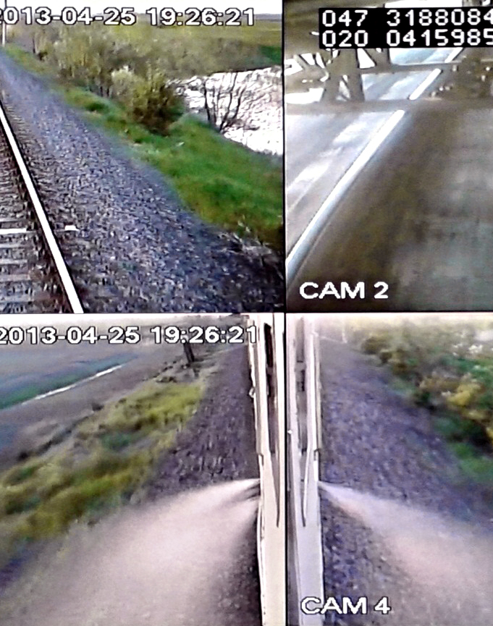
RecoSpray Camera documentation system
continuous video recording: a video footage from all camera positions with time stamp and GPS coordinates
complain or accident: events can be fully reconstructed
RESPONSIBILITY can be cleared even years later
Notes:
Continuous video recording: a video footage is made from all camera positions. The footage is supplied with time stamp and GPS coordinates.
In case of complain or accident the events can be fully reconstructed, RESPONSIBILITY can be cleared even years later.

Slide 23
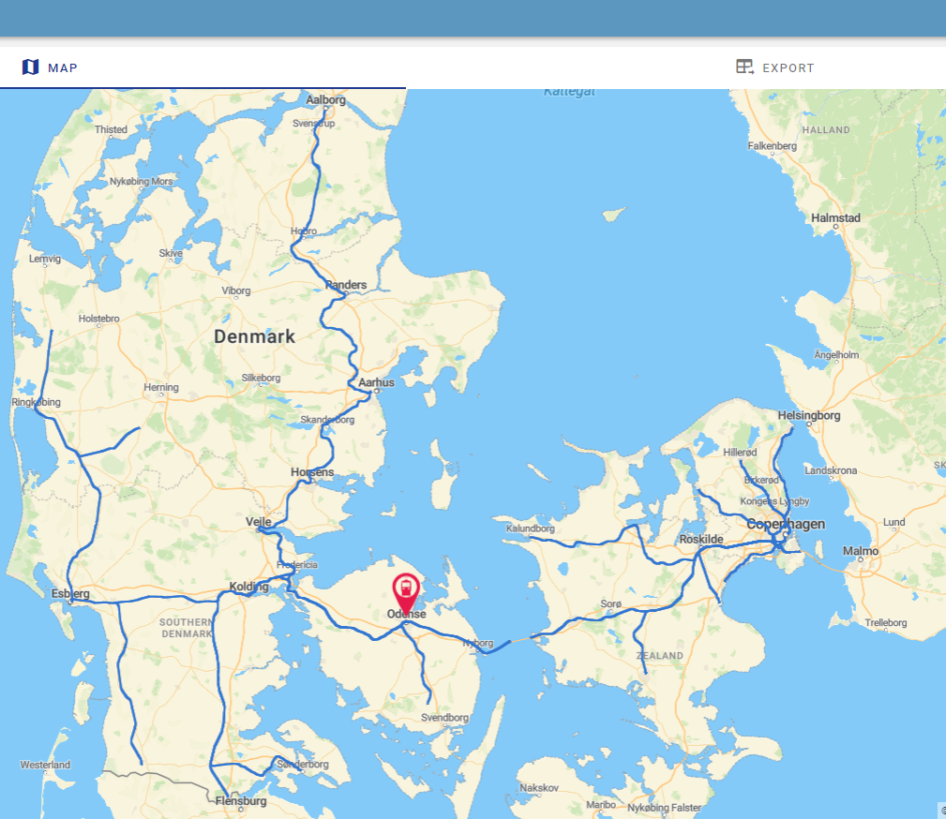
RECOSPRAY CLOUD cloud based real time tracking system
OPTIONAL
Notes:
Optional Cloud services.
The train is uploading continously the data to the cloud.
The position of the train could be tracked real-time.

Slide 24
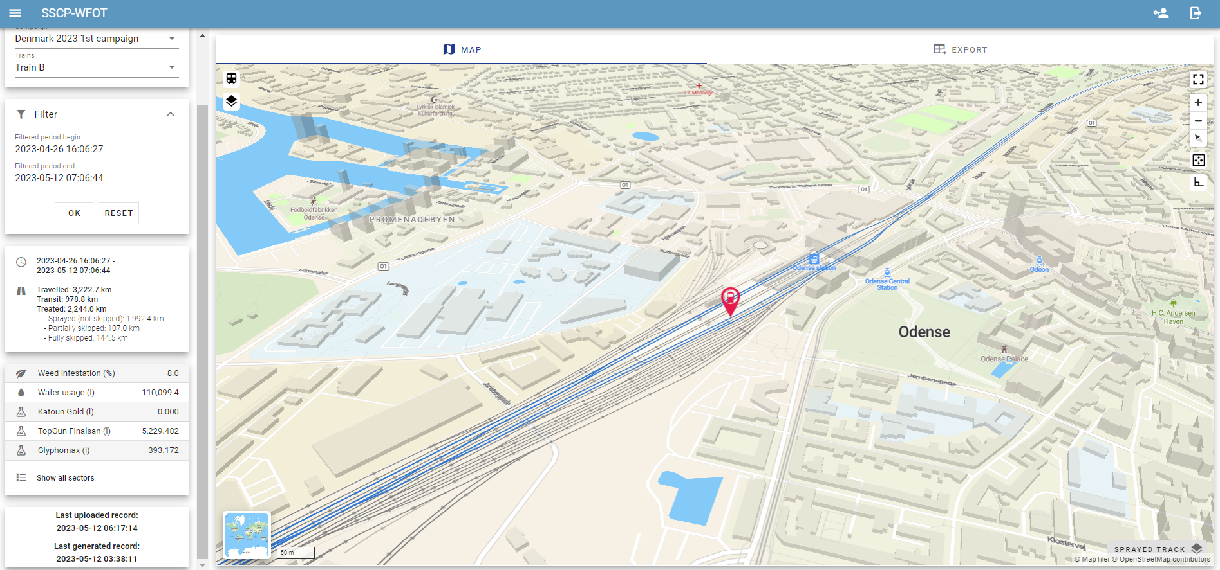
Treated track informations
OPTIONAL
Notes:
The history of the spraying could be checked online any time from anywhere.

Slide 25
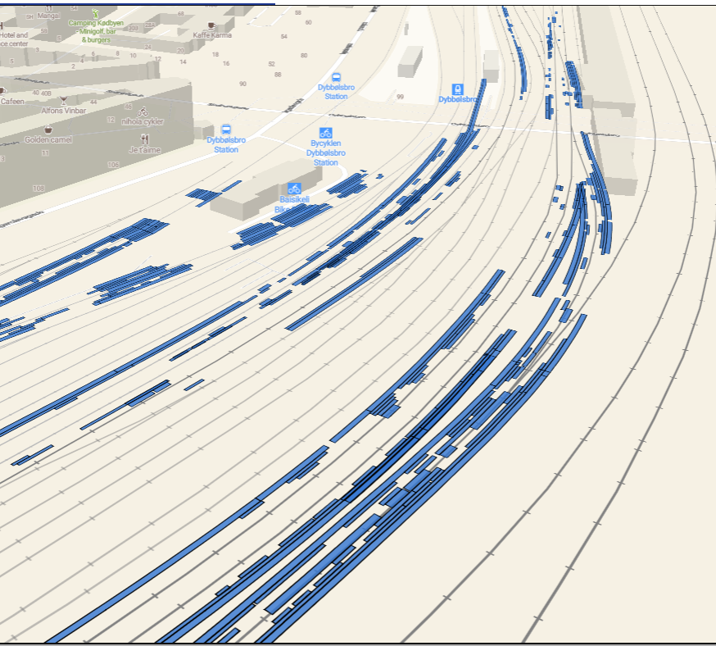
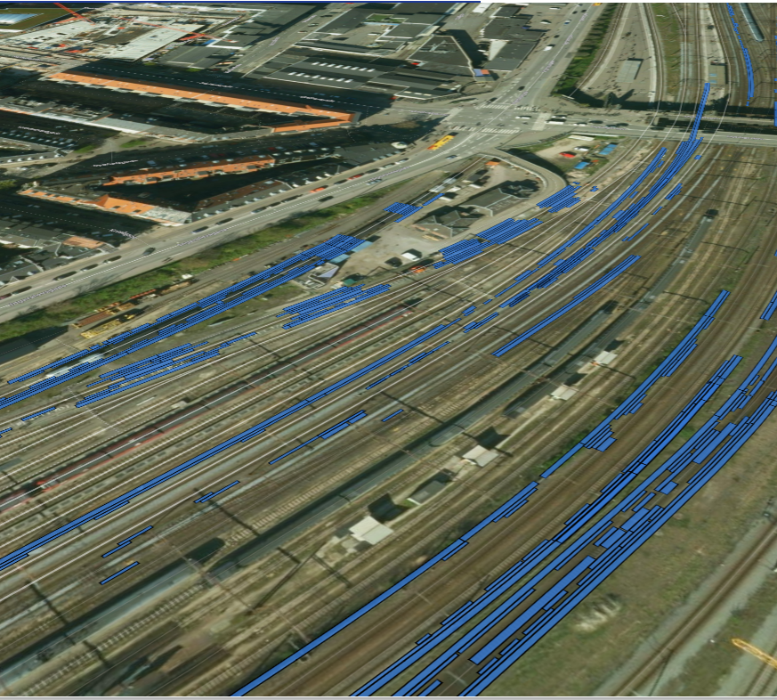
Satellite and 3D view
OPTIONAL
Notes:
There are detailed views also.

Slide 26
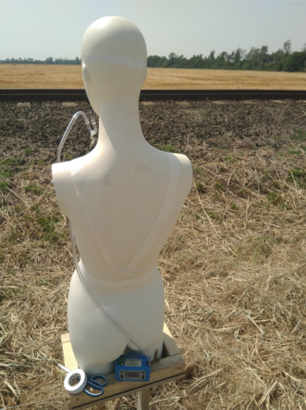
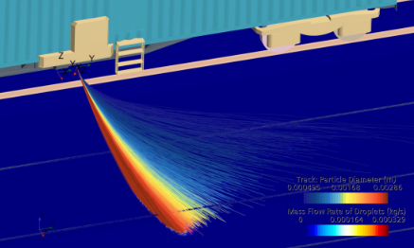
Quality Control and independent tests
Continuous testing with independent partners
Spray accurancy
Drift (lowest in the world)
Weed mapping
Notes:
The system has been inspected by several institutes.

Slide 27
MARKET POSITION AND REFERENCES
Notes:
Recospray is market leader in Precision railways weed control equipments

Slide 28
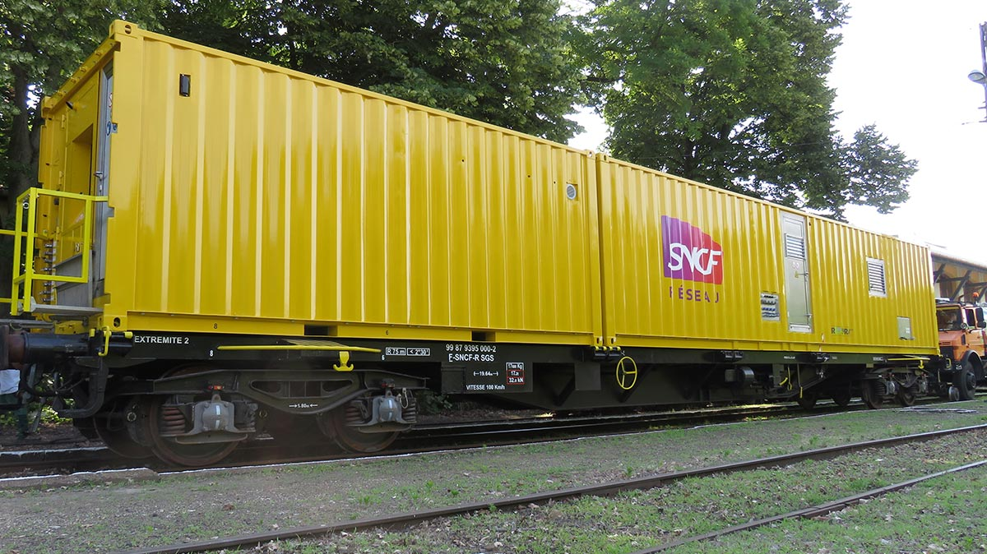
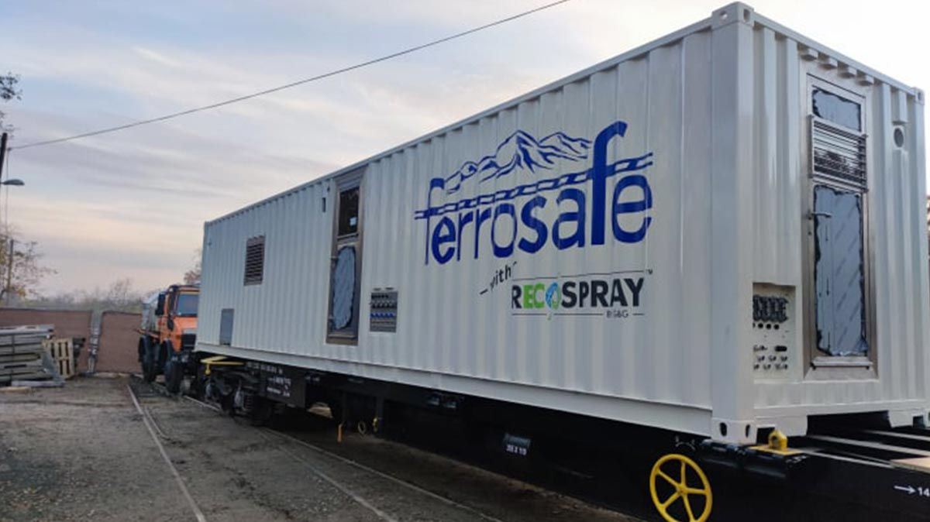
RECOSPRAY IS MARKET LEADER IN THE PRECISION RAILWAY SPRAYERS
10 + SPRAY UNITS OPERATE WORLDWIDE
REFERENCIES IN 10+ COUNTRIES
Notes:
Now G&G is the market leader in the precision railway weed killing bussiness.
Our partners have
- 2 trains in Western Europe and Skandinavian countries (Belgium, Denmark, Norway, Sweden)
5 container trains in France
2 containers and 5 HiRail trucks in USA
1 train in Croatia

Slide 29
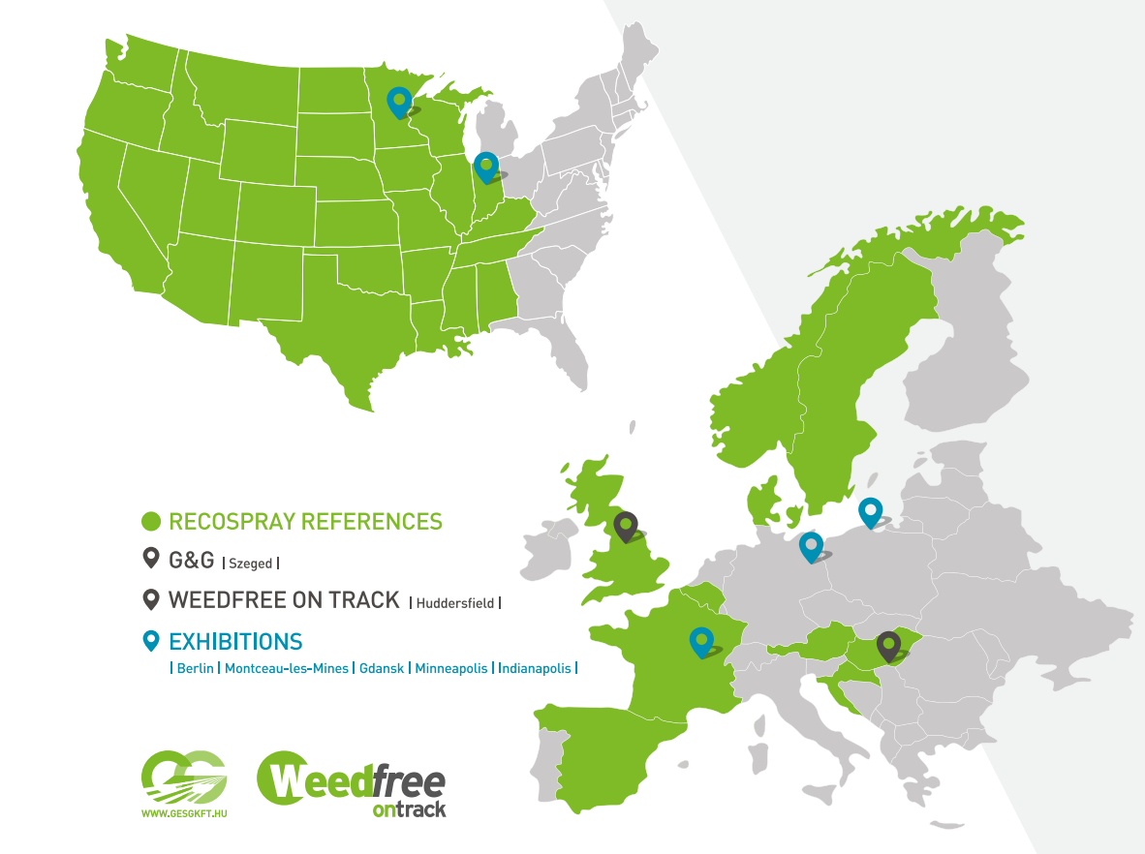
Notes:
RECOSPRAY technology has references in the USA, Belgium, UK, Sweden, Denmark, Norway, Luxemburg, Hungary, Austria, Spain, Croatia, France

Slide 30
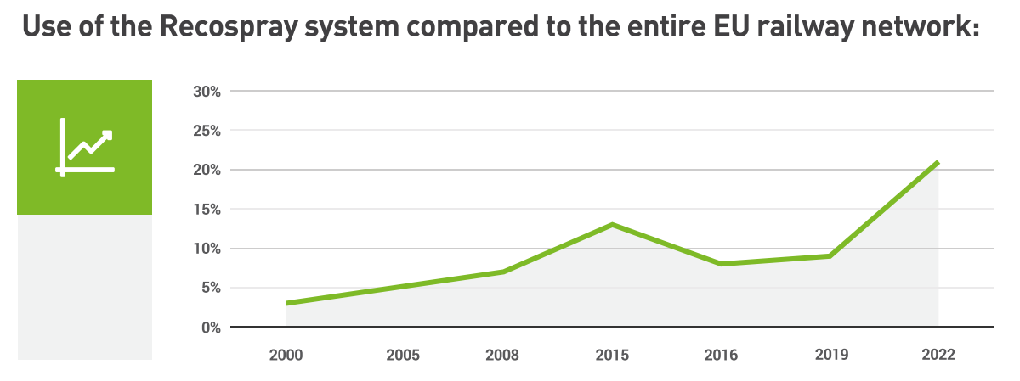
USE OF RECOSPRAY SYSTEM IN THE EU
Notes:
The rate of the railway network in the EU sprayed with RecoSpray system is constantly growing since 1998.

Slide 31
Thank You for your attention!

