Slide 1


Conclusion of the practical training
goran.rukavina@mmpi.hr
Ivan.gereci@mmpi.hr

Slide 2

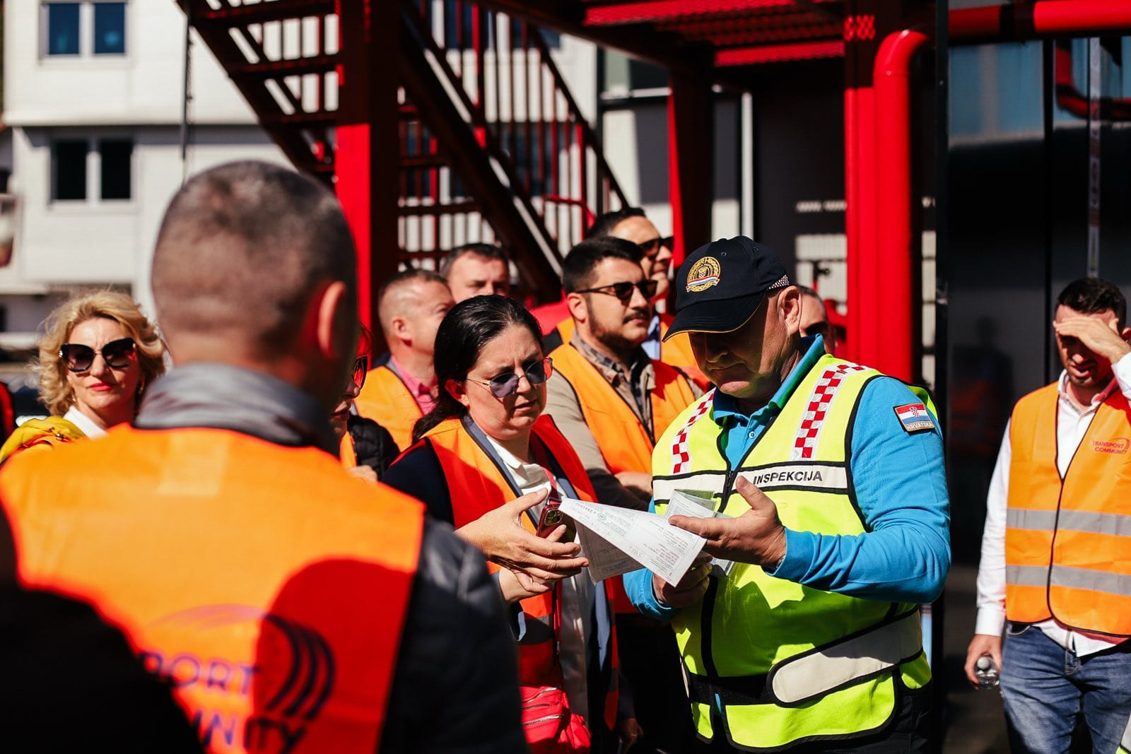
Inspection control – HIFA PETROL

Slide 3
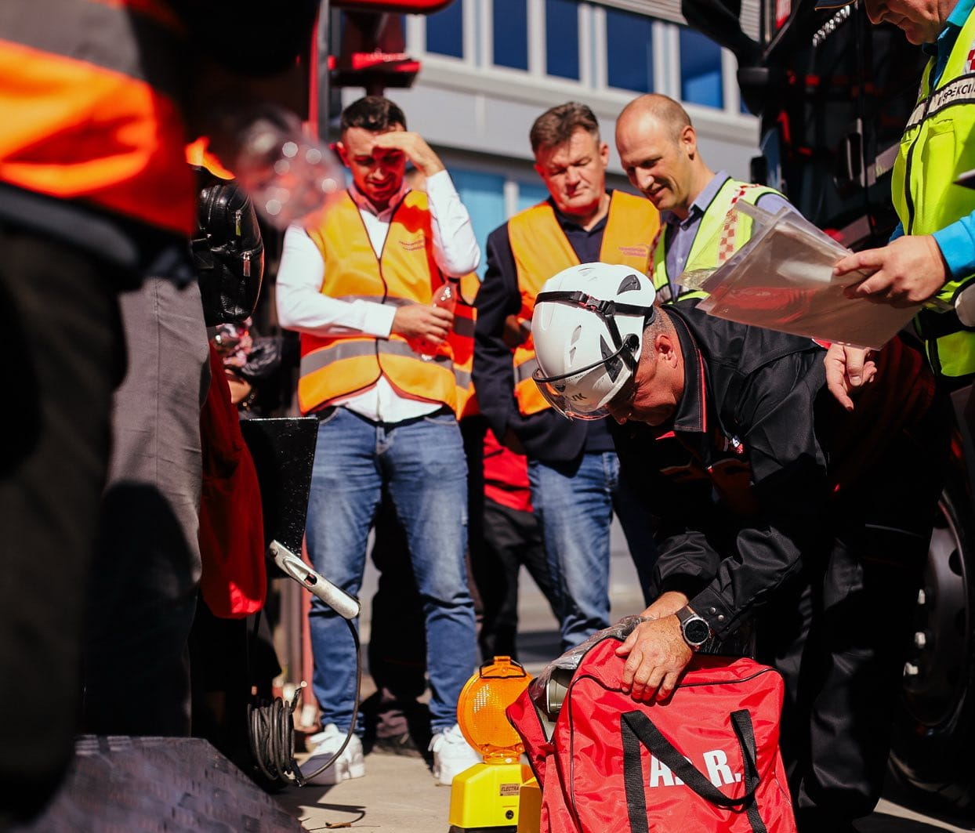
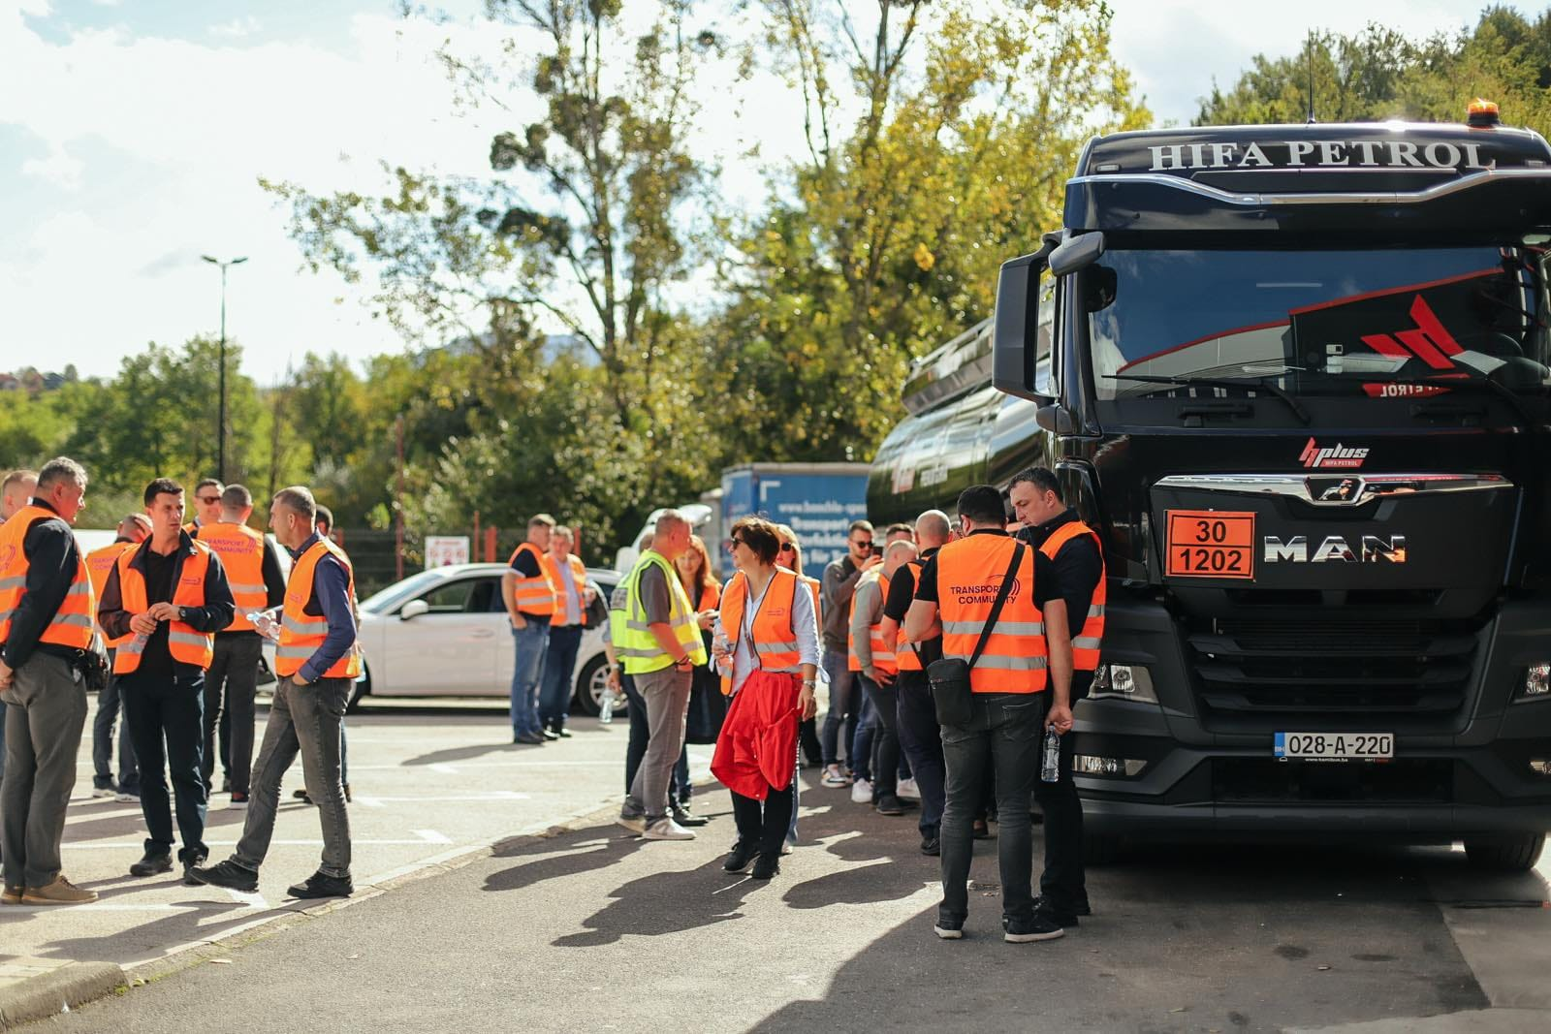

Slide 4
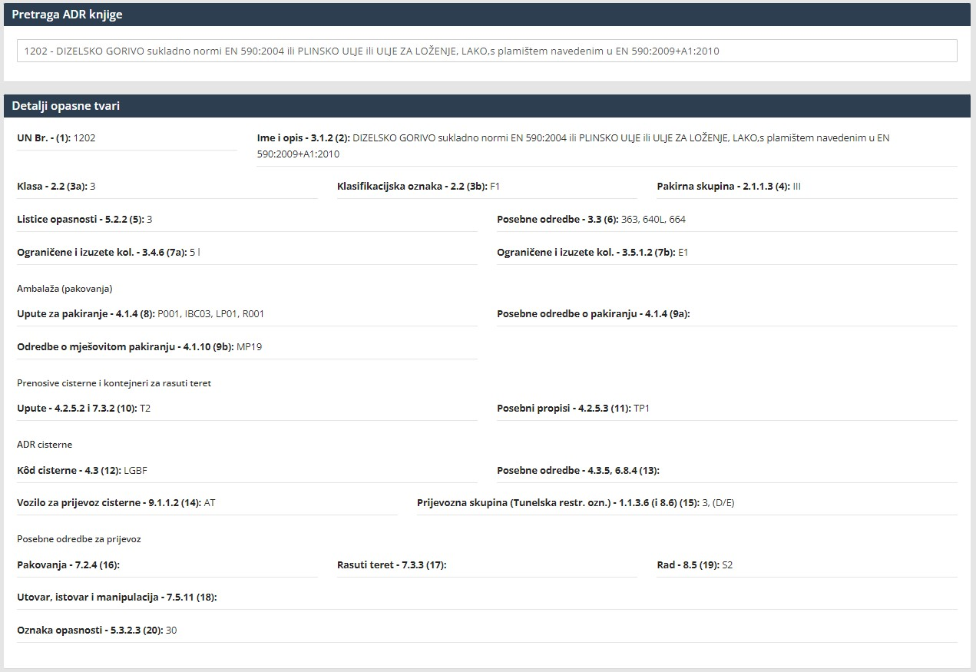
ADR - Book

Slide 5
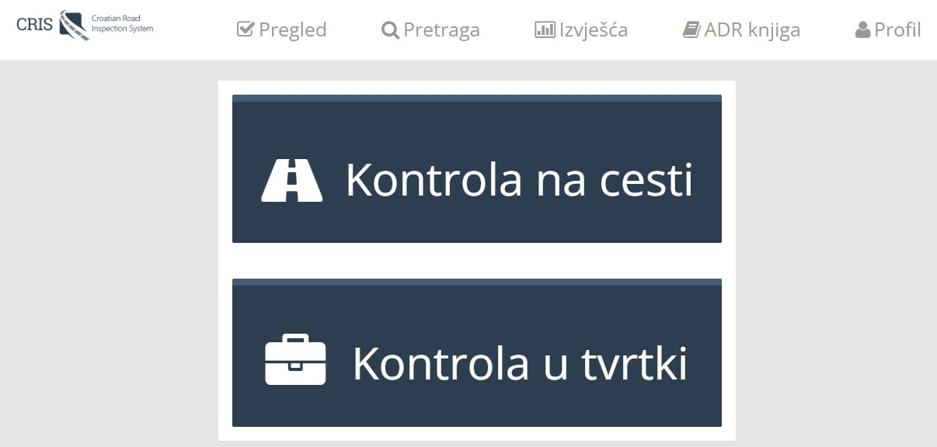
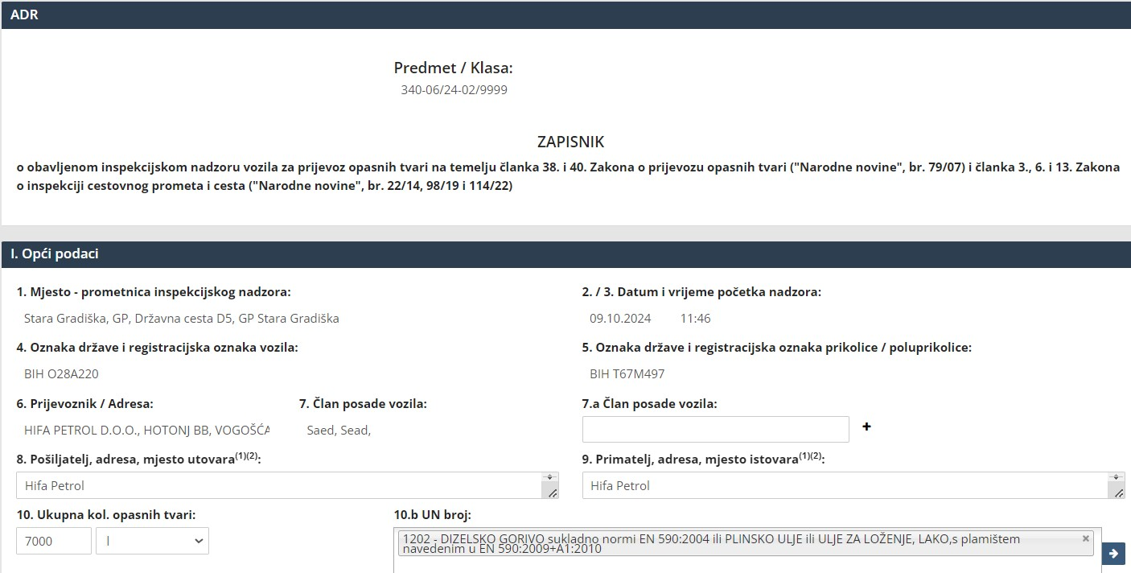

Slide 6
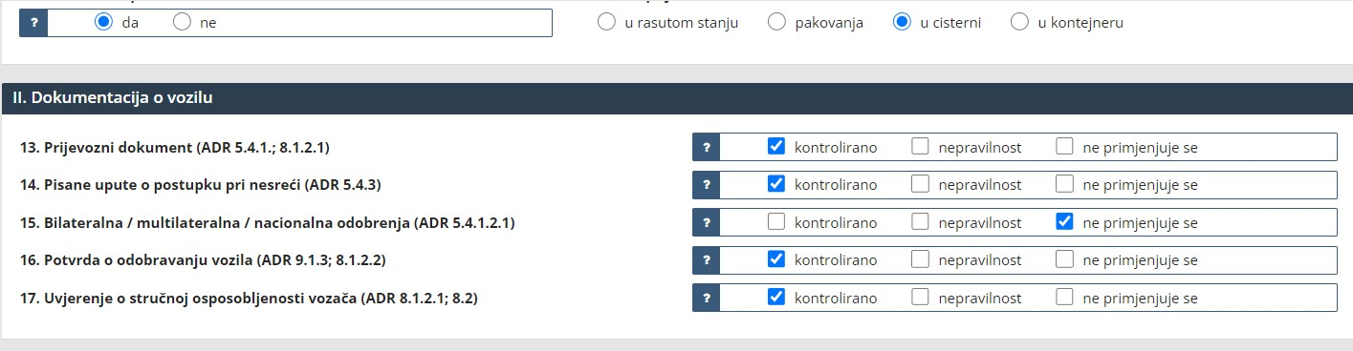
Documentation

Slide 7
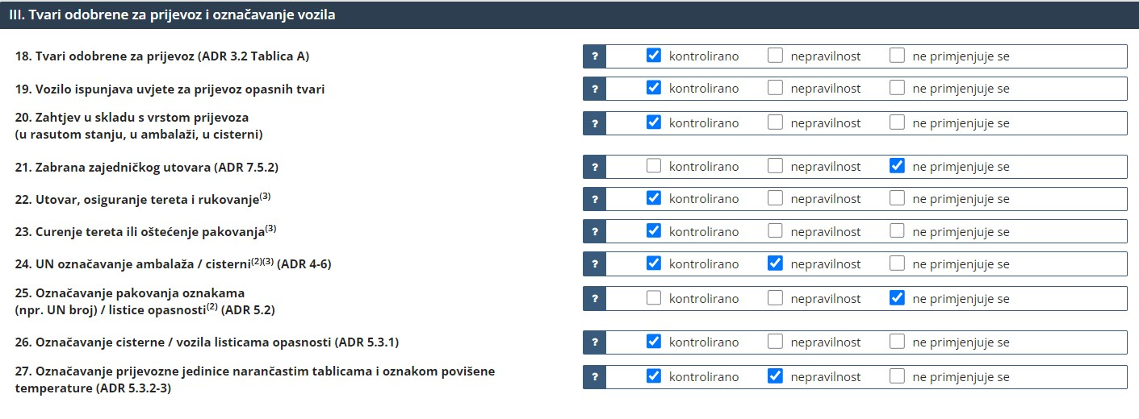

Dangerous goods - control

Slide 8
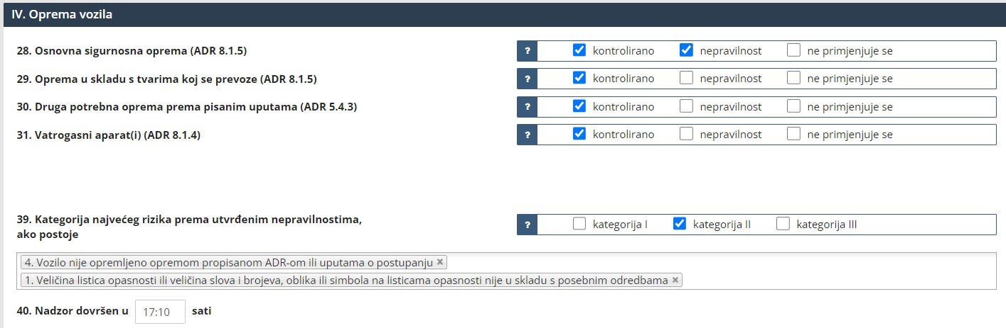
Equipment
Risk category

Slide 9
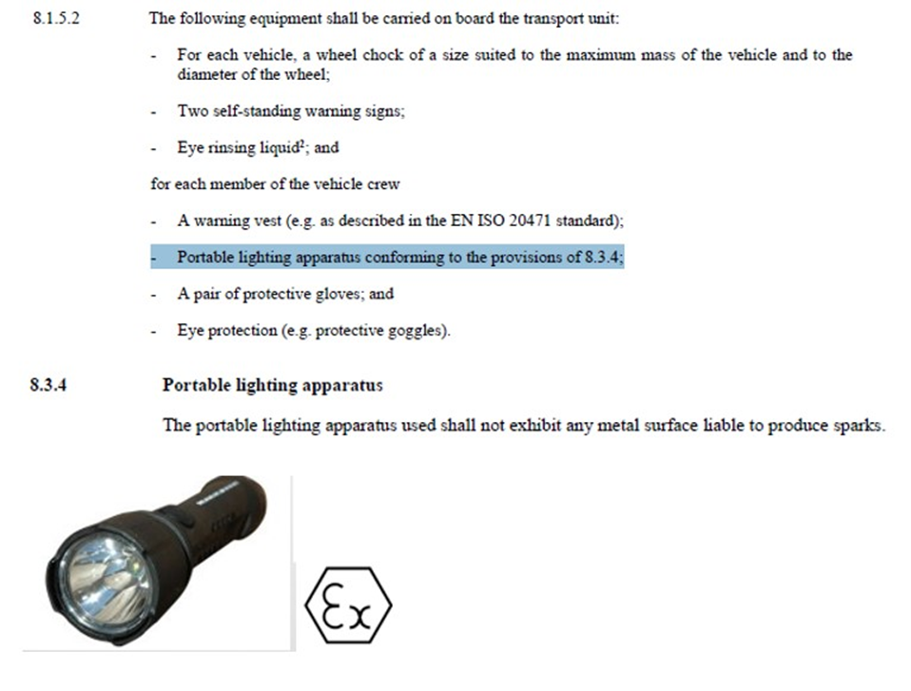
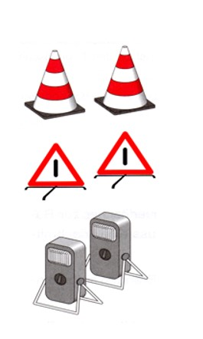
ADR Provision

Slide 10
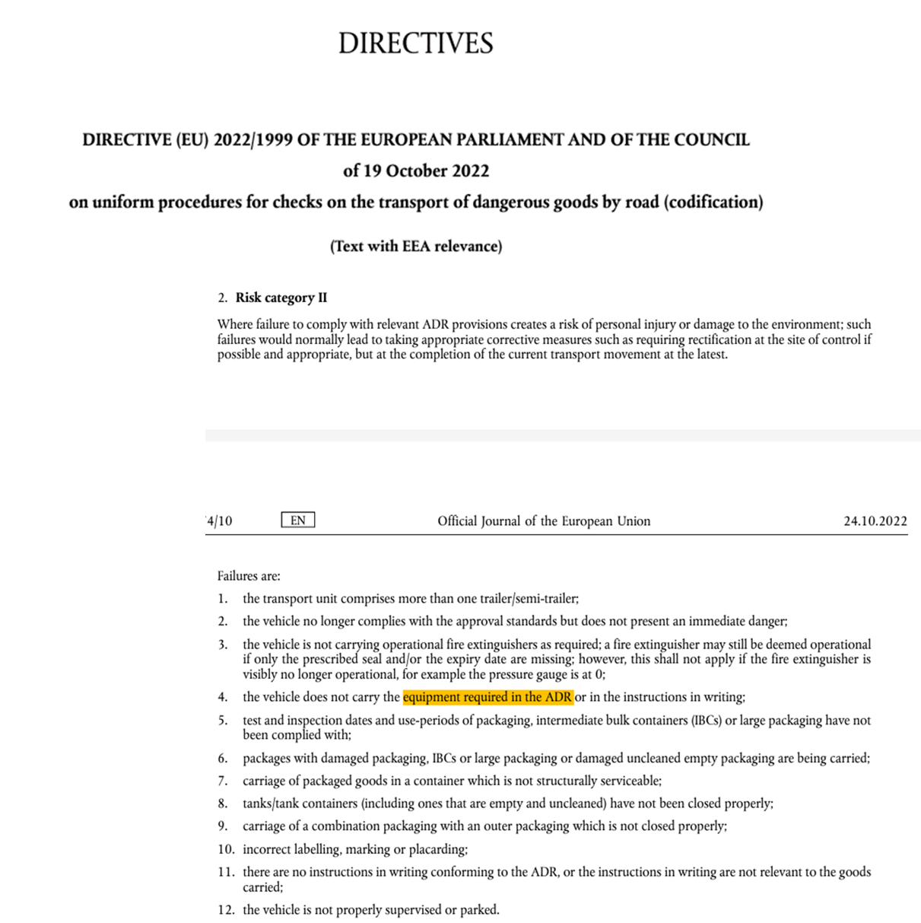
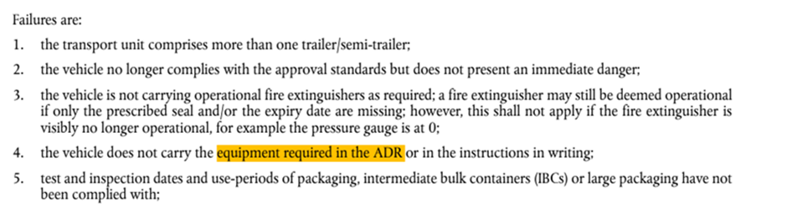

Slide 11

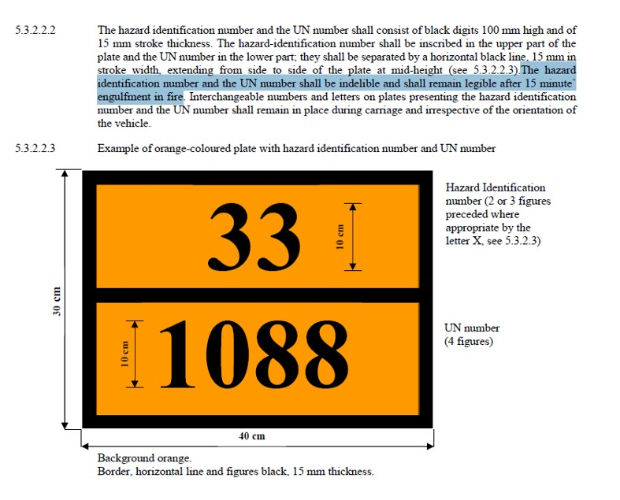

Slide 12
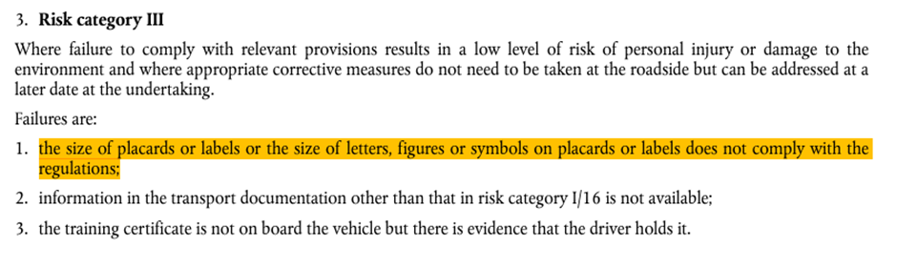
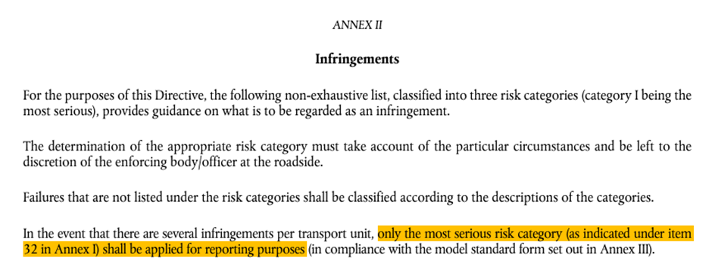

Slide 13
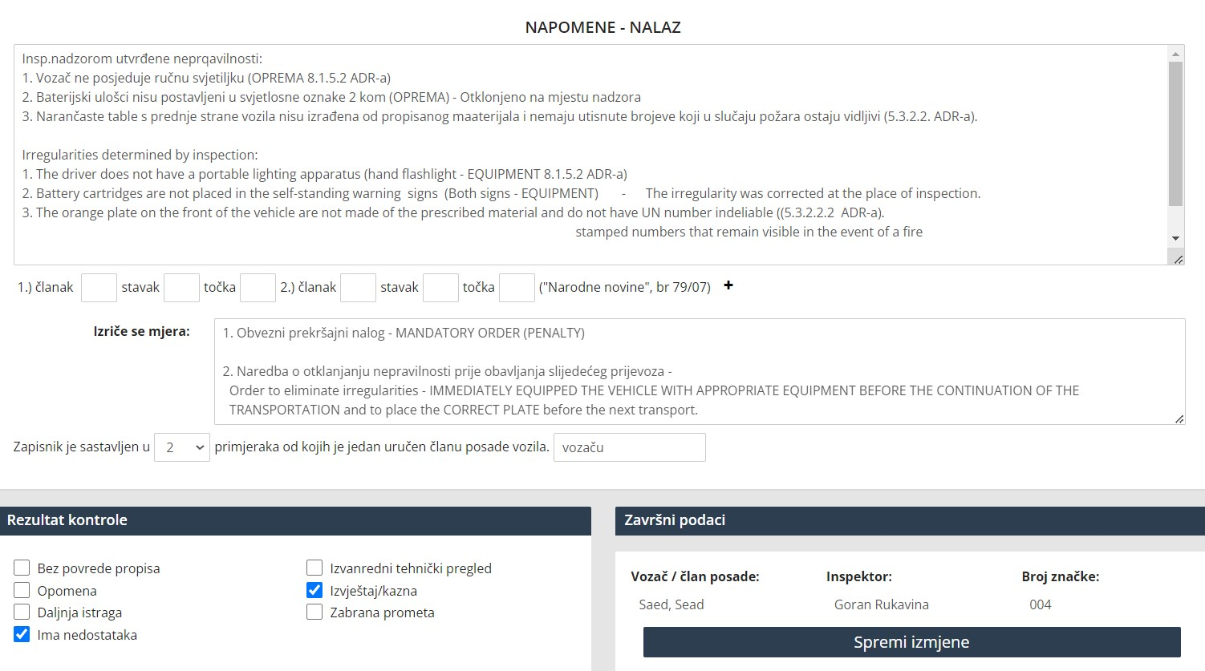
Irregulaties and consequences

Slide 14
Penalty according Act on transport of dangerous goods (OG 79/07)
Penalty for transport company…660,00 € - 66.000,00 € for each irregularity
Penalty for driver…………………..…200,00 € - 1.320,00 € for each irregularity

Slide 15


Thank you

