Slide 1


Conclusion remarks
REPUBLIC OF SLOVENIA
Ministry of Infrastructure
Sarajevo, 10 October 2024

Slide 2
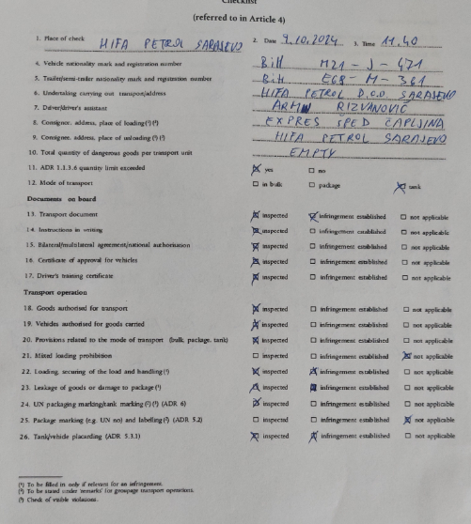
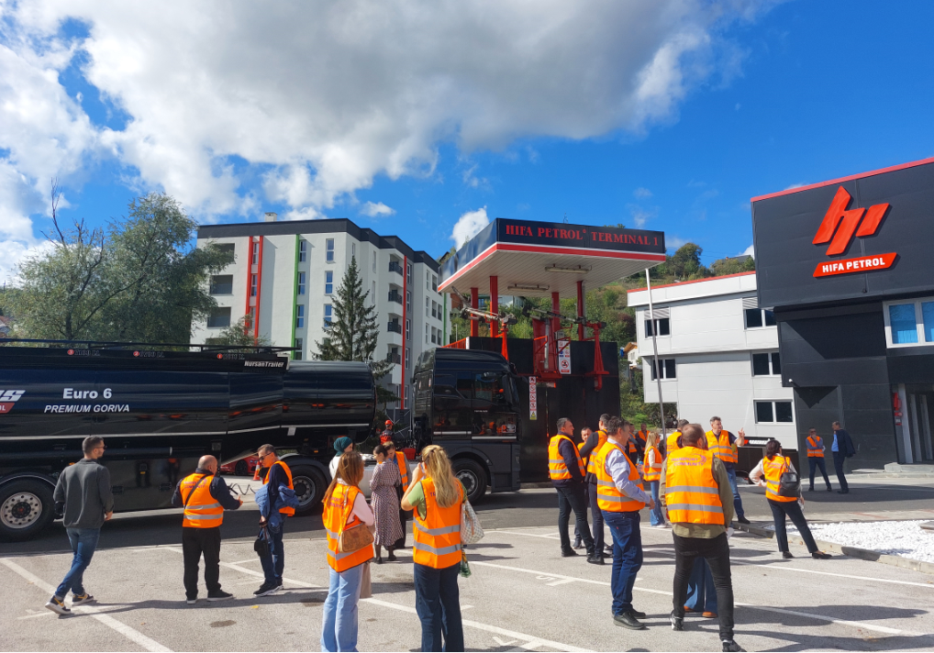
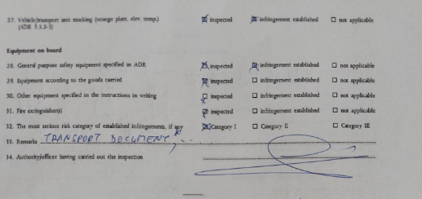
Checklist

Slide 3
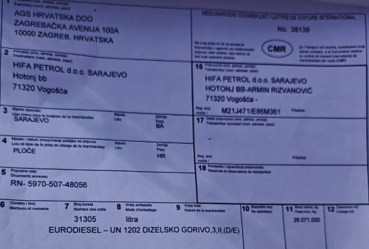
Transport document

Slide 4

Transport document
Language
Packing group
Environmentally hazardous (5.4.1.1.18)

Slide 5
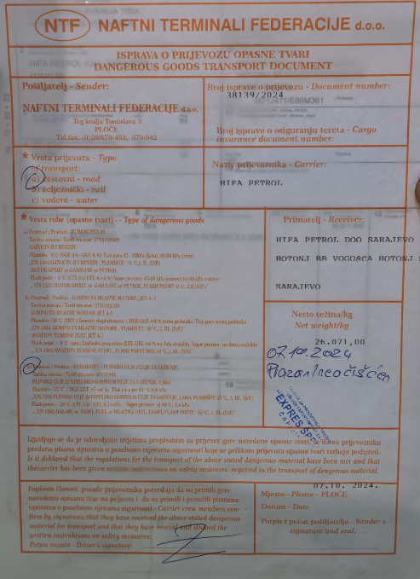
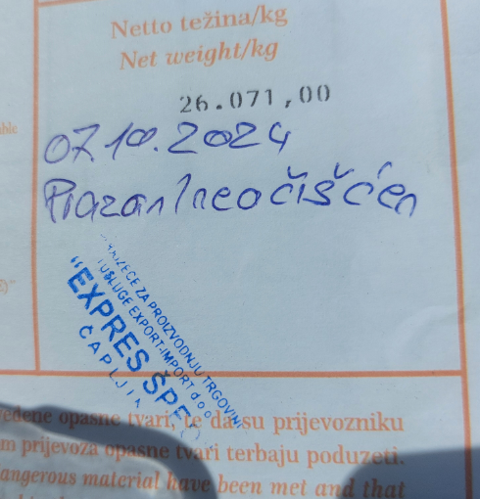

Transport document

Slide 6


Transport document

Slide 7
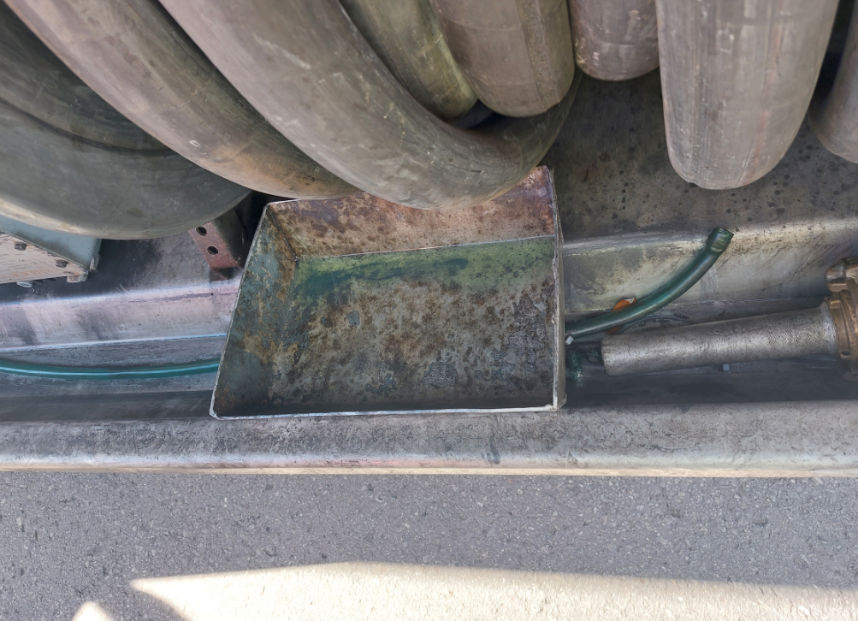
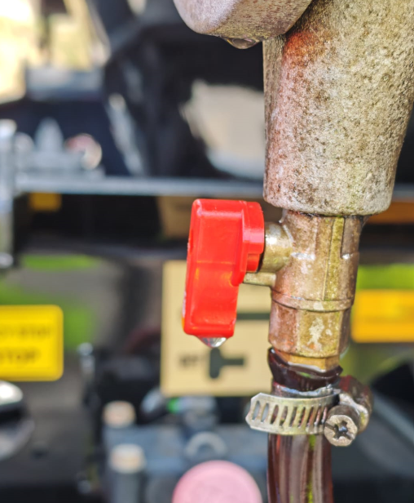
Leakage/risidue

Slide 8
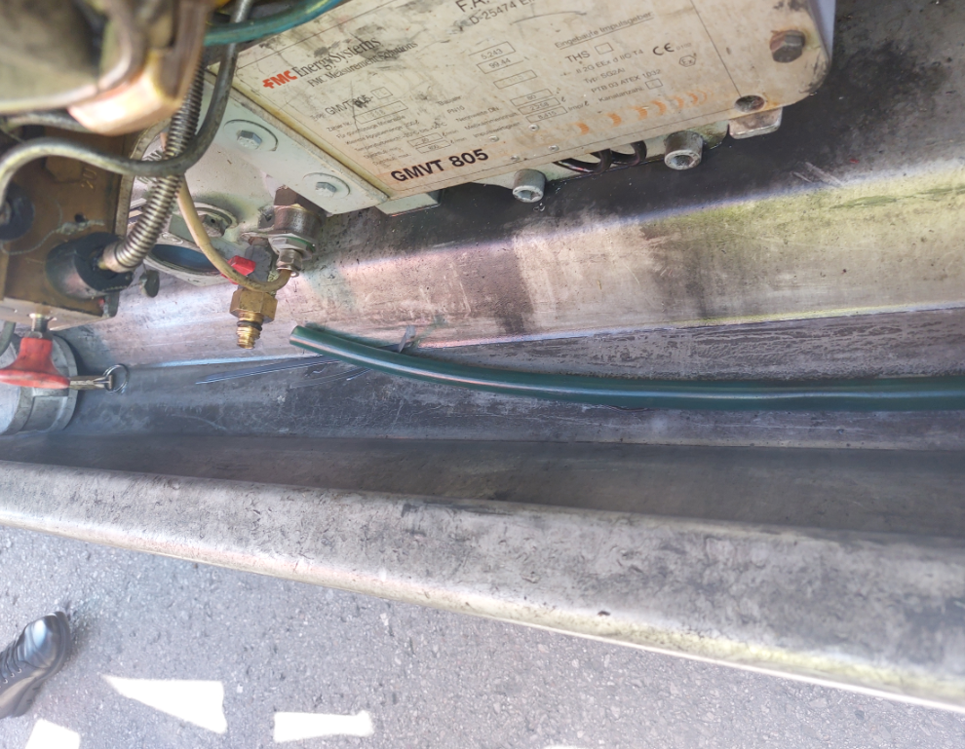
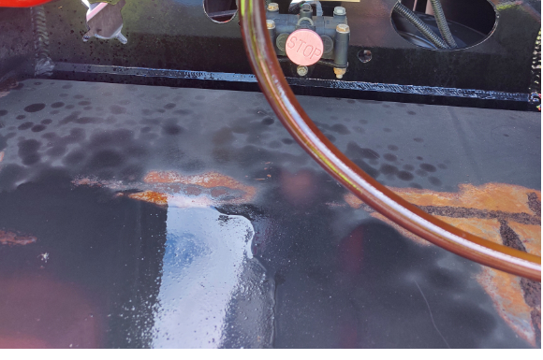
Leakage/risidue

Slide 9
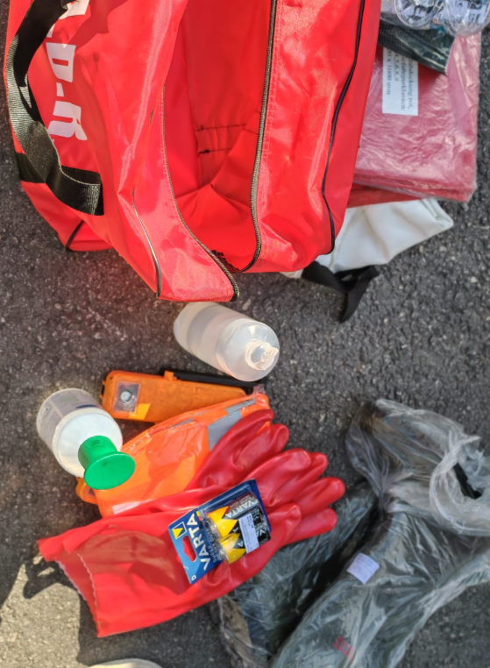
Equipment

Slide 10
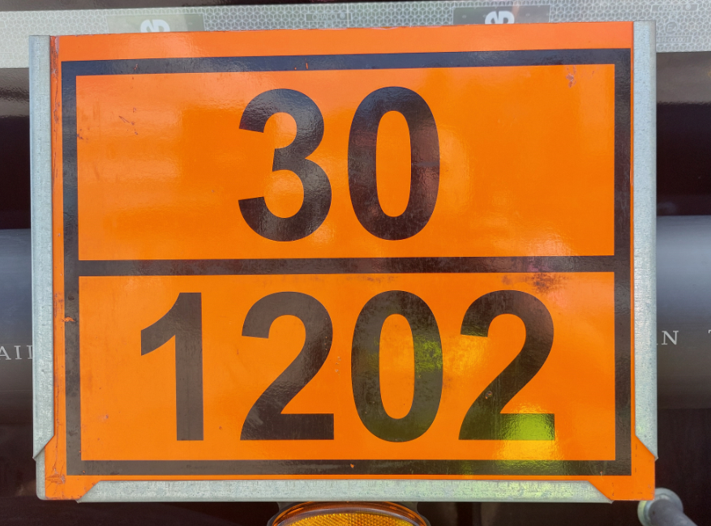
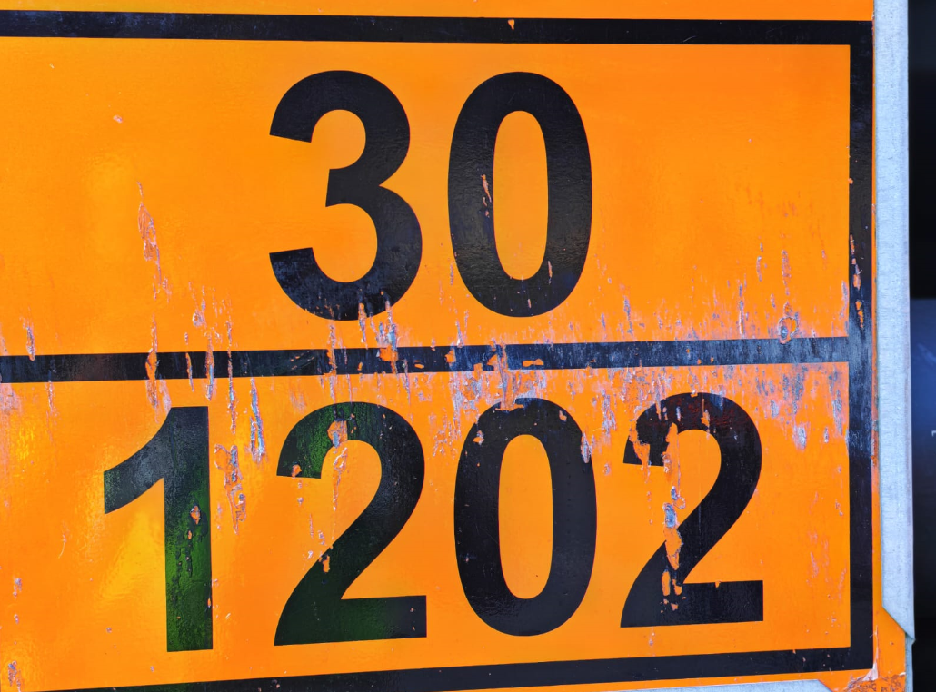
Orange coloured plates

Slide 11
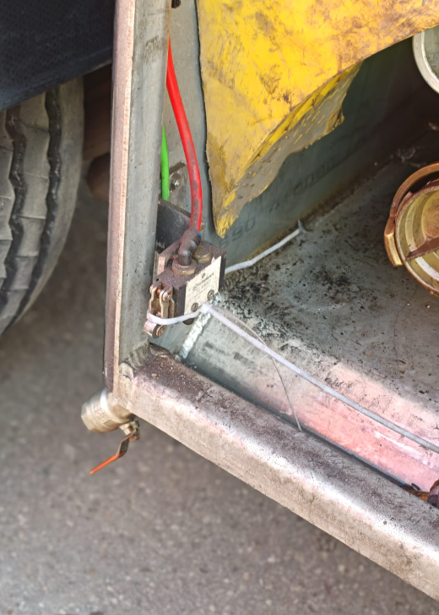
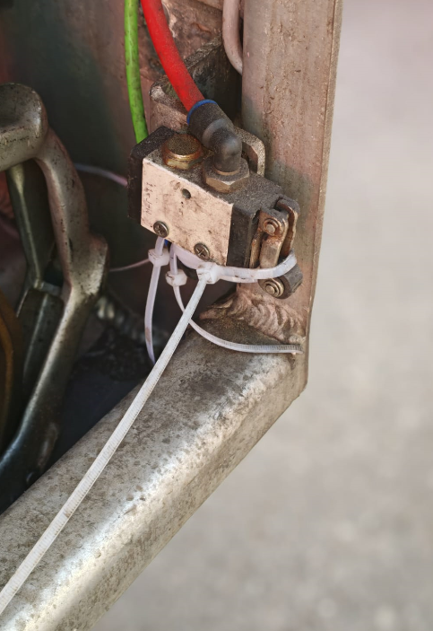
Safety switches

Slide 12
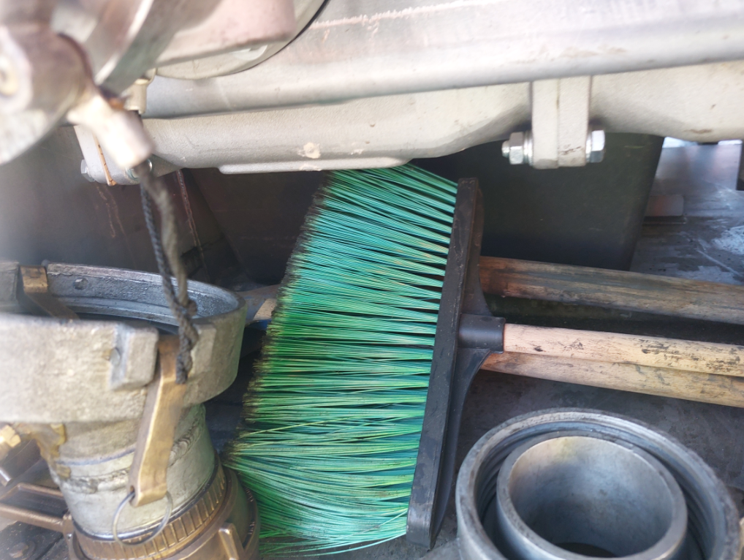
Equipment that can cause sparking

Slide 13
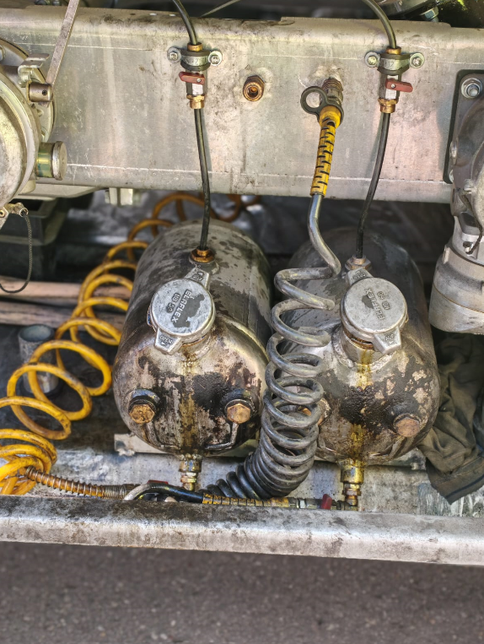

Additive devices/residue
SP 664

Slide 14
Thank you !

