Slide 1

A strategic approach for TAIEX to transport EU Acquis​
October 2024
Notes:
We are presenting you the third Action Plans Progress Report
Measures within each action plan were regularly discussed at the technical committee meetings.
Comments received from all regional partners as well as the EU COM are incorporated within the shared report
In comparison with the last year – we have divided the report in two parts : (I) Regional Overview, (II) Report for Each Regional Partner
Within the ANNEX-es we have added additional charts that can be used by all of you at different events/presentations

Slide 2

What is TAIEX

Slide 3
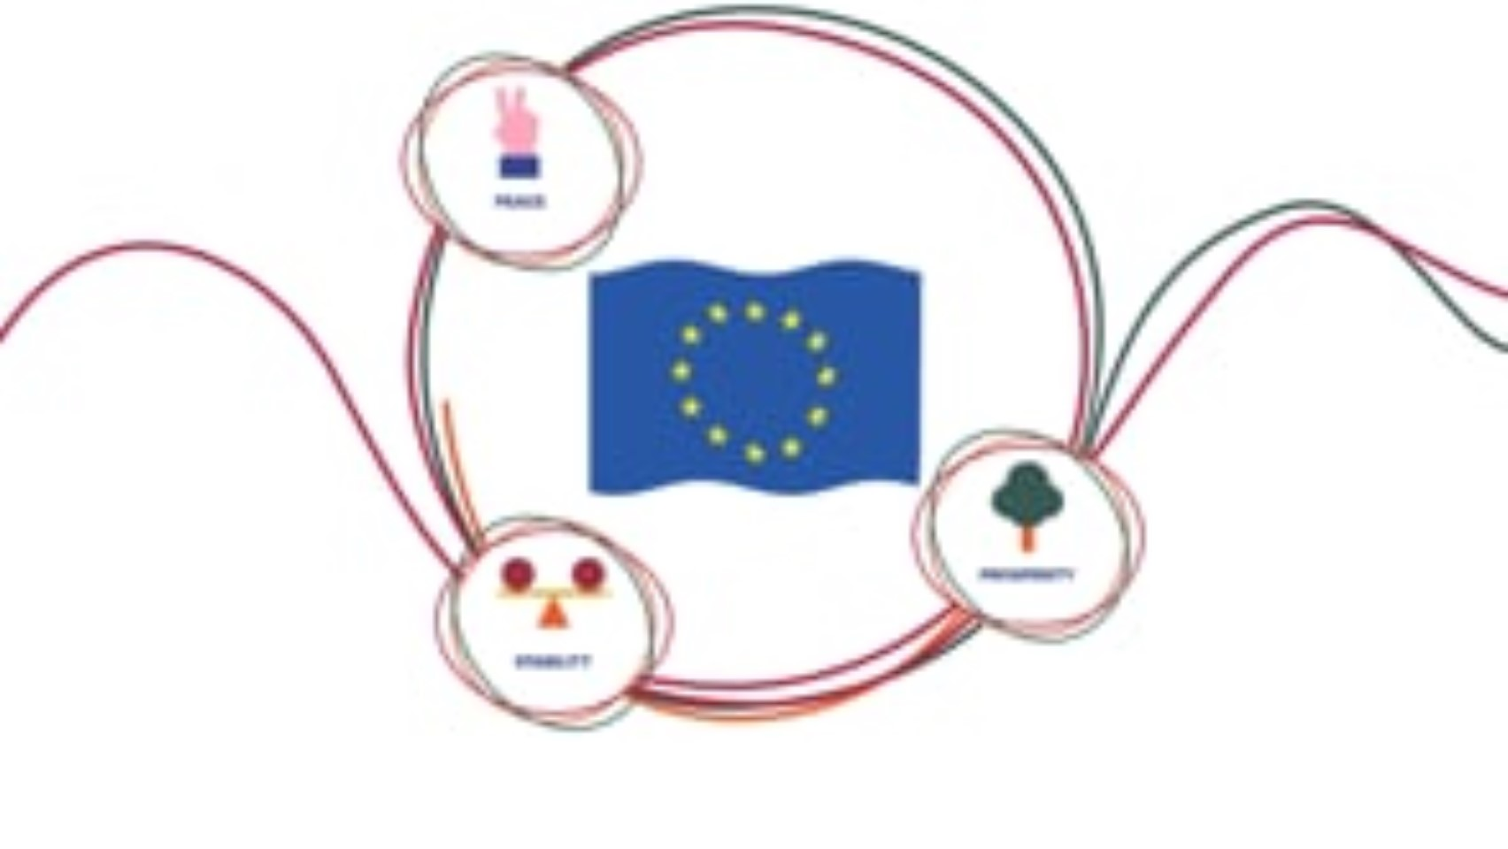
What is TAIEX

Slide 4
The basics of the process - EC
Identifying the need - justification
Preparation of an Application
Pre-approval process
Internal consultation within the TAIEX system
Selection of an expert – Experts database
Organisational aspects of the event
Realisation

Slide 5
Reference documents for this approach
EU enlargement package
TAIEX annual activity report
Transport Community Treaty
Rules of procedure of the technical committee on transport of dangerous goods of the transport community
Terms of reference and mandate of the technical committee on transport of dangerous goods
Guidelines for Transport of Dangerous Goods
Progress report on the Guidelines on Transport of Dangerous Goods

Slide 6
Why TAIEX
Fastest way to receive free technical assistance
Can be combined with other TA (Such have Albania and Montenegro)
It prepares the groundwork for EU enlargement
Supporting the Commission and the Transport community priorities
Transposition of the acquis listed in Annex I of the TCT lacks significant progress

Slide 7
Why TCT Secretariat
General overview of the Region’s needs
Can set the relevant priorities together with the TC TDG, the RSC and the Ministers
Take over in planning of an comprehensive Regional workshop (the hardest of them all)
Streamline the Commission and the Regional partners needs
Follow-up - very important and missing now

Slide 8
How the TCT Secretariat
• Identify key stakeholders involved in Annex I implementation, including government agencies, industry representatives, civil society organizations, and international organizations.
• Establish a multi-stakeholder platform for dialogue and knowledge sharing on Annex I implementation.
• Organize workshops and consultations to gather stakeholder input on priorities, challenges, and potential solutions.
• Build strong partnerships with relevant EU institutions and agencies to leverage their expertise and resources.

Slide 9
Concluding remarks - Goals
Meating the goals in the TDG guidelines
Improving the progress on Annex I transposition
Making transport of dangerous good safer
Decreasing number of accidents in the region
Capacity building

Slide 10

Discussion
www.transport-community.org
gtemovski@transport-community.org

