Slide 1
The secondment experience in Transport Community Permanent Secretariat – lessons learned for road safety
Sarajevo, 10th October 2024
Tomislav Bojic, Secondee at Transport Community Permanent Secretariat

Slide 2
Definition
The temporary transfer of an official or worker to another position or employment

Slide 3
Rules on secondment
A secondee shall be staff employed in public administration, having worked for their employer on a permanent or contract basis for at least two years before their secondment and remaining in the service of that employer throughout the secondment. They shall have at least three years experience of in legal, scientific, technical, advisory, or supervisory functions in a transport-related field
The secondee's employer shall undertake to continue to pay the secondee's salary and maintain the secondee's administrative status throughout the secondment. The secondee's employer shall also continue to be responsible for the social rights of the secondee, in particular health and pension insurance and other social security contributions as required by the domestic legislation. Terminating or changing the secondee's administrative status may lead to the termination of the secondment by the TCT Secretariat

Slide 4
Selection procedure
The secondee is selected through an open and transparent procedure that includes a selection panel consisting of a European Commission representative, the Chair or Co-Chair of the TCT Regional Steering Committee, and a representative of the TCT Secretariat
An invitation for submitting secondment applications in a given year is sent by the TCT Secretariat to the South East European parties, according to their alphabetical order, Albania, Bosnia and Herzegovina, Kosovo*, Montenegro, North Macedonia, Serbia, and the EU. Each South East Europe party and the EU shall be invited to submit a shortlist of a minimum of two and a maximum of three candidates that fulfill the selection criteria for a subsequent interview with the selection panel.
(*) This designation is without prejudice to positions on status and is in line with UNSCR 1244 (1999) and the ICJ Opinion on the Kosovo declaration of independence

Slide 5
Period of Secondment
The period of secondment is limited to six months
Secondees serve on a full-time basis throughout the period of secondment
From 15 April until 14 October 2024

Slide 6
Tasks of the secondee
Secondees receive a work plan with clearly defined tasks and responsibilities and lines of reporting.
All work-related arrangements are made in writing. The department to which the secondee is assigned informs the secondee and his/her employer, before the start of the secondment, on the intended duties and tasks and asks them to confirm in writing that they do not know of any reason (for ex. conflict interest, or not in line with the professional competencies of the secondee, etc.) against the assignment of those duties and tasks to the secondee.

Slide 7
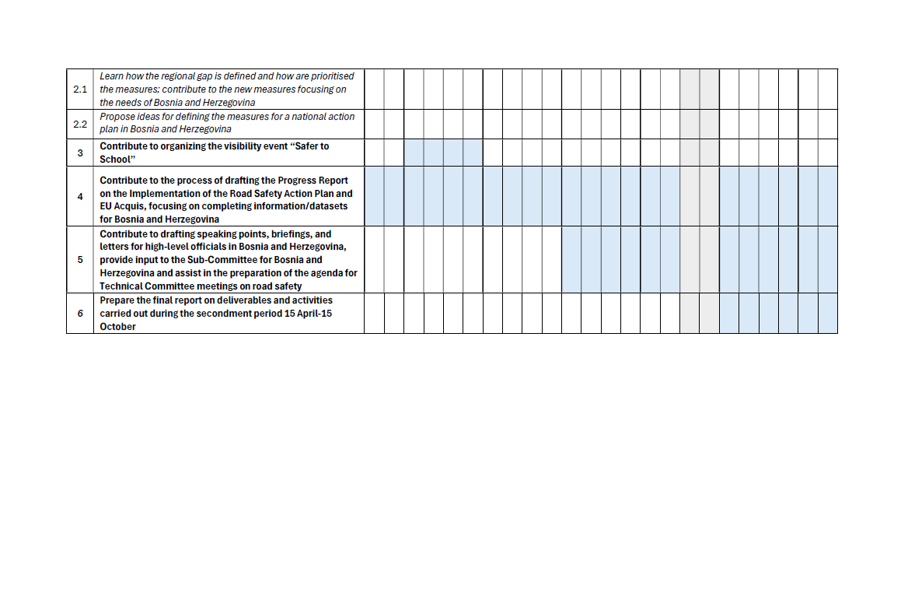
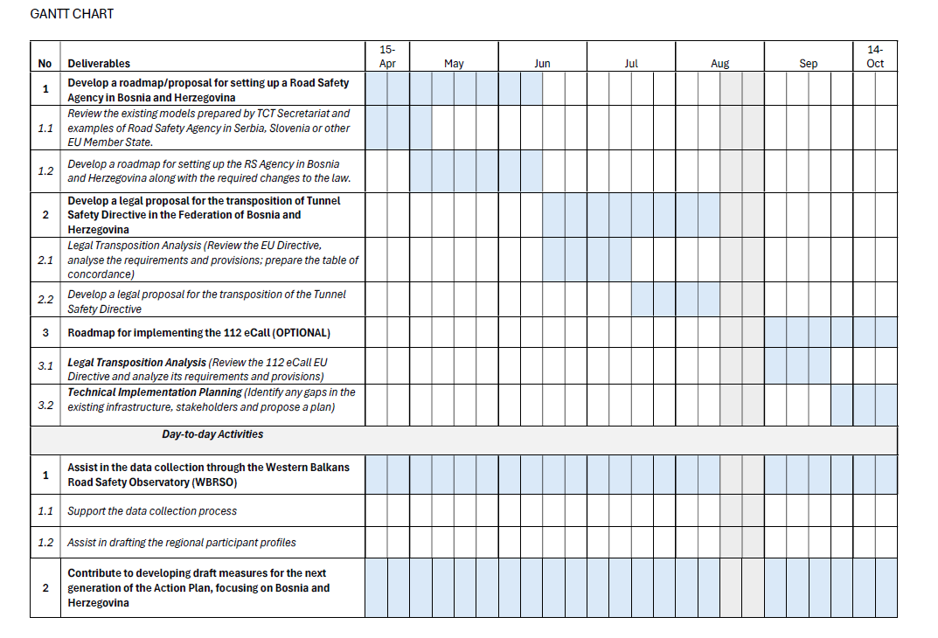
Timetable of Work plan

Slide 8
Challenges
Finding an apartment in Belgrade
Distance from family and friends
New professional environment
New city and new country

Slide 9
Main Benefits
Working with professionals of different nationalities and different backgrounds in various modes of transport at the international level
Working on the preparation of various documents, which allowed me to learn how documents such as New generation action plans, Progress Reports on the implementation of Action Plans, and EU acquis are prepared
Speaking and writing daily in English improved my speaking and writing skills in professional English

Slide 10
Confirmed lessons for Road Safety
Importance of Coordination in different sectors (Health, Police, education, transport, etc.)
Importance of data (different data basses)
Importance of transposed regulations
Importance of continues work in Road Safety

Slide 11
Q&A?

Slide 12
Thank you for your attention
www.transport-community.org
secondment@transport-community.org

