Slide 1
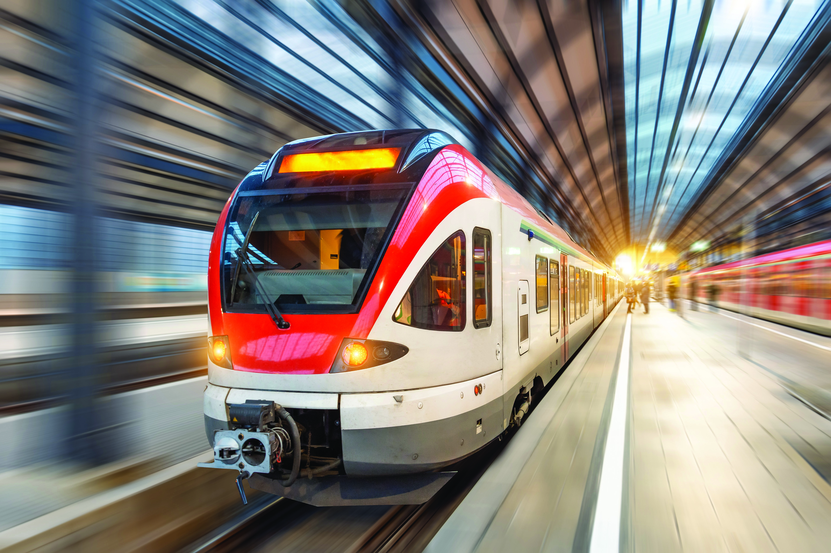
21th Technical Committee on Railway
Berlin, 25-26 September 2024

Slide 2
Agenda
Administrative matters
Adoption of the Agenda
Co-chairperson - representative of DG MOVE
New members of TC on Railway
2. New Generation of Rail Action Plan - Presentation of final draft document and discussion
3. Progress in the implementation of EU Acquis – Revised Annex I.2 of Treaty
4. Preparation of the TEN-T Annual Report on the development of the railway network and a Five-year rolling plan for the development of indicative TEN-T extension.
5. DAC project - Mr Libor Lochman, DAC Ambassador
Nomination of so-called DAC National Contact Points (NCPs)

Slide 3
Administrative matters
Adoption of the Agenda
Chairman election

Slide 4
New Generation of Rail Action Plan - Presentation of draft document and discussion
Transport Community Secretariat

Slide 5
Progress in the implementation of EU Acquis –
Revised Annex I.2 of Treaty
Transport Community Secretariat

Slide 6
Preparation of the TEN-T Annual Report on the development of the railway network and a Five-year rolling plan for the development of indicative TEN-T extension.
Transport Community Secretariat

Slide 7
Overview of the TEN-T projects in the WB region
Transport Community Secretariat

Slide 8

Coffee break

Slide 9
Nomination of so-called DAC National Contact Points (NCPs)
Mr Libor Lochman, DAC Ambassador

Slide 10

AOB Concluding remarks

Slide 11

Lunch break

